Slide 2
Unit Objectives:
Knowledge and skill（知识、技能目标）:
1.Students should be able to talk about true love both in movies and in life.
2.Student should acquire the new words and expressions.
3.Students should grasp the usage of modal words.
4.Students should grasp the principle of E-mail writing.
Feelings, attitudes and values（情感、态度和价值观目标）:
Students should be able to understand and cherish love.

Slide 3
Unit Objectives:
Ideological and Political Aims（思政目标）
1.Students should know what is true love.
2.Students should know how to set up a correct view of love and marriage.
3.Students should know how to cherish true love.

Slide 4
Part 1
Part 2
Part 3
Part 4
Part 5
Part 6
Lead-in
Listening ＆
Speaking
Reading
Grammar
Watching & Performing
Applied Writing

Slide 5
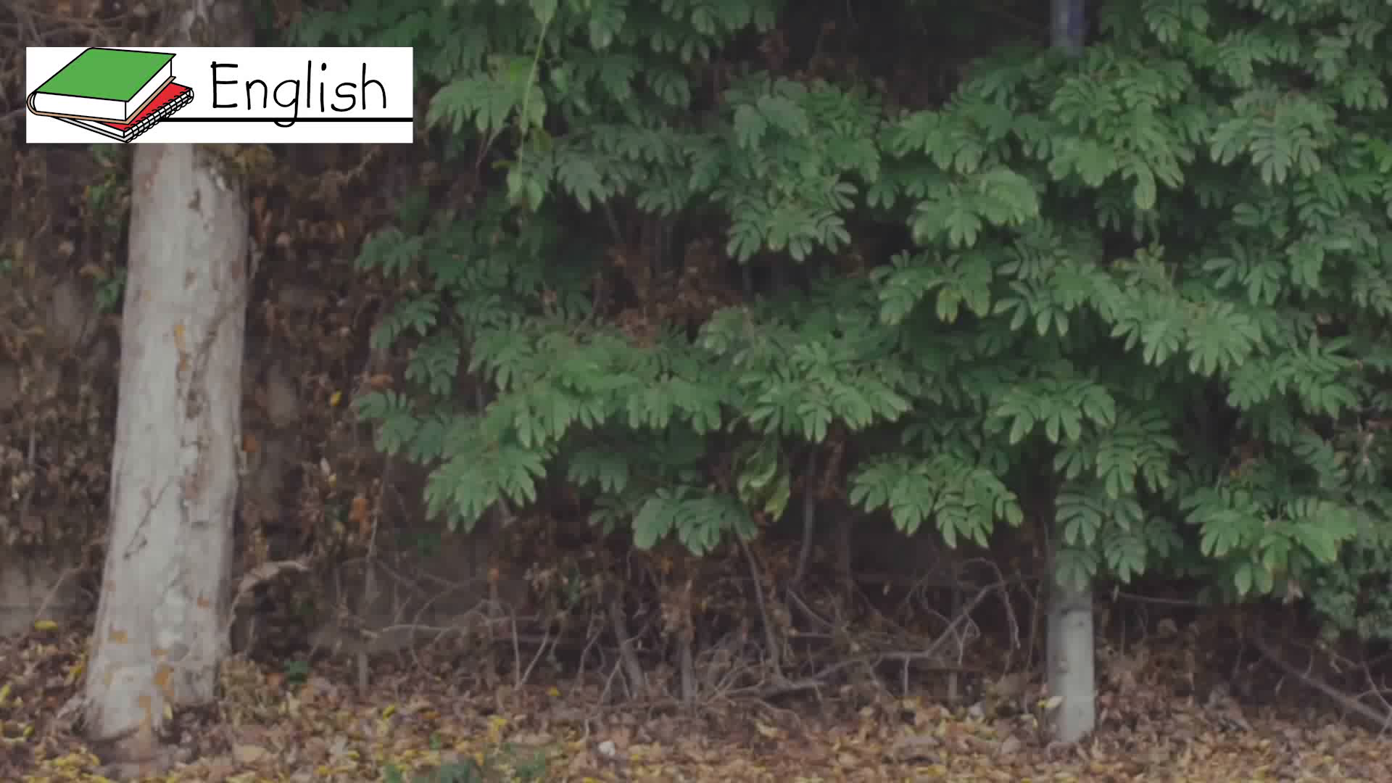
1
There are some little clues showing you are falling in love. Are
there any other clues? Watch the video and then share the answers with
your partners.

Slide 6


Chores are bearable with him / her.
You look through pictures of him / her when you’re bored.

Slide 7

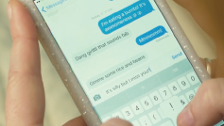
You’re OK with being upset around him / her.
You miss him / her after just one day.

Slide 8
2
Valentine’s Day is coming. Make an English Card for your love. The following words, phrases and sentences are for your reference.
date 约会
blind date 初次约会，相亲
Cupid 爱神丘比特
promise / vow 誓言
cute meet 浪漫的邂逅
fall in love 坠入爱河
candlelight dinner 烛光晚餐
puppy love / first love 初恋

Slide 9

sweet bitterness 甜蜜的痛苦
the chemical feeling 奇妙的感觉，触电
Valentine’s Day 情人节
Double Seventh Night 七夕
a doomed couple 天生一对
Love at the fi rst sight. 一见钟情。
I need him like I need the air to breathe. 我需要他，正如我需要呼吸空气。
Love is a vine that grows into our hearts. 爱是长在我们心里的藤蔓。
Love is a chord in life, not a solo. 爱是人生的和弦，而不是孤独的独奏曲。
Love and a cough cannot be hid. 爱情跟咳嗽一样是掩饰不了的。

Slide 10

3
Write down some classic romantic relations in movies or TV series you have ever watched, and then discuss what is true love with your partners.
Jack and Rose in Titanic. They fell in love with each other when they met. At the end of the movie, Jack sacrificed his life for love. Love means sacrifice.
Jack and Rose
Romeo and Juliet — Romeo and Juliet in Romeo and Juliet. They met in an occasional chance and then fell in love with each other. But their love was objected by their families so hardly that in the help of the priest, Juliet feigned death. However, when Romeo knew that Juliet was dead, he committed suicide for his love. With despair, Juliet died afterwards. Love is beyond life and death.
_______________ _________________________________________________________
_________________________________________________________
_________________________________________________________

Slide 11
Part 1
Part 2
Part 3
Part 4
Part 5
Part 6
Lead-in
Listening ＆
Speaking
Reading
Grammar
Watching & Performing
Applied Writing

Slide 12

1
Listen to the dialogues and fill in the blanks.

Slide 13
Words and Expressions
western food 西餐 candlelight dinner 烛光晚餐
anniversary 周年纪念日 fall in love with 爱上……
have a crush on 迷恋……

Slide 14
Dialogue 1
special
W: Why do you want to eat western food so much today? Anything __________ to celebrate?
M: Honey, do you really forget about it? Think it over. It’s a candlelight dinner.
W: It’s not your _____________, also not mine. Hey, come on. Just tell me.
M: It’s our wedding anniversary, honey. How can you forget about it?
W: My dear, tomorrow is our wedding anniversary. We’ve been together for 20 years.
M: But you never change. Always so careless! Do you remember things on our wedding day?
W: Of course. I almost missed my own ___________.
M: Do you remember our fi rst date? I got a really special gift.
W: I can never ____________ that. I bought you a box of chocolate, but I was so anxious that I forgot to
give them to you. You didn’t get them until we parted. They had already melted down ( 融化).
M: Yeah, it’s really unforgettable. Thank you for making me ___________ all these years.
W: You are the one I should thank. You’ve done really a great job.
birthday
wedding
forget
happy

Slide 15
Dialogue 2
A: Hey, Lily, what are you doing?
L: ___________ for someone.
A: You mean the boy you met on WeChat?
L: You’re right. He is so ___________ and I think I fall in love with him.
A: You must be joking. You can’t fall in love with someone you’ve never met!
L: I know, but I keep thinking of him every day. And I get really depressed ( 沮丧的) when he’s not online.
A: I think you just have a crush on him. You can’t be serious.
L: Well, this might be silly. But I just can’t get him off my ___________. And I can’t help missing him.
A: Did you tell him?
L: Yes. He said I’m his dream girl.
A: You shouldn’t take it too seriously. It might be a _______.
L: I know. I can’t tell whether he’s serious or not so I need your ___________.
A: I think you should enlarge your circle of real-life friends, and then the right person will come along.
Waiting
funny
mind
lie
advice

Slide 16
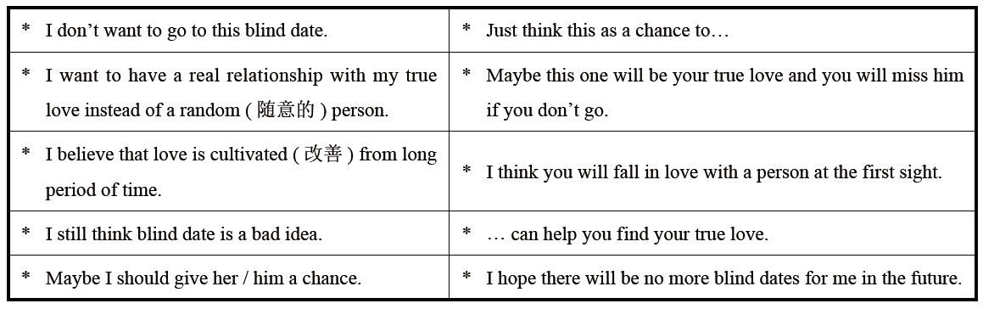
2
Listen to the dialogues again and check your answers, and then make a dialogue
according to the situation given below. The following sentence patterns are for your
reference.
Situation: Your mother set you up on a blind date with a girl / boy. You are talking
about this with your friend.

Slide 17
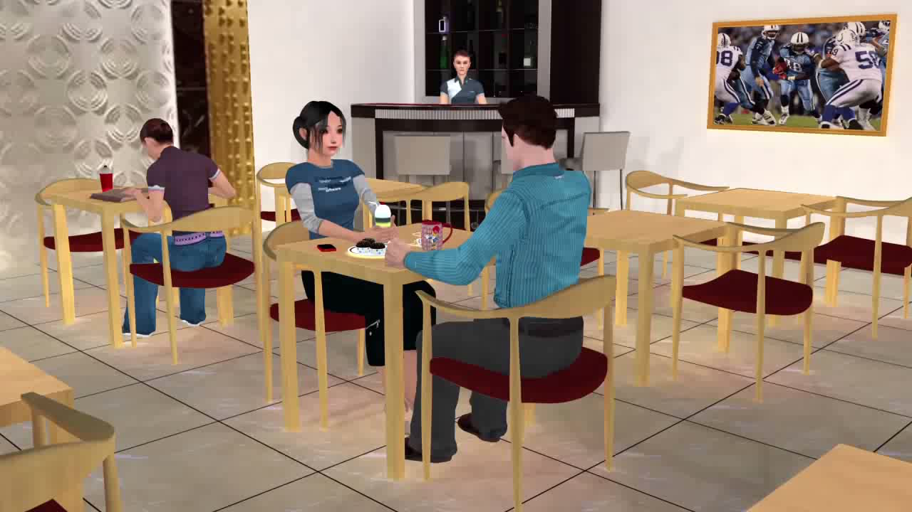

Slide 18


3
Listen to the song Beautiful Soul and fill in the blanks.
pretty
I don’t want another ___________ face
I don’t want just anyone to hold
I don’t want my love to go to waste
I want you and your beautiful soul
I know that you are something special
To you I’d be always faithful
I want to be what you always ___________
Then I hope you’ll see the heart in me
You’re the one I want to ___________
You’re the one I want to hold
I won’t let another minute go to waste
I want you and your beautiful soul
Your beautiful soul, yeah
chase
needed

Slide 19

You might need time to think it over
But I’m just fi ne moving ___________
I’ll ease your mind
If you give me the chance
I will never make you cry, come on let’s try
Am I ___________ for wanting you
Baby do you think you could want me too
I don’t want to waste your time
Do you see things the way I do
I just want to know that you feel it too
There is nothing left to hide
forward
You’re the one I want to chase
You’re the one I want to hold
I won’t let another minute go to waste
I want you and your soul
I don’t want another pretty face
I don’t want just anyone to hold
I don’t want my love to go to waste
I want you and your beautiful soul
Beautiful soul, yeah
crazy

Slide 20
Part 1
Part 2
Part 3
Part 4
Part 5
Part 6
Lead-in
Listening ＆
Speaking
Reading
Grammar
Watching & Performing
Applied Writing

Slide 21


Slide 22





Part Ⅲ
Text A Intensive Reading 1
★ tempt /tempt/ v.
(a) to attract sb. or make sb. want to do or have sth., even if they know it is wrong 引诱；诱惑
e.g. I was tempted by the dessert menu.
甜食菜单馋得我垂涎欲滴。
(b) to persuade or try to persuade sb. to do sth. that you want them to do, for example by offering them sth. 劝诱；鼓动；怂恿；利诱
e.g. Nothing would tempt me to live here.
什么也吸引不了我到这里居住。
be attempted to 被引诱做……
e.g. He did not want to be tempted to drink.
他不想被骗去喝酒。
Met the Love of My Life in 10th-Grade
1 The first time I walked into my 10th-grade English classroom in California, I saw a student at his desk, resting his head on folded¹ arms. I’d never seen a boy with such beautiful, wavy² blond³ hair, the color of butter⁴, and I was tempted⁵ to run my fingers
through it as I passed by.
★ folded /'fəʊldɪd/ adj.
bent over or doubled up so that one part lies on another 折叠的；合拢的
e.g. One day John pulled a folded paper from his wallet.
有一天，约翰从他的钱夹里取出一张折叠的纸。
Language Point:
resting his head on folded arms中，resting为现在分词做伴随状语，修饰前面的student。
在十年级遇到真爱
当我第一次走进加利福尼亚州十年级的英语教室时，我注意到一个正趴在桌前休息的同学。我从来没有见过一个男孩有这么漂亮的波浪状金发，像黄油的颜色。当我经过时，我竟有用手指穿过他头发的冲动。
★ wavy /'weɪvi/ adj. 波状的，起伏的
★ blond /blɒnd/ adj. 金色的，淡黄的
★ butter /'bʌtə(r)/ n. 黄油

Slide 23



Part Ⅲ
Text A Intensive Reading 2
★ opposite /'ɒpəzɪt/
(a) n. a person or thing that is as different as possible from sb. / sth. else 对立的人（或物）；对立面；反面
e.g. Hot and cold are opposites.
热和冷是对立面。
(b) adj. on the other side of a particular area from sb. / sth. and usually facing them
对面的；另一边的
e.g. I watched them leave and then drove off in the opposite direction.
我目送他们离开，然后开车向相反的方向驶去。
★ roll /rəʊl/
(a) n. an official list of names 花名册；名单
e.g. The chairman called / took the roll.
主席点了名。
(b) v. to turn over and over and move in a particular direction （使）翻滚，滚动
e.g. The ball rolled down the hill.
球滚下了山。
2 We sat in alphabetical ⁶ order, which put me at the opposite⁷ end of the room from my new crush⁸. I spent most of that class trying to get a glimpse⁹ of his face. At roll¹⁰ call I learned that his name was Vic.
我们的座位是按字母顺序排列的，我因此被安排到教室的另一端，与他隔空相望。那节课我大部分时间都在设法看他的脸。点名时我得知他的名字叫Vic。
★ crush /krʌʃ/
(a) v. to press or squeeze sth. so hard 挤压；粉碎
e.g. The car was completely crushed under the truck.
小轿车被卡车压得完全变形了。
(b) n. (on sb.) a strong feeling of love 迷恋；热恋
e.g. I had a huge crush on her.
我对她爱慕至极。
★ a glimpse of 一瞥
e.g. He caught a glimpse of the man’s face in
a shop window.
★ alphabetical /ˌælfə'betɪkl/ adj. 按字母顺序的

Slide 24
Part Ⅲ
Text A Intensive Reading 3
★ beyond /bɪ'jɒnd/ prep.
(a) more than sth. 超出；除……之外
e.g. She’s got nothing beyond her state pension.
除了政府发的养老金，她什么都没有。
(b) too far or too advanced for sb. / sth.
超出……之外；超越
e.g. The exercise was beyond the abilities of most of the class.
这个练习超出了班上大多数学生的能力。
★ glance at 朝……看了一眼
e.g. She took her eyes off the road to glance at me.
3 The next morning I nervously¹¹ waited at the classroom door until Vic came, he glanced¹² at me with his amazingly¹³ blue eyes. He was beyond¹⁴ movie-star handsome¹⁵!
★ nervously /'nɜːvəslɪ/ adv. 焦虑地
★ amazingly /ə'meɪzɪŋli/ adv. 令人惊奇地
第二天早晨，我紧张地在教室门口等Vic来。他走过我时，用他那迷人的蓝眼睛看了我一眼。他简直比电影明星还要英俊！
★ handsome /'hænsəm/
adj. 英俊的，有魅力的，漂亮的

Slide 25
Part Ⅲ
Text A Intensive Reading 4
4 Suddenly, it was hard to catch my breath, my face felt warm and my knees got weak. My heart pounded¹⁶ so loudly — I was sure he must have heard it, too. What was happening to me?
★ be hard to... 做……很难
e.g. If the ink sinks in, it will be hard to remove it.
突然，我呼吸困难，脸色通红，腿脚也站不住了。我的心砰砰跳动——我敢肯定他一定也听到了。我是怎么了呢？
★ catch one’s breath 喘气
e.g. I had to catch my breath after the exhausting meeting.
★ pound /paʊnd/ v. （心脏）狂跳，怦怦地跳

Slide 26
Part Ⅲ
Text A Intensive Reading 5
5 A perky¹⁷, pretty girl with an annoying¹⁸ giggle¹⁹ and a tight sweater sat one seat away from Vic. He called her bunny because she’d wrinkle²⁰ her little nose at him whenever²¹ he turned in her direction²², which was often. It drove me nuts. I couldn’t stop talking about her to my girlfriends in the back of the classroom.
★ annoying /ə'nɔɪɪŋ/ adj. 使烦恼的，使生气的
★ perky /'pɜːki/
adj. 高兴的，快活的，精力充沛的
一个活泼漂亮、穿着紧身毛衣的女孩与Vic只隔一个座位。她笑起来发出“咯咯”的声音，令人生厌。他叫她小兔子，因为每当他转向她时，她就会向他皱鼻子。这快把我逼疯了。我忍不住在教室后面和我的朋友们谈论她。
★ giggle /'gɪgl/ n. 咯咯笑，傻笑
★ whenever /wen'evə(r)/ conj. 无论何时
★ wrinkle /'rɪŋkl/ v. 皱起
★ direction /də'rekʃn/ n. 方向，方位

Slide 27
Part Ⅲ
Text A Intensive Reading 6
奇迹般地，为了不让我和朋友们聊天，我的老师克里斯托弗夫人要求我坐在前排，这就解决了我的难题。于是，我坐在了“紧身毛衣”和我的男神中间。
6 Miraculously²³, my teacher Mrs. Christopher solved my dilemma²⁴ when she demanded that I sit in the front row so I couldn’t chat²⁵ with my friends. This put me between the bunny in the tight sweater and my Adonis.
★ dilemma /dɪ'lemə/ n.
a situation in which you have to make a very difficult choice 窘境，困境
e.g. They try to find a way out of their dilemma.
他们试图摆脱困境。
solve the dilemma 解决困境
Language Point:
when she demanded that… with my friends是时间状语从句，而so I couldn’t chat with my friends是so引导的结果状语从句。
★ miraculously /mɪ'rækjələslɪ/ adv.
like a miracle; completely unexpected 奇迹般地；不可思议地
e.g. Miraculously, all those flowers are open.
奇迹般的，那些花儿全部开放了。
★ chat with 和……闲谈
e.g. Would you care to come and chat with me?

Slide 28
Part Ⅲ
Text A Intensive Reading 7
7 When I noticed Vic was having trouble with the assignments²⁶, I offered to help him after class. His grades began to improve, and soon he started carrying my books to class when he saw me in the hall. He said that I made him laugh the way no one else could. And there was something about him that made me feel safe and special just to be near him.
★ have trouble with 因……而苦恼
e.g. I often have trouble with my teeth.
发现他在作业上有困难时，我主动在课后帮助他。他的成绩开始提高，不久后，每当在大厅相遇，他就会帮我把书带到教室。他说，没有谁能像我一样让他开怀大笑。他身上有一些特别的东西，有他在身边，我很有安全感。
★ assignment /ə'saɪnmənt/ n. 任务，工作

Slide 29
Part Ⅲ
Text A Intensive Reading 8
8 One day I was going down the steps of the school library as Vic was going up. When our eyes met, we stopped and just stared at each other until the staircase²⁷ was empty. Then he came up to the step I was on, wrapped²⁸ his arms around my waist²⁹ and gave me my first grown-up kiss, the kind I’d seen in the movies.
有一天，我正沿着学校图书馆台阶向下走，Vic正往上走。当四目相对，我们停下来，彼此凝视。直到楼梯间只剩下我们两个人，他走到我站的台阶上，用双臂搂住我的腰，给了我第一个成人的吻，是我在电影中看到的那种吻。
★ stare at 盯着看，凝视
e.g. It is not polite to stare at a girl in the face
★ staircase /'steəkeɪs/ n. 楼梯
★ wrap /ræp/ v. 用……缠绕（或围紧）
★ waist /weɪst/ n. 腰，腰部

Slide 30
Part Ⅲ
Text A Intensive Reading 9
9 He lit my world like the Fourth of July, and after 50 years of marriage³⁰ he still does.
他让我的世界像独立日一样明亮，即使在后来50年婚姻中，也从未变过。
★ marriage /'mærɪdʒ/ n. 婚姻，婚姻生活

Slide 31
Text A Intensive Reading
Met the Love of My Life in 10th-Grade
New Words
1 folded /fəʊldɪd/ adj. 折叠的，合拢的
2 wavy /'weɪvi/ adj. 波状的，起伏的
3 blond /blɒnd/ adj. 金色的，淡黄的
4 butter /'bʌtə(r)/ n. 黄油
5 tempt /tempt/ v. 引诱，诱惑
6 alphabetical /ˌælfə'betɪkl/ adj. 按字母顺序的
7 opposite /'ɒpəzɪt/ adj. 对面的，另一面的
8 crush /krʌʃ/ n. 迷恋；热恋
9 glimpse /glɪmps/ n. 一看，一瞥
10 roll /rəʊl/ n. 花名册，名单
11 nervously /'nɜːvəslɪ/ adv. 焦虑地

Slide 32

12 glance /glɑːns/ v. 匆匆一看，扫视
13 amazingly /ə'meɪzɪŋli/ adv. 令人惊奇地
14 beyond /bɪ'jɒnd/ prep. 超过，越过
15 handsome /'hænsəm/ adj. 英俊的，有魅力的，漂亮的
16 pound /paʊnd/ v. （心脏）狂跳，怦怦地跳
17 perky /'pɜːki/ adj. 高兴的，快活的，精力充沛的
18 annoying /ə'nɔɪɪŋ/ adj. 使烦恼的，使生气的
19 giggle /'gɪgl/ n. 咯咯笑，傻笑
20 wrinkle /'rɪŋkl/ v. 皱起
21 whenever /wen'evə(r)/ conj. 无论何时
22 direction /də‘rekʃn/ n. 方向，方位

Slide 33

23 miraculonsly /mɪ’rækjələslɪ/ adv. 奇迹般地，不可思议地
24 dilemma /dɪ'lemə/ n. （进退两难的）窘境，困境
25 chat /tʃæt/ v. 闲聊，闲谈
26 assignment /ə'saɪnmənt/ n. 任务，工作
27 staircase /'steəkeɪs/ n. 楼梯
28 wrap /ræp/ v. 用……缠绕（或围紧）
29 waist /weɪst/ n. 腰，腰部
30 marriage /'mærɪdʒ/ n. 婚姻，婚姻生活

Slide 34

1 be tempted to 被引诱做……
e.g. He did not want to be tempted to fight.
2 a glimpse of 一瞥
e.g. He caught a glimpse of the man’s face in a shop window.
3 glance at 朝……看了一眼
e.g. She took her eyes off the road to glance at me.
4 be hard to ... 做……很难
e.g. If the ink sinks in, it will be hard to remove it.

Slide 35

5 catch my breath 喘气
e.g. I had to catch my breath after the exhausting meeting.
6 chat with 和……闲谈
e.g. Would you care to come and chat with me?
7 have trouble with 因……而苦恼
e.g. I often have trouble with my teeth.
8 stare at 盯着看，凝视
e.g. It is not polite to stare at a girl in the face.

Slide 36

California /ˌkælɪ'fɔːnjə/ 加利福尼亚州
Christopher /'krɪstəfə/ 克里斯托弗（人名）
Bunny /'bʌni/ 邦尼（人名）
Adonis /ə'dəʊnɪs/ 阿多尼斯
the Fourth of July 美国独立日

Slide 37

1 I’d never seen a boy with such beautiful, wavy blond hair, the color of butter, and I was tempted to run my fi ngers through it as I passed by. (Para. 1)
the color of butter 进一步补充说明wavy blond hair。and 连接两个并列句，as I passed by 是由 as 引导的时间状语从句，意思是“当……的时候”，pass by 是动词短语，意思是“经过，过去”。
2 The next morning I nervously waited at the classroom door until Vic came, he glanced at me with his amazingly blue eyes. (Para. 3)
the next morning 是句子的时间状语，until 是连词，意思是“直到……”。he glanced at me with his amazingly blue eyes 中的glance at 的意思是“朝……看了一眼”，with 表示“用，使用”。

Slide 38
3 He called her Bunny because she’d wrinkle her little nose at him whenever he turned in her direction, which was often. (Para. 5)
because she’d wrinkle her little nose at him 是because 引导的原因状语从句，wrinkle her little nose at him 的意思是“朝着他皱鼻子”，whenever he turned in her direction 是whenever 引导的时间状语从句。which was often 是which 引导的非限定性定语从句，修饰限定前面的整句话。非限定性定语从句通常与前句用逗号隔开。
4 Miraculously, my teacher Mrs. Christopher solved my dilemma when she demanded that I sit in the front row so I couldn’t chat with my friends. (Para. 6)
“when she demanded that… with my friends”是时间状语从句，其中that 后面引导的是宾语从句。so I couldn’t chat with my friends 是so 引导的结果状语从句。solve my dilemma 的意思是“解决困境”。

Slide 39

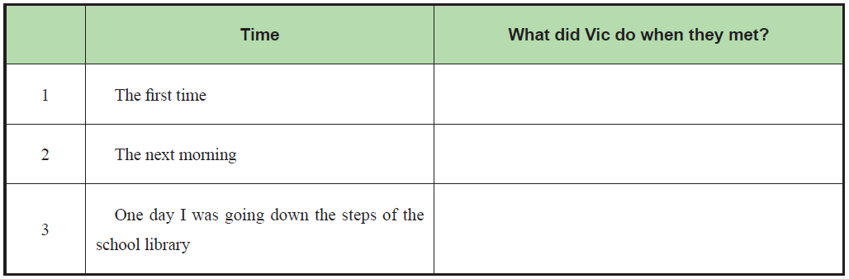
1
Read Text A and then complete the following table.
Vic rested his head on folded arms.
Vic glanced at me with his amazingly blue eyes.
Vic came up to the step I was on, wrapped his arms around my waist and gave me my first grown-up kiss.

Slide 40

2
Answer the following questions and then discuss with your partners.
1. How did the author know the boy’s name?
2. How did the author feel when the boy glanced at her?
3. Did they get married or not?

Slide 41
3
Read the 6th paragraph aloud and recite it.
When I noticed Vic was having trouble with the assignments, I offered to help him after class. His grades began to improve, and soon he started carrying my books to class when he saw me in the hall. He said that I made him laugh the way no one else could. And there was something about him that made me feel safe and special just to be near him.

Slide 42
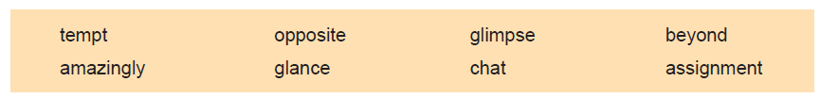
4
Fill in the blanks with the words given below. Change the form where necessary.
glimpse
1 Several thousand supporters strained to catch a _____________ of the new president.
2 Nothing can _____________ me to live here.
3 The road continued _____________ the village up into the hills.
4 He _____________ at the watch in the shop.
5 What are you _____________ about?
6 You will need to complete three written _____________ every semester.
7 She was a / an _____________ good cook.
8 We live further down on the _____________ side of the road.
tempt
beyond
glanced
chatting
assignments
amazingly
opposite

Slide 43
5
Add -ize, -ful or -fy to the following words to form new words and give the
corresponding Chinese meanings of the new words.
Affix | Words | New Words | Chinese Meanings
-ize | ideal
 | civil
 | global
-ful | care
 | use
 | help
-fy | pure
 | class
 | beauty
idealize
实现，意识到
civilize
使文明，开化
globalize
全球化
careful
小心的；谨慎的
useful
有用的
helpful
有帮助的
purify
净化
classify
分类
beautify
美化，装饰

Slide 44
6
There are two sentences chosen from the text. Choose the best Chinese translation for each sentence.
A
Suddenly, it was hard to catch my breath, my face felt warm and my knees got weak.
A. 突然，我呼吸困难，脸色通红，腿脚也站不住了。
B. 突然，我不能呼吸，感觉脸上温暖，腿变得虚弱。
C. 突然，追上呼吸很困难，感觉脸上温暖，腿变得虚弱。
2 Miraculously, my teacher Mrs. Christopher solved my dilemma when she demanded that I sit in the front row so I couldn’t chat with my friends.
A. 奇迹般地，为了避免和朋友们聊天，当我的老师克里斯托弗夫人要求我坐在前排时，
这解决了我的难题。
B. 奇迹般地，为了不让我和朋友们聊天，我的老师克里斯托弗夫人要求我坐在前排，这
解决了我的难题。
C. 奇迹般地，我的老师克里斯托弗夫人解决了我的难题，当她要求我坐在前排，以至于
不能和我的朋友们聊天。
B

Slide 45
7
Complete the following sentences with the given sentence structures.
It is hard to... 做……很困难
e.g. It is hard to get ready for the trip all by myself. 独自为旅行做准备有点困难。
1 ______________________________ (为上学做准备很难。)
2 ______________________________ (读英文小说很难。)
drive sb. nuts 让某人发疯
e.g. What he has said drove me nuts. 他说的话让我发疯。
1 What he has done _____________________ ( 让他的父母发疯).
That he did not learn anything in college ____________________ ( 让他的老师发疯).
It is hard to prepare for school.
It is hard to read English novels.
drove his parents nuts
drove his teacher nuts

Slide 46


Slide 47


Slide 48
Part Ⅲ
Text B Extensive Reading 1-2
A Letter to My Love, My Friend, My Wife
To my love, my friend, my wife and my partner — Dusty,
1 I know it’s the day before Valentines — some things can’t wait just for a day.
2 Ten years — that’s how long we’ve been with one another. It feels like a lifetime¹ — so much has changed.
致吾爱、吾友、吾妻
我的爱人、朋友、妻子和伴侣Dusty：
我知道，还有一天就是情人节了。但有些事情就连一天都等不及。
十年了。我们在一起十年，却像在一起了一辈子。这中间发生了太多事。
★ wait for 等待
★ one another 互相
★ feel like 感觉像……
★ lifetime /'laɪftaɪm/ n. 一生，终生

Slide 49
Part Ⅲ
Text B Extensive Reading 3
3 We’ve been through² our times of trial³ — little things like accidentally⁴ renting⁵ an apartment⁶ in a war zone⁷ (my bad!) — and much bigger things from health, to finances⁸, to not knowing what we were doing or where we were going. We’ve been through a lot in ten years.
★ through /θruː/ prep. 经历；穿过，通过
我们经历了太多的挫折——比如，偶然在战争区租了一套房子这种小事（我的错！），以及从健康到财产之类的大事，甚至还有不知道自己在做什么、要去哪里之类的困惑。一路走过来，十年间，我们经历了太多故事。
★ trial /'traɪəl/
n. an experience or a person that causes difficulties for sb. 考验；令人伤脑筋的事；惹麻烦的人
e.g. the trials and tribulations of married life
婚姻生活的考验与磨炼
She was a sore trial to her family at times.
她有时让家人伤透了脑筋。
★ accidentally /ˌæksɪ'dentlɪ/
adv. 意外地，偶然地
★ rent /rent/ v. 租用，租借
★ zone /zəʊn/ n. 地区；地带
★ apartment /ə'paːtmənt/ n. 公寓套房
★ finances /’faɪnænsɪz/ n. ［复数］个人财务管理

Slide 50
Part Ⅲ
Text B Extensive Reading 4
★ Despite /dɪ'spaɪt/ prep.
sth. happened or is true although sth. else might have happened to prevent it 即使；尽管
e.g. Despite applying for hundreds of jobs, he is still out of work.
尽管他申请了数百个工作，但仍然在失业中。
She was good at physics despite the fact that she found it boring.
尽管她认为物理枯燥无味，她却学得很好。
Language Point:
despite 相当于in spite of，常用于引导让步状语从句，意为“尽管；即使”。
4 Despite⁹ the trials — we have made each other stronger. You have also given me the cherished¹⁰ gift of your love, your tears and support in my times of pain¹¹.
尽管如此，我们使得彼此更加强大。你给了我最为珍贵的礼物，不仅是你的爱和泪，还有困难时期的支持。
★ cherish /'tʃerɪʃ/ v. 钟爱；爱护
★ pain /peɪn/ n. 疼痛

Slide 51
Part Ⅲ
Text B Extensive Reading 5
5 You have given me more than just your love; you gave me our first daughterAbby — who might as well be a tiny¹² clone¹³ of myself in female¹⁴ form¹⁵, who despite her willfulness¹⁶ and strong personality¹⁷ makes my heart jump each time I hear her laugh, each time she runs to me and hugs¹⁸ me and tells me she loves me.
★ personality /ˌpɜːsə'næləti/
n. the various aspects of a person’s character that make them different from others 性格
e.g. The children all have very different personalities.
孩子们的性格各不相同。
当然还不止这些。你还给我带来我们的第一个宝贝女儿Abby。她长得简直和我一模一样，任性的表现和强烈的个性却与我不同。每每听到她笑，每当她跑向我、拥抱我、说她爱我时，我的心都会砰砰跳动。
★ tiny /'taɪni/ adj. 极小的；微小的
★ clone /kləʊn/ n. 好像一模一样的人；复制品
★ form /fɔːm/ n. 外表，样子
★ willfulness /'wɪlfəlnɪs/ n. 任性，倔强
★ female /'fiːmeɪl/ adj. 女的，女性的
★ hug /hʌg/ v. 拥抱，搂抱

Slide 52
Part Ⅲ
Text B Extensive Reading 6
6 Then there is Addison, our bubbling¹⁹ eight month old. What can I say about someone who greets²⁰ me with a smile and a laugh whether it’s five in the morning, or me just coming home from a hard day at work? Addison’s happiness and flourishing²¹ is not just due to doctors, or therapists²² — it’s directly tied to the amazing²³ love and care you provide to her. Every time I look at Addison, I see an extension²⁴ of you — your smile, your happiness.
★ bubble /'bʌbl/ v. 发出冒泡的声音
还有Addison，我们八个月大的小女儿。即使在凌晨五点，我拖着疲惫的身躯回家，她也总是笑着和我打招呼。面对她，我还能说什么呢？她的幸福健康成长不应归功于医生，而应归功于你的爱和照顾。每当我看到她，总是仿佛看到了你，看到了你的笑和幸福。
★ greet /griːt/ v. 打招呼；欢迎；迎接
★ flourish /'flʌrɪʃ/ v. 茁壮成长，健康幸福
★ therapist /'θerəpɪst/ n. 治疗专家
★ amazing /ə'meɪzɪŋ/
adj. 令人大为惊奇的；令人惊喜的
★ extension /ɪk'stenʃn/ n. 延续；延伸

Slide 53
Part Ⅲ
Text B Extensive Reading 7
7 You and our daughters have given me more than a reason to just keep working and moving from day to day. You’ve given me a reason to truly live, a place and arms to cry in, to laugh in, and to grow in. You’ve given me a view of life, of living, of loving I never dreamed of having. You’ve driven me to be a better man, a better husband and father.
你和女儿们不只是我每天工作的理由。你们给了我真正活下去的勇气，给了我分享喜怒哀乐的地方，让我成长。你们给了我梦寐以求的生活和爱，让我成长为一个更好的男人、丈夫和父亲。

Slide 54
Part Ⅲ
Text B Extensive Reading 8-12
8 I am but a broken²⁵ man, but with you I am whole.
9 Thank you for being who you are.
10 Thank you for being with me.
11 Thank you for loving me.
12 Thank you for letting me love you in return.
Jesse
我不是一个完美的人，但有你在，我就是完整的。
感谢你是你自己。
感谢你陪我一起。
感谢你爱我。
感谢你让我爱上你。
Jesse
★ broken /'brəʊkən/ adj. 破损的；残缺的

Slide 55
A Letter to My Love, My Friend, My Wife
New Words
1 lifetime /'laɪftaɪm/ n. 一生，终生
2 through /θruː/ prep. 穿过，贯穿
3 trial /'traɪəl/ n. 试验
4 accidental /ˌæksɪ'dentl/ adj. 意外的，偶然的
5 rent /rent/ v. 租用，租借
6 apartment /ə'paːtmənt/ n. 公寓套房
7 zone /zəʊn/ n. 地区；地带
8 finance /'faɪnæns/ n. 资金；财政；金融
9 despite /dɪ'spaɪt/ prep. 即使；尽管
10 cherish /'tʃerɪʃ/ v. 钟爱；爱护
11 pain /peɪn/ n. 疼痛

Slide 56


12 tiny /'taɪni/ adj. 极小的；微小的
13 clone /kləʊn/ n. 好像一模一样的人；复制品
14 female /'fi ːmeɪl/ adj. 女的，女性的
15 form /fɔːm/ n. 形状；外表，样子
16 willfulness /'wɪlfəlnɪs/ n. 任性，存心
17 personality /ˌpɜːsə'næləti/ n. 人品；人格；个性
18 hug /hʌg/ v. 拥抱，搂抱
19 bubble /'bʌbl/ v. 发出冒泡的声音
20 greet /griːt/ v. 打招呼；欢迎；迎接
21 flourish /'fl ʌrɪʃ/ v. 繁荣；昌盛；兴旺
22 therapist /'θerəpɪst/ n. 治疗专家
23 amazing /ə'meɪzɪŋ/ adj. 令人大为惊奇的；令人惊喜的
24 extension /ɪk'stenʃn/ n. 扩大；延伸
25 broken /'brəʊkən/ adj. 破损的；残缺的

Slide 57

1 wait for 等待
2 one another 互相
3 feel like 感觉像……
4 greet sb. with 用……迎接某人

Slide 58
1 This is a letter from __________ to _____________.
A. husband; wife B. wife; husband C. father; son D. mother; daughter
2 How long have they been together?
A. Nine years. B. Ten years. C. Eleven years. D. Not mentioned.
3 How many children do they have?
A. One child. B. Two children. C. Three children. D. Not mentioned.
4 Who gave the author the strength to keep working and moving from day to day?
A. His father and mother. B. Himself. C. His wife and children. D. His friends.
5 Which one is NOT true about the author?
A. The author is expressing his love to his family. B. The author is writing a letter.
C. The author is feeling sorry for his family. D. The author loves his family very much.
A
B
B
C
C

Slide 59
Part 1
Part 2
Part 3
Part 4
Part 5
Part 6
Lead-in
Listening ＆
Speaking
Reading
Grammar
Watching & Performing
Applied Writing

Slide 60
情态动词
情态动词又称为情态助动词，是一种本身有一定的词义，表示说话人的情绪、态度或语气 的动词，不能单独作谓语。情态动词主要有can, may, must, could, might, shall, should, will, would, ought to, need, dare 等，表示可能、怀疑、允诺、愿望、义务、必要、猜测等语气。情态动词没有 人称和数的变化。

Slide 61
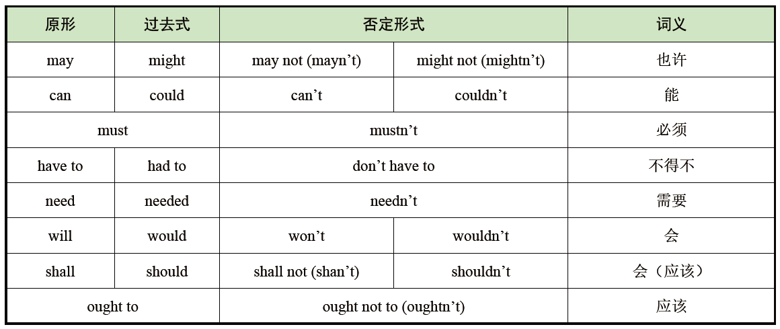
1、情态动词一览表

Slide 62
2、情态动词may / might 的基本用法
1）may / might 表示许可或请求
其否定回答用can’t 或mustn’t。
e.g. —May I go home now? 我现在能回家吗？
—Yes, you may. / No, you can’t. 是的，你可以。/ 不，你不能。
2）表示可能性或猜测
当表示请求时，might 比 may 语气更婉转，当表示猜测时，might 比 may 更不确定。
e.g. You may ask the teacher tomorrow. 你可以明天问老师。
You might ask your father to buy this bag for you. 你也许可以让你父亲给你买这个包。

Slide 63

3）表示祝愿
e.g. May you succeed. 祝你成功。
4）注意区分maybe 和may be
maybe 是副词，意思是“也许”，“可能”，在句中作状语，常用于句首。在may be 结构中，may 是情态动词，be 是动词原形，两者构成完整的谓语形式，与主语构成系表结构，意思为“可能是，也许是”。
e.g. Maybe you put the letter on your desk.
可能你把信放在桌子上了。
I can’t fi nd my watch; it may be in your bag.
我的表找不到了，可能在你包里。

Slide 64
3、情态动词can / could 的基本用法
1）表示“会”，“能够”
could 是can 的过去式，可以表示过去的能力。
e.g. He can speak English. 他会说英语。
The baby could speak when she was eight months old. 这个婴儿八个月时就会说话了。
2）表示许可或请求
此时可等同于may。但could 比can 语气更婉转、客气。could 不表示时态，可以用作提出委婉请求，could 不可在答句中使用。
e.g. Can I borrow your book? 我能向你借本书吗？
—Could I have the radio on? 我可不可以听收音机呢？
—Yes, you can. / No, you can’t. 是的，你可以。/ 不，你不能。
3）表示怀疑、不确定或猜想的情况
多用于疑问或否定句中。
e.g. He couldn’t be a bad man. 他不大可能是坏人。

Slide 65

4、情态动词must 的基本用法
1）表示必须
must 的否定形式通常表示禁止。
e.g. You must do your homework now.
你现在必须做作业。
You mustn’t smoke here.
这里禁止吸烟。
2）表推测
意思是“一定”，一般用于肯定句。
e.g. He must be on the playground.
他一定是在操场。

Slide 66

5、情态动词need 的基本用法
need 既可作实义动词，又可作情态动词。作情态动词时，后面接动词原形，常用于疑问句、否定句和条件句中。need 作实义动词时后面接不定式。
e.g. I think you need complete the work today. 我想你需要今天完成这个工作。
— Need you go now? 你现在就需要走了吗？
— Yes, I must. 或 No, I needn’t. 是的，我必须走。/ 不，我不必。

Slide 67

Fill in the blanks with correct forms of the modal verbs.（选择正确的情态动词填空。）
1 在做了很多工作之后，你一定很累了。
You ________ be very tired after doing much work.
2 他现在不可能在家。
He ________ be at home now.
3 不要玩火，你可能会烧伤自己。
Don’t play with the fi re. You ______ burn yourself.
4 我们不能摘花。
We _______ pick the flowers.
must
can’t
may
mustn’t

Slide 68
Part 1
Part 2
Part 3
Part 4
Part 5
Part 6
Lead-in
Listening ＆
Speaking
Reading
Grammar
Watching & Performing
Applied Writing

Slide 69

1
Now watch the movie clip. Read the words closely after the speaker so as to improve
your short-term memory, pronunciation, stress and intonation by imitating what you hear.
Setting: The evil knight Gaston finds Beast and he wants to kill Beast.

Slide 70
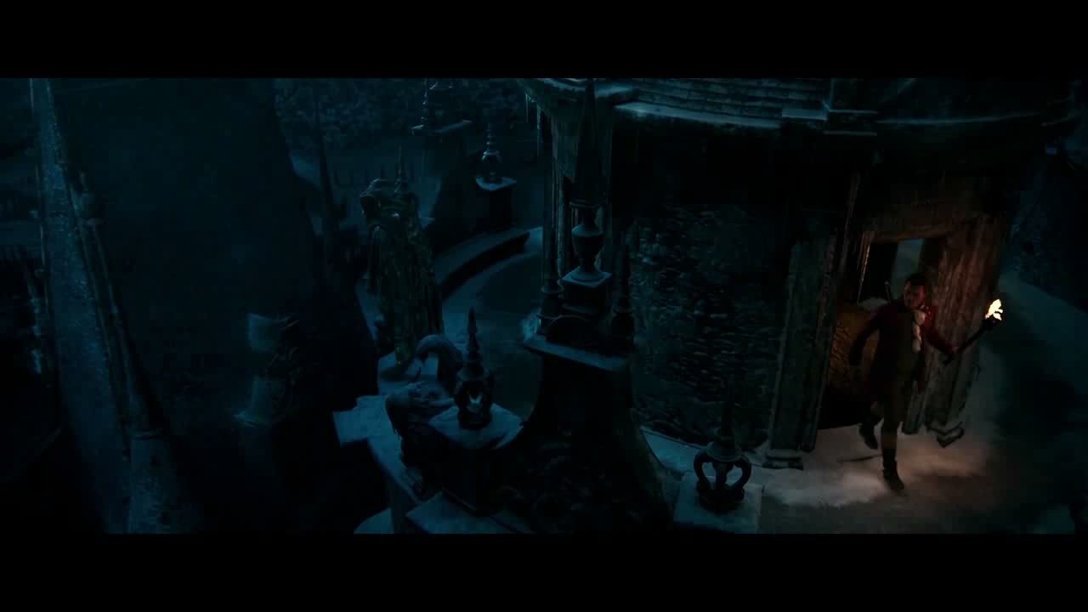

Slide 71
2
Work in pairs. Make a dialogue according to the given situation and useful expressions, and then perform it. The teacher and students in other teams can give a score for the performance. The following score sheet is for your reference.
Situation: You are Mr. Seeger’s secretary ( 秘书). Mr. Seeger asks you to make a reservation ( 预订) for him and his wife in Meimei Restaurant.

Slide 72
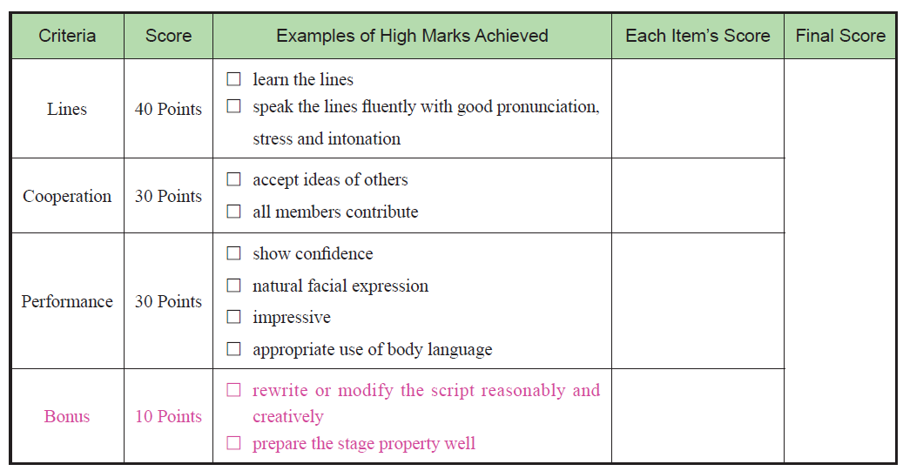


Slide 73
3
Read the lines chosen from the movie Beauty and the Beast (美女与野兽) and try to recite them.
1 Imagine what you dream of, show it in your mind, feel it with your heart.
想象你梦寐以求的东西，在你的脑海中呈现它，用心去感受它。
2 Easy to remember, hard to move on.
记住虽易，然前行难。
3 True beauty comes from the heart, not from the outside.
真正的美源于内心而非外表。

Slide 74
Part 1
Part 2
Part 3
Part 4
Part 5
Part 6
Lead-in
Listening ＆
Speaking
Reading
Grammar
Watching & Performing
Applied Writing

Slide 75
E-mail
Useful Expressions
✧ Dear…
✧ We are glad to inform you that…
✧ I have received your…
✧ I’m looking forward to your reply.
✧ Yours sincerely.

Slide 76

思政拓展：真正的爱情
Watch the video “Titanic” after class and try to say something about what you get from the video in the discussion groups.

