Slide 2
Unit Objectives:
Knowledge and skill（知识、技能目标）:
1.Students should be able to talk about money and wealth management.
2.Student should acquire the new words and expressions.
3.Students should grasp the usage of the usage of the past tense.
4.Students should grasp the principle of letters of thanks.
Feelings, attitudes and values（情感、态度和价值观目标）:
Students should be able to manage their own money
in a responsible way.

Slide 3
Unit Objectives:
Ideological and Political Aims（思政目标）
1. Students should know what is the concept of the money.
2. Students should know how to set up a correct view of money
3. Students should know the value of the money.

Slide 4
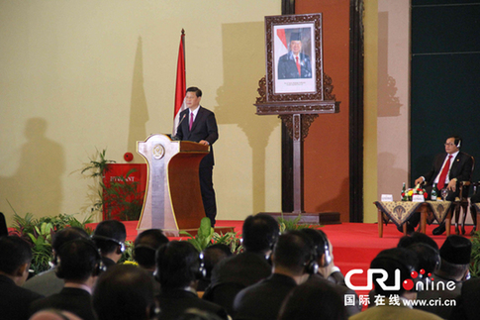
习近平主席在印尼国会发表演讲： “金钱易得，朋友难求”
Please give your own opinion about the role that money has always played in our life.

Slide 5
List more proverbs that involve money.
如果你把金钱当成上帝，它便会像魔鬼一样折磨你。——菲尔丁
金钱和享受的贪求不是幸福。 ——《伊索寓言》
金钱能做很多事，但它不能做一切事。我们应该知道它的领域。并把它限制在那里;当它想进一步发展时，甚至要把它们踢回去。——卡莱尔
金钱是能让我们去除了天堂以外的任何地区性方面军的一份护照;同时，它也能向我们提供除了幸福以外的任何东西。—— 查尔斯·兰姆

Slide 6
Part 1
Part 2
Part 3
Part 4
Part 5
Part 6
Lead-in
Listening ＆
Speaking
Reading
Grammar
Watching & Performing
Applied Writing

Slide 7
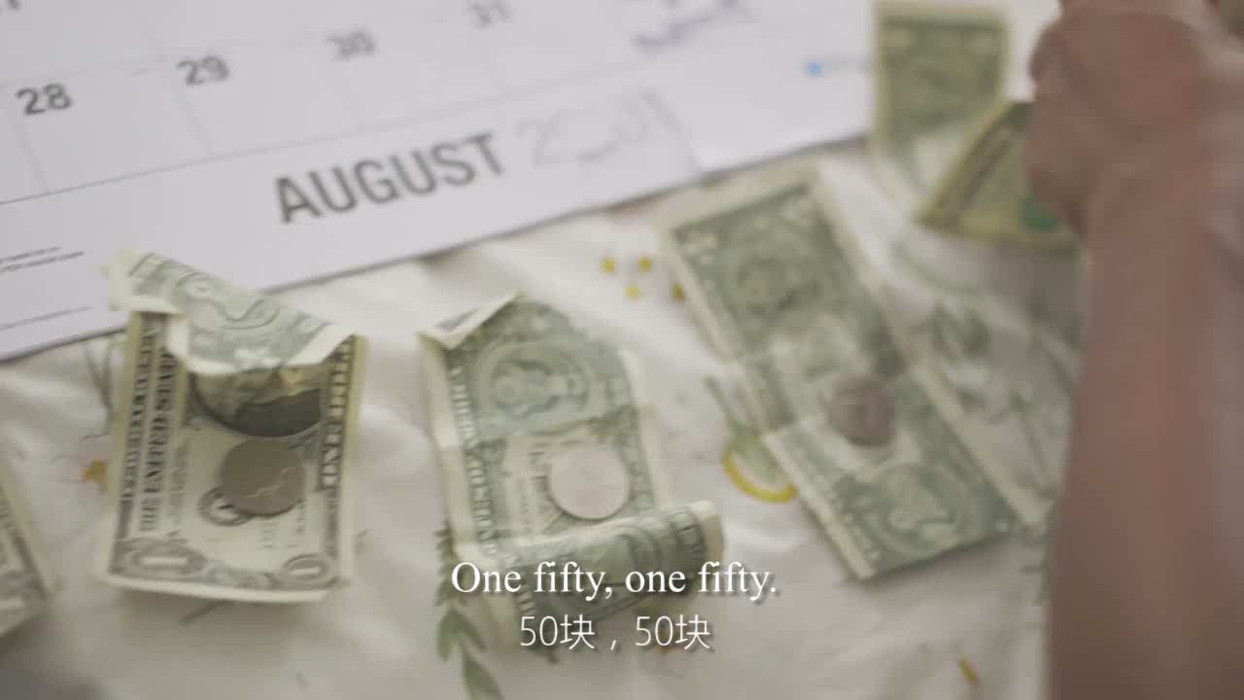
1
Have you ever got the experience of being short of money? Watch the video and then write down some of your experiences when you are short of money.

Slide 8

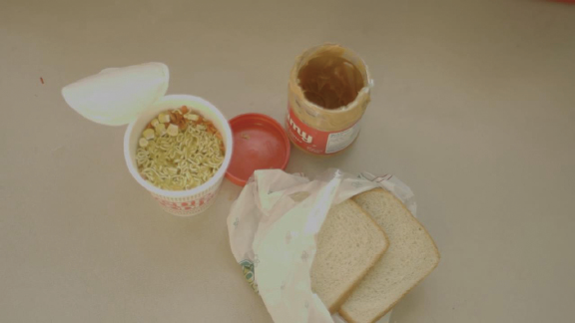
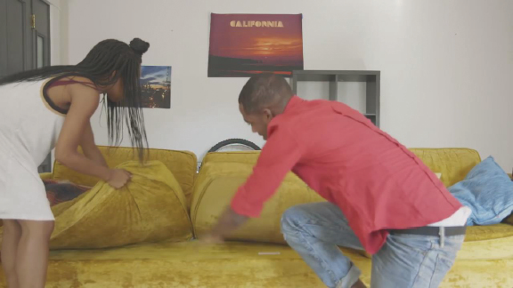
allocate ( 分配) money to more important things
put off dates
find cash and coins everywhere
eat less and simpler
Your experiences:
___________________ ___________________ ___________________ ___________________

Slide 9
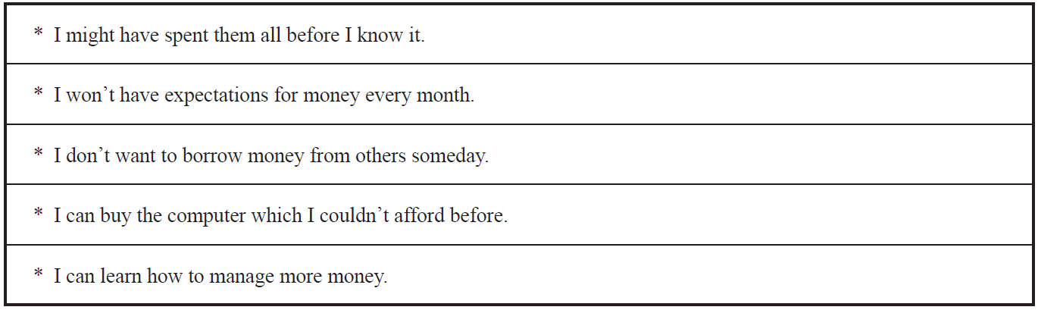
2
If you have a chance to get all of your allowances or salaries for a year in one time, how do you want to spend the money? Share your thoughts with your partners. The following sentences are for your reference.

Slide 10
Part 1
Part 2
Part 3
Part 4
Part 5
Part 6
Lead-in
Listening ＆
Speaking
Reading
Grammar
Watching & Performing
Applied Writing

Slide 11
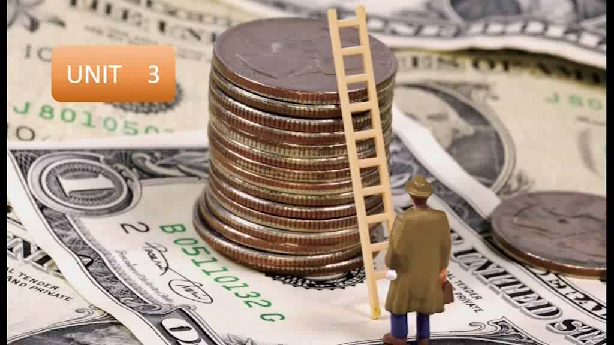
1
Listen to the dialogues and fill in the blanks.

Slide 12
Words and Expressions
millionaire 百万富翁 be interested in 对……感兴趣
sacrifice 牺牲 proverb 格言
take care of… 照顾；注意 invest 投资，花费
tropic 热带的 charity 慈善
name after… 以……命名 depend 依靠；决定于

Slide 13
Dialogue 1
B: What are you doing now, Steven?
S: I am reading a ___________ about money management.
B: Oh, my God. Do you want to be a millionaire? I can see you are very crazy about money.
S: Everyone wants to _______ a lot of money. Don’t you think so? What’s more, I am interested in money management.
B: No. Money can’t buy happiness and health. I won’t sacrifice my ___________ in order to
get more money. In other words, I don’t want to be a millionaire and I want to have more____________ to enjoy life.
S: Oh, I see. But a proverb says “Money makes the mare go ( 有钱能使鬼推磨).” I think it will be
___________ if you have more money.
B: Maybe you are right. Please take care of yourself when you make money. Anyway health is the
most important thing.
S: Thank you for your advice. I will.
book
earn
health
free time
better

Slide 14
Dialogue 2
would
W: If you had one million dollars, what ___________ you do?
M: I would buy a small island, build a house there, and invest the rest of my money so that I would
never have to ___________ again.
W: OK. So are you talking a tropical island?
M: A tropical island, yeah, or maybe I would ________ all to charity and have a bridge named after me.
W: That’s two different things there. Would you want to be alone on an island?
M: No, I would want all of my friends to come and _______ me often.
W: OK. Nice. So how would you pass the time on this island?
M: I would read books. I would ________. I would go swimming, go fi shing, and have fun with my dog.
W: OK. Do you think money can make people happy?
M: No, but it can sometimes make life easier. It depends.
work
give it
visit
study

Slide 15
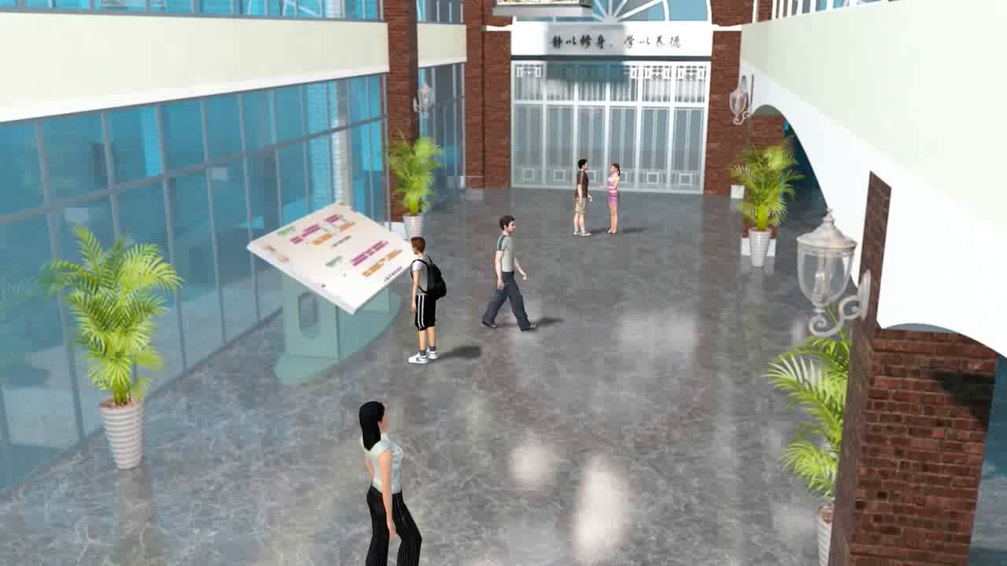
2
Listen to the dialogues again and check your answers, and then make a dialogue according to the situation given below. The following sentence patterns are for your reference.
Situation: You just won a scholarship of 8,000 yuan. Your friend is curious
about how you are going to spend the money. And you tell him / her about your idea.

Slide 16
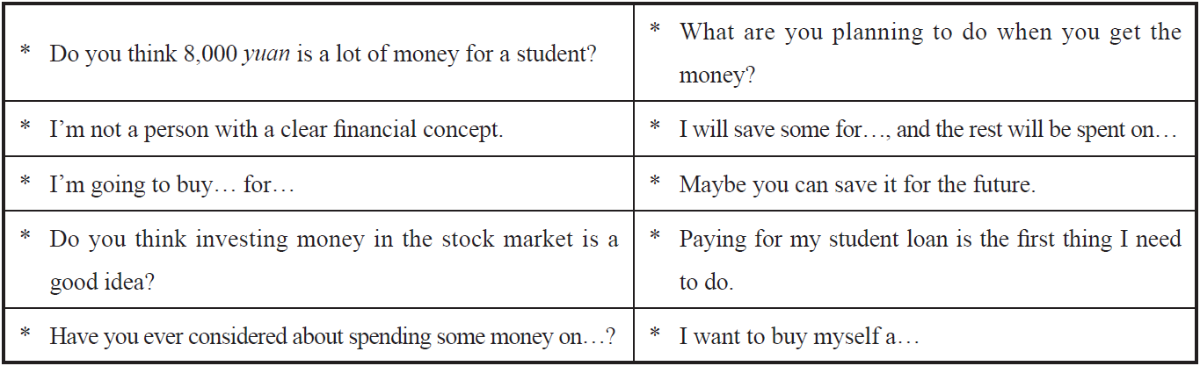

Slide 17

Seems like everybody’s got a price
I wonder how they sleep at night
When the sale comes first
And the truth comes second
Just stop for a minute and ___________
Why is everybody so serious
Acting so damn mysterious
You got your shades on your eyes
And your heels so _______
That you can’t even have a good time
Everybody look to their left
Everybody look to their ___________
Can you feel that
We’re paying with love tonight
3
Listen to the song Price Tag and fill in the blanks.
smile
high
right

Slide 18
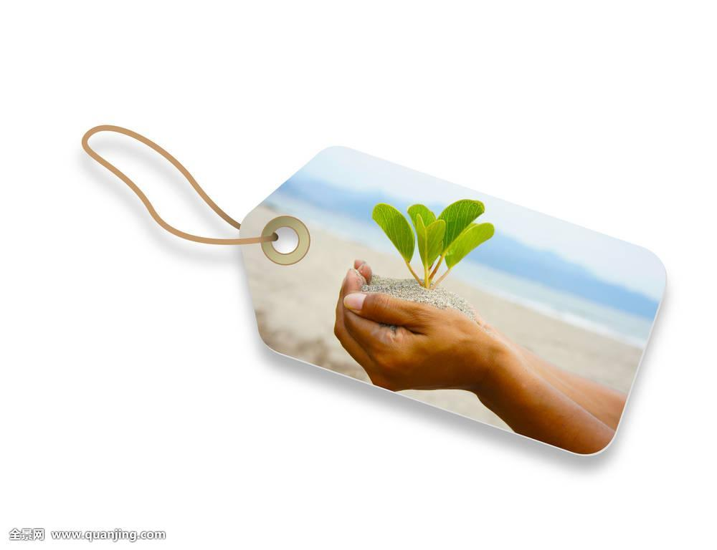
It’s not about the money, money, money
We don’t need your money, money, money
We just wanna make the world ___________
Forget about the price tag
Ain’t about the (ha) Cha-Ching, Cha-Ching
Ain’t about the (yeah) Ba-Bling, Ba-Bling
Wanna make the world dance
Forget about the price tag
We need to take it back in time
When music made us all _______
And it wasn’t low blows and video
Am I the only one getting tired
dance
Why is everybody so obsessed
Money can’t buy us happiness
Can we all slow down and enjoy right now
Guarantee we’ll be feeling all right
Yeah, yeah
Well keep the price tag
And take the cash back
And give me six strings and a half stack
And you can keep the cars
Leave me the garage
unite

Slide 19
Part 1
Part 2
Part 3
Part 4
Part 5
Part 6
Lead-in
Listening ＆
Speaking
Reading
Grammar
Watching & Performing
Applied Writing

Slide 20


Slide 21





Part Ⅲ
Text A Intensive Reading 1-4
★ in a moment 立刻，马上
e.g. I’ll be back home in a moment.
Money Can’t Buy You Success
★ come to mind 突然想到
e.g. When we talk about Wuhan, the first that comes to mind is the Yangtze River.
1 In a moment, I’m going to ask you to close your eyes, think about one word, and tell me what comes to mind. Not yet. First you have to know what the word is.
2 The word is “success”.
3 Now close your eyes, sit quietly, and tell me what comes to mind.
4 That’s your current¹ definition² of “success”.
金钱买不到成功
一会儿，我将邀请你闭上眼睛，想一个词，并告诉我你想到了什么。还没开始。首先你得知道这个词是什么。
这个词是“成功”。
现在闭上你的眼睛，静静思考，然后告诉我你的想法。
你的回答就是你目前对“成功”的定义。
★ current /'kʌrənt/ adj. 现在的
★ definition /ˌdefɪ'nɪʃn/ n. 定义

Slide 22
Part Ⅲ
★ fulfill /fʊl'fɪl/ v.
(a) (~ sb. / yourself) to make sb. feel happy and satisfied with what they are doing or have done 使高兴；使满意
e.g. He was able to fulfill himself through his painting.
他通过绘画充分发挥了自己的才能。
(b) to do or achieve what was hoped for or expected 完成；实现；履行
e.g. to fulfill your dream / ambition / potential 实现梦想 / 抱负；发挥潜力
(c) to do or have what is required or necessary 履行；执行
e.g. to fulfill a duty / an obligation / a promise 履行职责 / 义务 / 诺言
Language Point：比较realize, achieve, accomplish和fulfill
realize v. When someone realizes a design or an idea, they make or organize something based on that design or idea. 强调的是成为现实
accomplish v. put in effect; to gain with effort 强调的是努力之后实现，关键在努力
fulfill v. put in effect 强调的是实现的结果
achieve v. to gain with effort 同样强调是通过努力实现
Text A Intensive Reading 5-6
★ achieve /ə'tʃiːv/
v. to succeed in reaching a particular goal, status or standard, especially by making an effort for a long time （凭长期努力）达到（某目标、地位、标准）；实现
e.g. There are many who will work hard to achieve these goals.
这里的许多人都将会为实现这些目标而努力。
Language Point:
because后面有两个并列的句子，and后面省略了I am。what引导的名词性从句作介词with的宾语。a lot older相当于much older，意思是“年长得多”。
5 When I do that experiment, I open my eyes to see the same thing I imagined when my eyes were closed. That’s probably because I’m a lot older than you and happy with what I’ve achieved³ in life.
6 However, I still have goals. I’m still hungry to accomplish⁴ certain things, as that’s what life is all about. And actually⁵, wealth⁶ was never my goal and never my definition of success, or else, I’m certain that I would not be fulfilled⁷.
★ be hungry to 渴望
e.g. I left Oxford in 1961 hungry to be a critic.
我于1961年离开牛津，渴望成为一名评论家。
be hungry for 渴望
e.g. In today’s world many people appear to be hungry for money.
当今世界，有不少人对金钱流露出极度的渴望。
当我做这个实验时，我睁开眼睛，看到的东西与我闭上眼睛想到的一样。那可能是因为我比你年长些，且对自己目前的生活很满意。
然而，我仍然有目标。我仍然渴望完成某些事情，因为这才是生活的真谛。事实上，财富从来不是我的目标，也不是我对成功的定义，否则，我肯定我不会得到满足。
。
★ accomplish /ə'kʌmplɪ / v. to succeed in doing or completing sth. 完成
e.g.The first part of the plan has been safely accomplished.
计划的第一部分已顺利完成。
Language Point:
这里，as引导原因状语从句，意为“因为，由于”。
★ actually /'æktʃuəli/ adv. 实际上；事实上
★ wealth /welθ/ n. 财产，财富

Slide 23
Part Ⅲ
Text A Intensive Reading 7-9
7 This is the essence⁸ of one of life’s great ironies⁹: Success leads to money. Money rarely¹⁰ leads to success. It’s real-world¹¹ logic¹².
8 If you’re true to yourself and achieve your goals, not only will you feel fulfilled, but you’ll also find plenty of money when you arrive at your destination¹³.
9 But if wealth is your definition of success, you will possibly never achieve it. It’s superficial. It’s not fulfilling. The more you have, the more you want. The more you spend, the more you need.
★ irony /'aɪrəni/ n. 讽刺，冷嘲
★ essence /'esns/ n. ~ (of sth.) the most important quality or feature of sth., that makes it what it is 本质；实质；精髓
e.g. His paintings capture the essence of France.
他的画描绘出法国的神韵。
in essence 从本质上讲；事实上
e.g. In essence, your situation isn’t so different from mine.
从本质上讲，你我的情况并非相差很远。
★ rarely /'reəli/ adv. 很少；罕有地
★ logic /'lɒdʒɪk/ n. 逻辑，逻辑学
这是人生一大讽刺的本质：成功带来金钱，金钱却很少能带来成功，也是现实世界的运行规则。
如果你忠于自己，且效力于实现自己的目标，你不仅会感到满足，而且在你实现目标的同时，也会得到很多钱。
但如果财富是你对成功的定义，你可能永远得不到它。它很肤浅，而且贪婪无止境。你拥有的越多，想要的就越多。你花费的越多，你需要的就越多。
★ real-world /'riːəl'wɜːld/
adj. 存在于现实世界的；真实的
★ lead to (道路) 通向；导致
e.g. All roads lead to Rome.
★ destination /ˌdestɪ'neɪʃn/ n. 目的地，终点

Slide 24
Part Ⅲ
Text A Intensive Reading 10
10 VCs are a great example of what I’m talking about. Since some of them manage¹⁴ $1 billion funds, you’d imagine that their entire lives have been focused on generating¹⁵ and increasing their own wealth. Not true, at least not for any of the top tech industry VCs I’ve known.
那些风险投资者就是很好的例子。有些人管理着10亿美元的基金，你肯定会以为，他们全部生活的重心都集中在产生和增加自己的财富上。事实并非如此，至少我所认识的顶尖科技产业风险投资者并不都是这样。
★ manage /'mænɪdʒ/ v. 经营，管理
★ generate /'dʒenəreɪt/ v. 产生；形成

Slide 25
Part Ⅲ
Text A Intensive Reading 11-12
11 Most of them cut their teeth as engineers¹⁶, researchers, analysts¹⁷, or marketers¹⁸ who eventually became successful through the efforts of a long period. During long years, their goals were inevitably¹⁹ related to their work, not their wealth.
12 Then, and only then, did they become investors²⁰. If they’re successful²¹ at that, then personal wealth comes with the territory²².
★ engineer /ˌendʒɪ'nɪə(r)/ n. 工程师，技师
★ marketer /'mɑːkɪtə(r)/ n. 市场商人；市场营销人员
★ analyst /'ænəlɪst/ n. 分析家
★ inevitably /ɪn'evɪtəbli/
adv. 不可避免地，自然而然地
be related to 与……有关，和……有联系
e.g. She claims (that) she is related to the Queen.
他们大多数人都是从工程师、研究人员、分析师或营销人员努力一步步走向成功的。在漫长的岁月里，他们的目标必然与工作有关，而非财富。
唯有如此，他们才成为投资者。如果他们完成了自己的目标，那么个人财富就会随之而来。
★ investor /ɪn'vestə(r)/ n. 投资者
★ successful /sək'sesfl/ adj. 成功的
★ territory /'terətri/ n. 领域，范围；势力范围

Slide 26
Part Ⅲ
Text A Intensive Reading 13-14
13 Look at it this way. If your professional goals are to enjoy what you do for a living, work hard at it, and accomplish things you’re proud of, then you’ll possibly achieve all that and make all the money you need to be happy. That’s how it works in the real world.
14 If, on the other hand, you want to follow the examples of millionaires or billionaires²³ who really just want to talk about themselves, be my guest. Just remember one thing. That’s not what any of them were doing on their way up.
这样看，如果你的职业目标是享受你的谋生之道，努力工作，完成你引以为傲的事情，那么你就可能实现所有这些目标，并得到足以使你幸福的金钱。这就是现实世界的规律。
另一方面，如果你想追随那些只想谈论自己的百万富翁或亿万富翁，那就请自便吧。你需要知道，他们所说的并非在他们成长中所做的。
★ on the other hand 另一方面
e.g. On the other hand, many women choose to go out to work.
★ billionaire /ˌbɪljə'neə(r)/ n. 亿万富翁；巨富

Slide 27

Text A Intensive Reading
Money Can’t Buy You Success
1 current /'kʌrənt/ adj. 现在的
2 definition /ˌdefɪ'nɪʃn/ n. 定义
3 achieve /ə'tʃiːv/ v. 取得；获得
4 accomplish /ə'kʌmplɪʃ/ v. 完成；达到（目的）
5 actually /'æktʃuəli/ adv. 实际上；事实上
6 wealth /welθ/ n. 财产，财富
7 fulfilled /fʊl'fɪld/ adj. 满足的，个人志向得以实现的
8 essence /'esns/ n. 本质，实质；精华，精髓
9 irony /'aɪrəni/ n. 讽刺，冷嘲
10 rarely /'reəli/ adv. 很少；罕有地
11 real-world /'riːəl'wɜːld/ adj. 存在于现实世界的；真实的
12 logic /'lɒdʒɪk/ n. 逻辑，逻辑学
13 destination /ˌdestɪ'neɪʃn/ n. 目的地，终点
New Words

Slide 28

14 manage /'mænɪdʒ/ v. 经营，管理
15 generate /'dʒenəreɪt/ v. 产生；形成
16 engineer /ˌendʒɪ'nɪə(r)/ n. 工程师，技师
17 analyst /'ænəlɪst/ n. 分析家
18 marketer /'mɑːkɪtə(r)/ n. 市场商人；市场营销人员
19 inevitably /ɪn'evɪtəbli/ adv. 不可避免地，自然而然地
20 investor /ɪn'vestə(r)/ n. 投资者
21 successful /sək'sesfl/ adj. 成功的
22 territory /'terətri/ n. 领域，范围；势力范围
23 billionaire /ˌbɪljə'neə(r)/ n. 亿万富翁；巨富

Slide 29

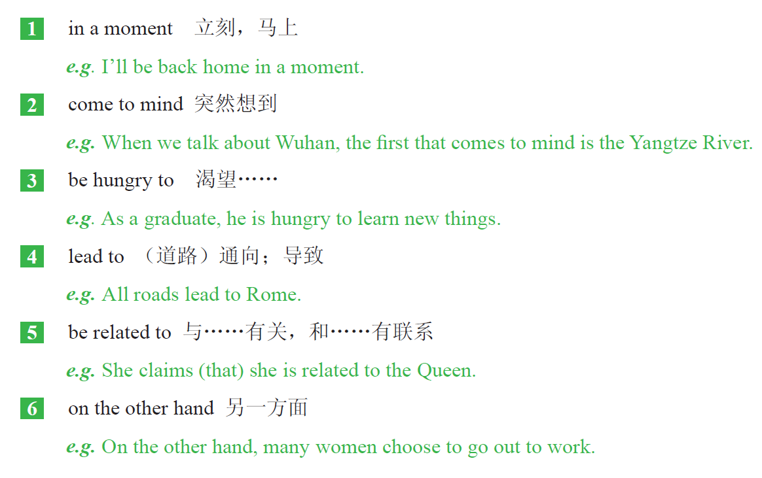

Slide 30

VCs (Venture Capitalists) 风险投资家，投机资本家

Slide 31

1 That’s probably because I’m a lot older than you and happy with what I’ve achieved in life. (Para. 5)
because 后面有两个并列的句子，and 后面省略了“I’m”。what 引导的名词性从句作介词 with 的宾语。a lot older 相当于much older，意思是“年长得多”。
2 And actually, wealth was never my goal and never my definition of success, or else, I’m certain that I would not be fulfilled. (Para. 6)
此句中第二个and 连接的是was 后面的两个并列表语。or else 的意思是“否则”，后面是一个与前面情况相反的结论。I’m certain that 的意思是“我可以肯定……”，that 引导的是一个宾语从句，表示“肯定”的内容。
3 If you’re true to yourself and achieve your goals, not only will you feel fulfi lled, but you’ll also find plenty of money when you arrive at your destination. (Para. 8)
此句中if 引导的是一个条件从句，后面的主句中用的not only ... but also ... 的结构，意思是“不仅……而且……”。其中not only 后面用的倒装结构，即not only ＋助动词/ 情态动词＋主语＋行为动词原形，but also 中的also 也可放在助动词或情态动词之后。

Slide 32
4 Since some of them manage $1 billion funds, you’d imagine that their entire lives have been focused on generating and increasing their own wealth. (Para. 10)
since 后面引导的是原因状语从句。you’d 是you would 的缩写，imagine 后面是由that 引导的宾语从句， generating and increasing 是两个并列的现在分词结构，作介词on 的宾语。
5 If your professional goals are to enjoy what you do for a living, work hard at it, and accomplish things you’re proud of, then you’ll possibly achieve all that and make all the money you need to be happy. (Para. 13)
在if 引导的条件从句中，to enjoy what... you’re proud of 是3 个并列的不定式结构作条件从句中的表语。主句用的一般将来时，you need to be happy 是省略了连接词that 或which 定语从句，修饰前面的money。

Slide 33

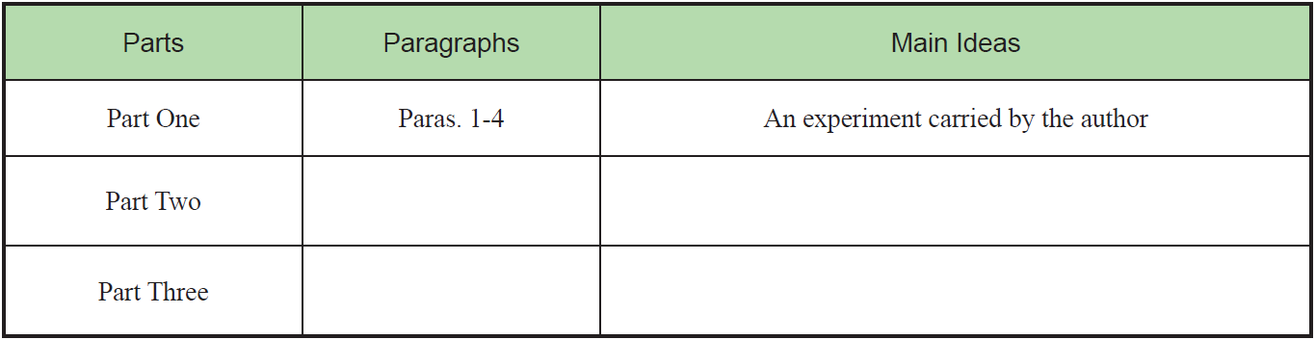
1
Read Text A and complete the following table.
Paras. 5-9
The author’s views upon money and success.
Paras.10-14
Examples of rich people to show that success leads to money.

Slide 34
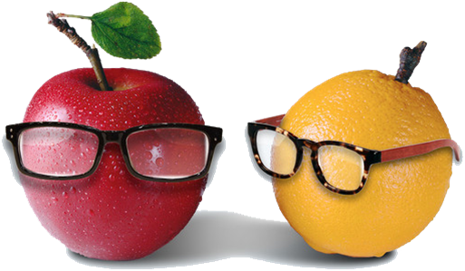
2
Answer the following questions and then discuss with your partners.
1 What’s the relationship between money and success according to the author?
2 Why does the author think that “if wealth is your definition of success, you will possibly never achieve it” in Para. 9?
3 What does the author mean by “Most of them cut their teeth as engineers, researchers, analysts, or marketers” in Para. 11?

Slide 35

3
Please read the 6th paragraph aloud and recite it.
However, I still have goals. I’m still hungry to accomplish certain things, as that’s what life is all about. And actually, wealth was never my goal and never my definition of success, or else, I’m certain that I would not be fulfilled.

Slide 36
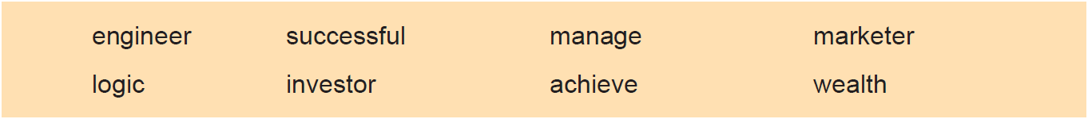
4
Fill in the blanks with the words given below. Change the form where necessary.
investor
1 The main ___________ in the project is HSBC（汇丰银行）.
2 Many people work hard to __________ their goals.
3 I don’t follow the ________ of your argument.
4 We need people who can __________ our team well.
5 They’re sending an ____________ to fi x the phone.
6 The play was very _________________ on Broadway.
7 His personal _____________ is estimated ( 预估) at around $100 million.
8 Most consumers doubt what the ______________ says to them.
achieve
logic
manage
engineer
successful
wealth
marketer

Slide 37
5
Add -some, -ern or -(ic)al to the following words to form new words and give the
corresponding Chinese meanings of the new words.
Affix | Words | New Words | Chinese Meanings
-some | tire
 | awe
 | bore
-ern | south
 | north
 | southeast
-(ic)al | history
 | physics
 | chemistry
tiresome
无聊的
awesome
可怕的
boresome
烦人的
southern
南方的
northern
北方的
southeastern
东南的
historical
历史的
physical
物理的
chemical
化学的

Slide 38
6
There are two sentences chosen from the text. Choose the best Chinese translation for each sentence.
B
1 I’m still hungry to accomplish certain things, as that’s what life is all about.
A. 我仍然希望达到某种目的，因为这就是生活。
B. 我仍然渴望完成某些事情，因为这就是生活的全部。
C. 我仍然渴望完成某件事情，因为这就是生活的全部。
2 But if wealth is your defi nition of success, you will possibly never achieve it.
A. 但是，如果财富是你对成功的定义，你将可能永远不会获得它。
B. 但是，如果富有是你对成功的定义，你永远不会实现。
C. 但是，如果财富是你对成功的看法，你将永远不会达到。
A

Slide 39
7
Complete the following sentences with the given sentence structures.
I’m certain that... 我相信……；我确定……
e.g. I’m certain that they will give you some good advice. 我相信他们会给你一些好建议的。
1 _______________________ (我相信他会来) to my house to join the party.
2 _____________________________ (我相信她会待在家) to do the housework.
the more... the more... 越……越……
e.g. The more powerful the car is, the more difficult it is to handle.
汽车的功率越大，就越难驾驭。
1 _________ you are expecting, ________ you’ll be disappointed!（希望越大，失望越大！）
2 _________ you prepare for the speech, ________ skillful you will be.（你准备得越多，就越熟练。）
I’m certain that he will come
I’m certain that she will stay at home
The more
The more
The more
The more

Slide 40


Slide 41
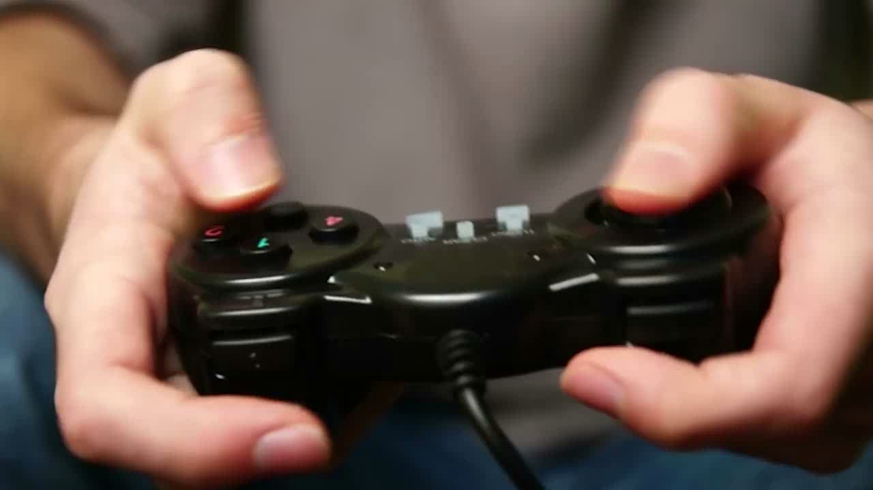

Slide 42
Part Ⅲ
Text B Extensive Reading 1
A Story About Coins
1 Every month, Julia and her cousins go for the big family meal at their grandparents’ house. They always wait excitedly¹ for the moment their grandfather gives them a few coins. Then all the children run off to buy candies.
硬币的故事
Julia和堂兄弟姐妹每个月都会去祖父母家参加家庭聚餐。孩子们总是兴奋地等着祖父给他们一些硬币，然后拿着钱跑去买糖果。
★ excitedly /ɪk'saɪtɪdli/ adv. 兴奋地，激动地
★ run off 跑掉

Slide 43
Part Ⅲ
Text B Extensive Reading 2-3
2 Relatives often comment² that, behaving³ like this, the children will never learn to manage their money. So they propose⁴ a test, in which the children will have to show, over the course⁵ of a year, what they could do to manage those coins.
3 Ruben and Nico, the two smallest kids, continue spending it all on sweets. Every time, they show off their sweets in front of other children. They made another two kids called Clara and Joe so angry that they could no longer keep saving their money.
★ comment /'kɒment/ v. 评论，谈论
★ behave /bɪ'heɪv/ v. 表现
★ propose /prə'pəʊz/
v. to suggest a plan, an idea, etc. for people to think about and decide on 提议；建议
e.g. The government proposed changes to the voting system.
政府建议修改表决制度。
亲戚们经常评论说，这样下去，孩子们永远也学不会理财。因此，他们提出了一个测试计划。在测试中，孩子们必须在一年中展示他们是如何管理这些钱的。
Ruben和Nico年纪最小，他们继续用得到的钱去买糖果。每次他们都在其他孩子面前炫耀他们的糖果。这使得另外两个孩子Clara和Joe很生气，于是他俩的存钱计划就此搁置。
★ course /kɔːs/ n. 进展；进程
★ show off 炫耀
★ no longer 不再……

Slide 44
Part Ⅲ
Text B Extensive Reading 4
★ collect /kə'lekt/ v. 聚积
★ involve /ɪn'vɒlv/
v. to make sb. take part in sth. （使）参加，加入
involve sb. in sth. 把某人（或牵扯）到某事里
e.g. Parents should involve themselves in their child’s education.
父母应当参与孩子的教育。
be involved in… 参与
e.g. She wants to be involved in every area of your life. 她想参与你生活中的方方面面。
4 Monty decides to manage his money by exchanging⁶ it: buying and selling things, or betting⁷ it with other children in card games. Soon he collected⁸ a lot of money with little effort. However, Monty got involved⁹ in more and more risky¹⁰ deals¹¹. A few months later he lost all the money on a horse race.
Monty决定通过交易来管理他的钱：买卖东西或者和其他孩子玩纸牌游戏赢钱，很快就用很少的成本挣了一笔钱。然而，Monty参与到越来越多有风险的交易中。几个月后，他在赛马比赛中输光了所有的钱。
★ bet /bet/ v. 赌博；与……打赌
★ exchange /ɪks'tʃeɪndʒ/ v. 交换，互换
★ risky /ˈrɪski/ adj. involving the possibility of sth. bad happening 有危险（或风险）的
e.g. Life as an aid worker can be a risky business.
救援人员的工作会有危险。
★ deal /diːl/ n. （一笔）交易

Slide 45
Part Ⅲ
Text B Extensive Reading 5
5 Alex, on the other hand, had a will of iron¹². He saved all the money, and one year later he collected more money than anyone. With so much money, he managed to buy sweets at a low price. And he still left some money for a toy. He was the clear winner. The rest of his cousins learnt from him the advantages¹³ of saving and waiting.
另一方面，Alex有钢铁般的意志。他把所有的钱都存起来了，一年后，他攒的钱比其他孩子都多。有了这些钱，他以低价买了糖果，还留了一些钱买玩具。他显然是胜利者。其余的堂兄弟从他那里学到了储蓄和维持满足感的好处。
★ iron /'aɪən/ n. 烙铁；坚强
★ advantage /əd'vɑːntɪdʒ/ n. 有利条件；益处

Slide 46
Part Ⅲ
Text B Extensive Reading 6
6 Julia didn’t enjoy the competition¹⁴ day. Even though she had a wonderful plan, she didn’t have enough time to complete¹⁵ her plan. In the second year, Julia surprised everyone by showing up at the grandparents’ house with a violin and a lot of money. What’s more, everyone could hear her excellent¹⁶ play.
★ competition /ˌkɒmpə'tɪʃn/ n. 竞争；比赛
★ even though 即使
朱丽亚Julia不喜欢参与这样的比赛。尽管她曾有一个很好的计划，但她没有足够的时间去完成。第二年，Julia带着小提琴和许多钱来到爷爷奶奶家，这让所有人大吃一惊。而且，每个人都听到了她精彩的演奏。
★ complete /kəm'pliːt/ v. 完成
★ excellent /'eksələnt/ adj. 杰出的；优秀的
★ show up 出现
★ What’s more... 另外……，此外……

Slide 47
Part Ⅲ
Text B Extensive Reading 7
7 Everyone knows that Julia adores¹⁷ the violin, but the family couldn’t afford¹⁸ the lessons. Julia gets to know a poor violinist¹⁹ who plays in the park. She offered²⁰ him all the coins, and asked him to teach her. The violinist agreed, and taught her for months.
所有人都知道Julia喜欢小提琴，但家里无法支付小提琴的课程。Julia在公园里认识了一个可怜的小提琴演奏家。她把所有的硬币都交给他，请他教授小提琴。他同意了，教了她几个月。
★ adore /ə'dɔː (r)/ v. 非常喜欢
★ afford /ə'fɔːd/ v. 买得起；承担得起
★ violinist /ˌvaɪə'lɪnɪst/
n. 小提琴家；小提琴演奏者
★ offer /'ɒfə(r)/ v. 提供，给予

Slide 48
Part Ⅲ
Text B Extensive Reading 8
8 Julia showed so much desire²¹ that after a year the violinist lent her a violin to play together with him in the park. They were so successful that gradually²² she managed to buy her own violin. From then on, the whole family helped her, and she became a very famous violinist.
Julia学习的愿望非常强烈。一年后小提琴手借给她一把琴，和她一起在公园里完成了一场演奏。演奏非常成功，渐渐地她攒钱给自己买了一把小提琴。从那时起，在全家人的帮助下，Julia成为了一位非常著名的小提琴家。
★ desire /dɪ'zaɪə(r)/ n. 渴望；欲望
★ gradually /'grædʒuəli/ adv. 逐步地，渐渐地
★ from then on 从那时起

Slide 49
Part Ⅲ
Text B Extensive Reading 9
9 We all have impressive²³ stories and memories about money. Money is a tool to help us get what we want. But you have to ask yourself how you are using the tool. If a little money is well spent, you can achieve a lot more than you imagine, especially²⁴ if it helps us to learn and develop ourselves.
我们都有许多关于金钱的感人故事和回忆。金钱是一种工具，能帮助我们得到想要的东西。但是你必须不断问自己，思考如何利用这个工具。如果钱能花在刀刃上，尤其是花在能帮助自己学习和提升的地方，你就可以因此获得更多。
★ impressive /ɪm'presɪv/
adj. 给人印象深刻的，感人的
★ especially /ɪ'speʃəli/ adv. 尤其地

Slide 50
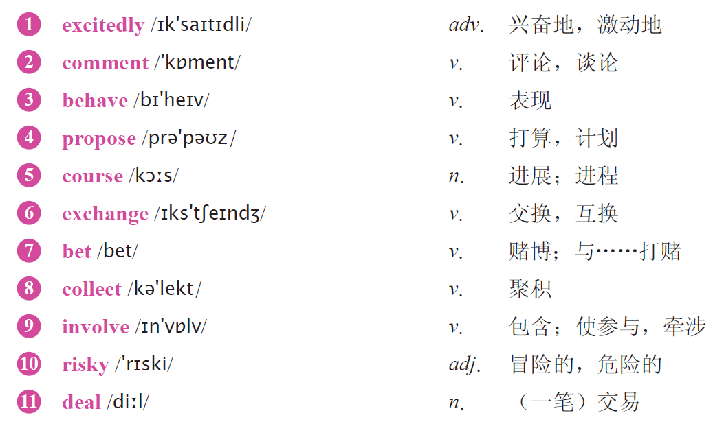
Text B Extensive Reading
A Story About Coins
New Words

Slide 51
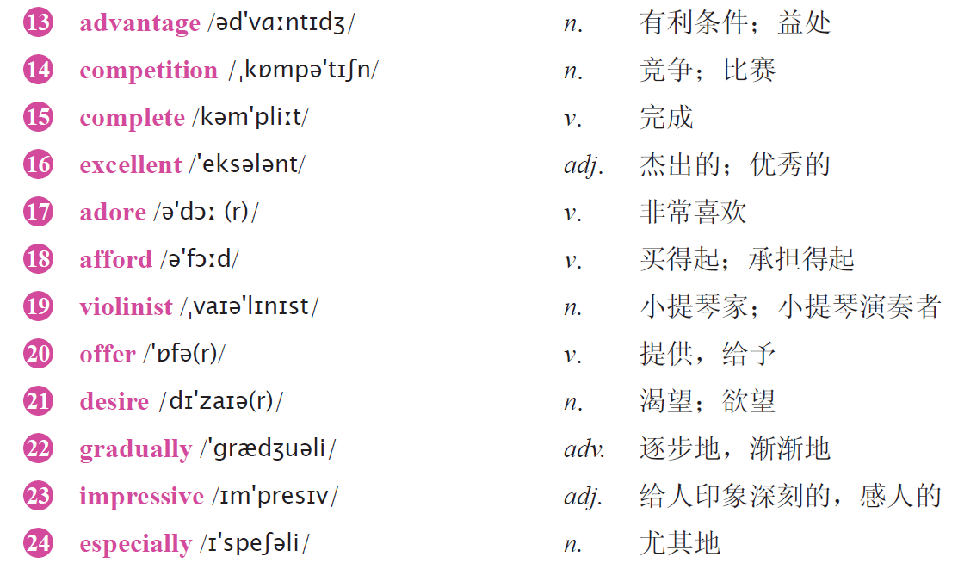


Slide 52
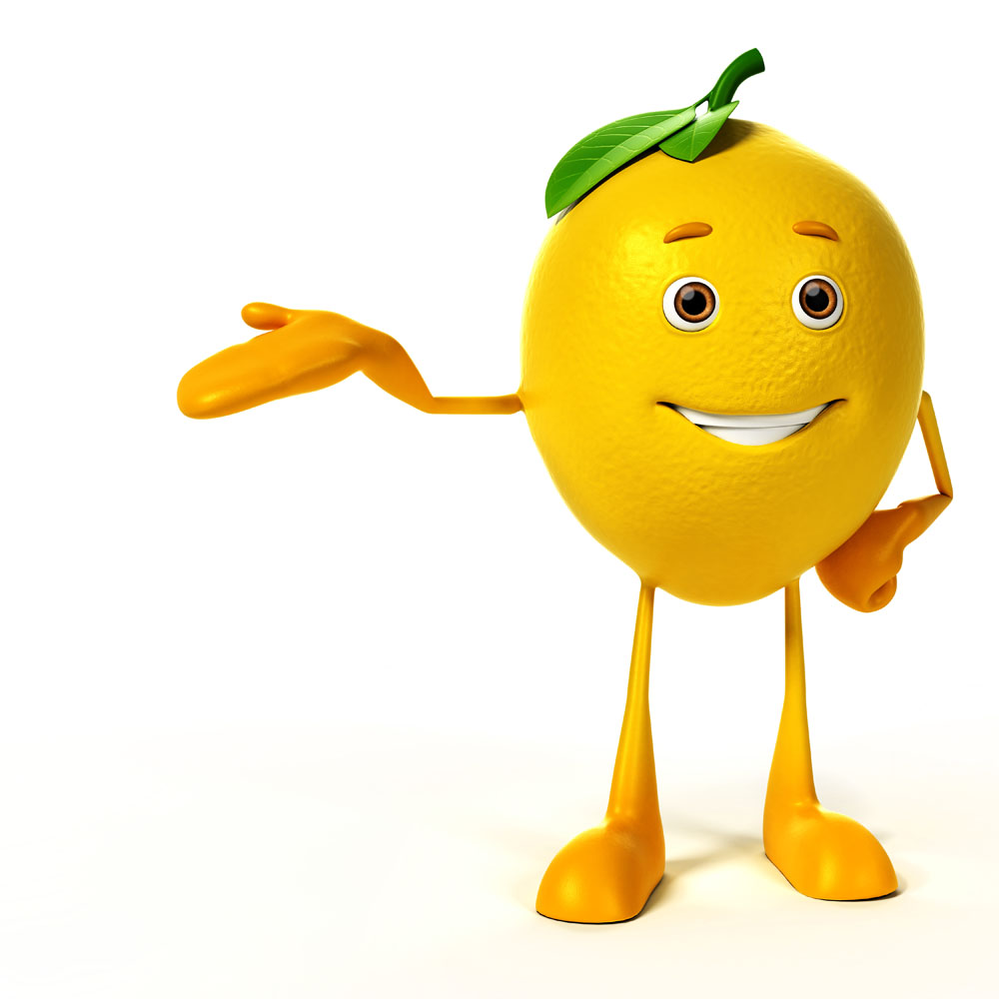
1 run off 跑掉
2 show off 炫耀
3 no longer 不再……
4 even though 即使
5 show up 出现
6 from then on 从那时起
7 What’s more... 另外……，此外……

Slide 53
B
1 What is Julia and her cousins’ exciting moment at their grandparents’ house?
A. Enjoying the big family meal.
B. The moment their grandfather gives them a few coins.
C. Their grandfather’s praising.
D. The candies their grandfather buys for them.
2 Why do the relatives propose a test among the children?
A. They want to ask the children not to eat candies.
B. They want to know what the children will buy with these coins.
C. They want to test if the children will buy candies.
D. They want to know what the children could do to manage those coins.
D

Slide 54
C
3 Which of the following is TRUE about Ruben, Nico and Monty?
A. Ruben and Nico didn’t spend it on sweets any more.
B. Ruben and Nico asked Clara and Joe not to keep saving their money.
C. Monty lost all the money on a horse race at last.
D. Monty collected a lot of money at last through exchanging.
4 What did Alex do with the coins?
A. He saved all the money and collected more money than anyone.
B. He bought sweets at a normal price with the coins.
C. He bought toys with all the coins.
D. He used the coins to buy iron.
A

Slide 55

C
5 Which one is NOT true about Julia?
A. She didn’t have a good time on the competition day.
B. She didn’t complete her plan till the second year.
C. She asked her parents to afford the violin lessons.
D. She surprised everyone by turning up with a violin and much money.

Slide 56
Part 1
Part 2
Part 3
Part 4
Part 5
Part 6
Lead-in
Listening ＆
Speaking
Reading
Grammar
Watching & Performing
Applied Writing

Slide 57
1、一般过去时的基本句式
1）肯定句：① 主语＋ be 动词的过去式（was / were）＋其他
② 主语＋行为动词的过去式＋其他
e.g. He was at home last night. 他昨天晚上在家。
We had classes last week. 上周我们上课了。
2）否定句：① 主语＋ be 动词的过去式（was / were）＋ not ＋其他
② 主语＋ didn’t ＋动词原形＋其他
e.g. He wasn’t at home last night. 他昨天晚上不在家。
We didn’t have classes last week. 上周我们没有上课。

Slide 58
3）一般疑问句：① be 动词的过去式（Was / Were）＋主语＋其他
② Did ＋主语＋动词原形＋其他
e.g. Was he at home last night? 他昨天晚上在家吗？
Did you have classes last week? 你们上周有课吗？
肯定回答：Yes, 主语 ( 常用代词) ＋ be 动词的过去式 (was / were) / did.
e.g. Yes, he was. 是的，他在。 Yes, we did. 是的，我们上课了。
否定回答：No, 主语 ( 常用代词) ＋ be 动词的过去式 (was / were) / did ＋ not.
e.g. No, he wasn’t. 不，他不在。 No, we didn’t. 不，我们没有上课。
4）特殊疑问句：疑问词＋ be 动词的过去式（was / were）＋主语＋其他，或疑问词＋ did ＋主语＋动词原形＋其他
e.g. Where was he last night? 他昨天晚上在哪里？
What did you do last week? 你们上周做什么了？

Slide 59
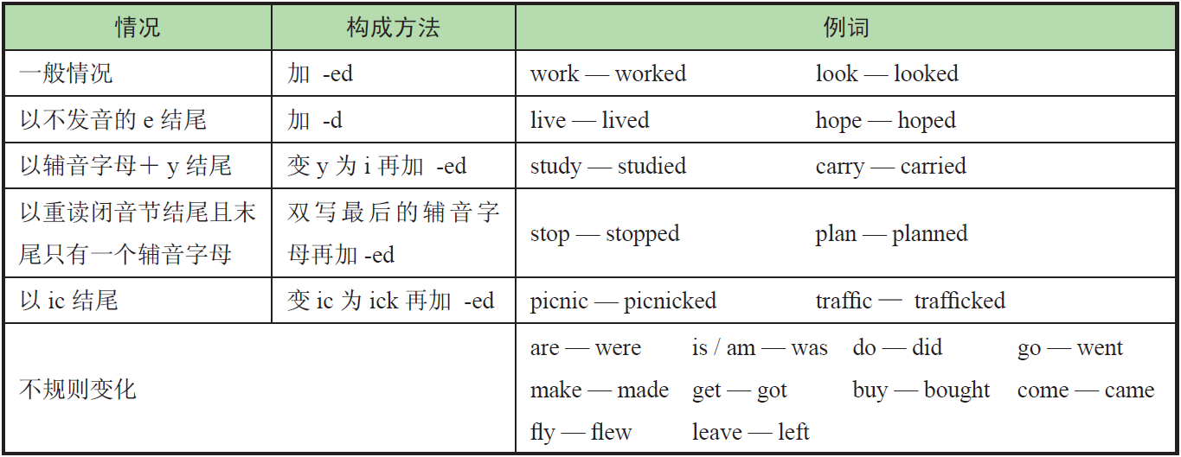
2、动词过去式的变化规则

Slide 60

3、一般过去时的用法
1）表示在过去某个特定时间发生的动作
常与表示过去的时间状语或从句连用，如：yesterday, last week, last year, in 1993, at that time, once, a few days ago 等等。
e.g. I had a word with Julia this morning. 今天早晨，我跟朱莉娅说了几句话。
2）表示在此之前一段时间内经常或反复的动作
常与always，often 等词连用，表示过去经常性的动作。
e.g. Mrs. Peter always carried an umbrella. 彼得太太过去老是带着一把伞。
3）表示出生或死亡的情况多用过去时
表示某人的出生或死亡通常用一般过去时。
e.g. He died in the accident last year. 他在去年的那场事故中去世了。
4）表示说话时已经发生的动作或存在的状态
有些句子，虽然没有表示过去确定时间的状语，但实际上是指过去发生的动作或存在的状态，也要用过去时。
e.g. I didn’t know you were in Paris. 我不知道你在巴黎。

Slide 61
1
Write down the past forms of the verbs.（写出下列动词的过去式形式。）
touched
stayed
cried
1 touch __________ 2 stay __________ 3 cry __________
4 go __________ 5 have __________ 6 come __________
went
had
came
2
Fill in the blanks with the correct forms of the verbs in brackets.（用括号中动词的适当形式填空。）
came
1 Mary ___________ (come) to China last month.
2 There _________ (be) a telephone call for you just now.
3 I listened but ___________ (hear) nothing.
4 Mike _____________ (not go) to bed until 12 o’clock last night.
was
heard
didn’t go

Slide 62

3
Change the sentence patterns according to the directions.（按要求转换句型。）
1 Lucy did her homework at home.（变否定句）
__________________________________________________________________
2 He found some meat in the fridge.（变一般疑问句）
__________________________________________________________________
3 She stayed there for a week.（对划线部分提问）
__________________________________________________________________
4 There was some oranges in the bag.（变一般疑问句）
__________________________________________________________________
Lucy didn’t do her homework at home.
Did he find any meat in the fridge?
How long did she stay there?
Are there any oranges in the bag?

Slide 63
Part 1
Part 2
Part 3
Part 4
Part 5
Part 6
Lead-in
Listening ＆
Speaking
Reading
Grammar
Watching & Performing
Applied Writing

Slide 64

1
Now watch the movie clip. Read the words closely after the speaker so as to improve your short-term memory, pronunciation, stress and intonation by imitating what you hear.
Setting: Derek is chasing Rebecca for her debts, after answering Derek’s call Suze wants to help Rebecca calculating the amount of debts.

Slide 65
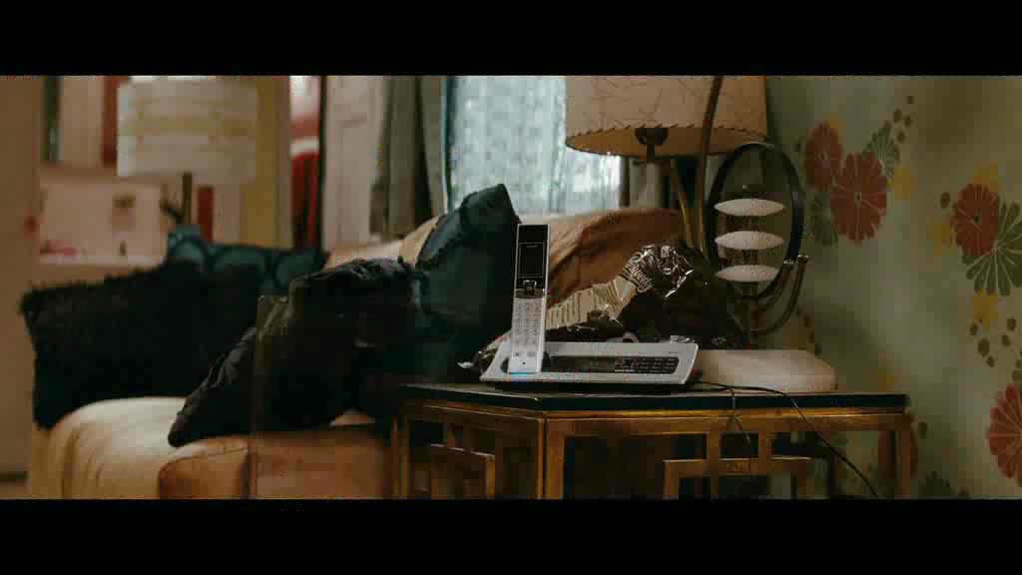

Slide 66

2
Work in pairs. Make a dialogue according to the given situation and useful expressions, and then perform it. The teacher and students in other teams can give a score for the performance. The following score sheet is for your reference.
Situation: You’re on behalf of the company to purchase office supplies on the exhibition. But the supplies are more expensive than last year, so you bargain with the merchant.

Slide 67
3
Read the lines chosen from the movie Dr. Strange (奇异博士) and try to recite them.
1 Be careful which path you travel now. Stronger men than you have lost their way.
人生的旅途中你一定要小心谨慎，因为比你强的人都曾迷失过方向。
2 Not everything makes sense. Not everything has to.
不是每件事都解释得通，也不是每件事都有必要解释。
3 Sometimes one must break the rules.
有时候人总得打破常规。

Slide 68
Part 1
Part 2
Part 3
Part 4
Part 5
Part 6
Lead-in
Listening ＆
Speaking
Reading
Grammar
Watching & Performing
Applied Writing

Slide 69
What does Money mean to you? Money can be or should be earned through hard working? Watch the video and give your opinion.
http://mp.weixin.qq.com/s?__biz=MjM5NjM2MjA4NA==&mid=2650929387&idx=1&sn=cd86bb182b861b2ed5f6d5077fd3bbc7&chksm=bd1f3ae08a68b3f6261817bd01e23069ba9cb4627d11bfb407cf6c0bd173cd8c1f4c8f87fcee&mpshare=1&scene=23&srcid=1205oo8obGazci6EMt6EKpcI&sharer_sharetime=1638671406072&sharer_shareid=03040d1e7c960cc307d17fbc25563a26#rd

