Slide 2
Unit Objectives:
Knowledge and skill（知识、技能目标）:
1.Students should be able to talk about new lifestyles and changes in modern society.
2.Student should acquire the new words and expressions.
3.Students should grasp the usage of the present tense
4.Students should grasp the principle of invitation and reply
Feelings, attitudes and values（情感、态度和价值观目标）:
Students should be able to be more creative and open-minded.

Slide 3
Unit Objectives:
Ideological and Political Aims（思政目标）
1.Students should know what is new lifestyles
2.Students should know how to set up a correct view of new lifestyles
3.Students should fill with happiness, peace and contribution in their mind.

Slide 4
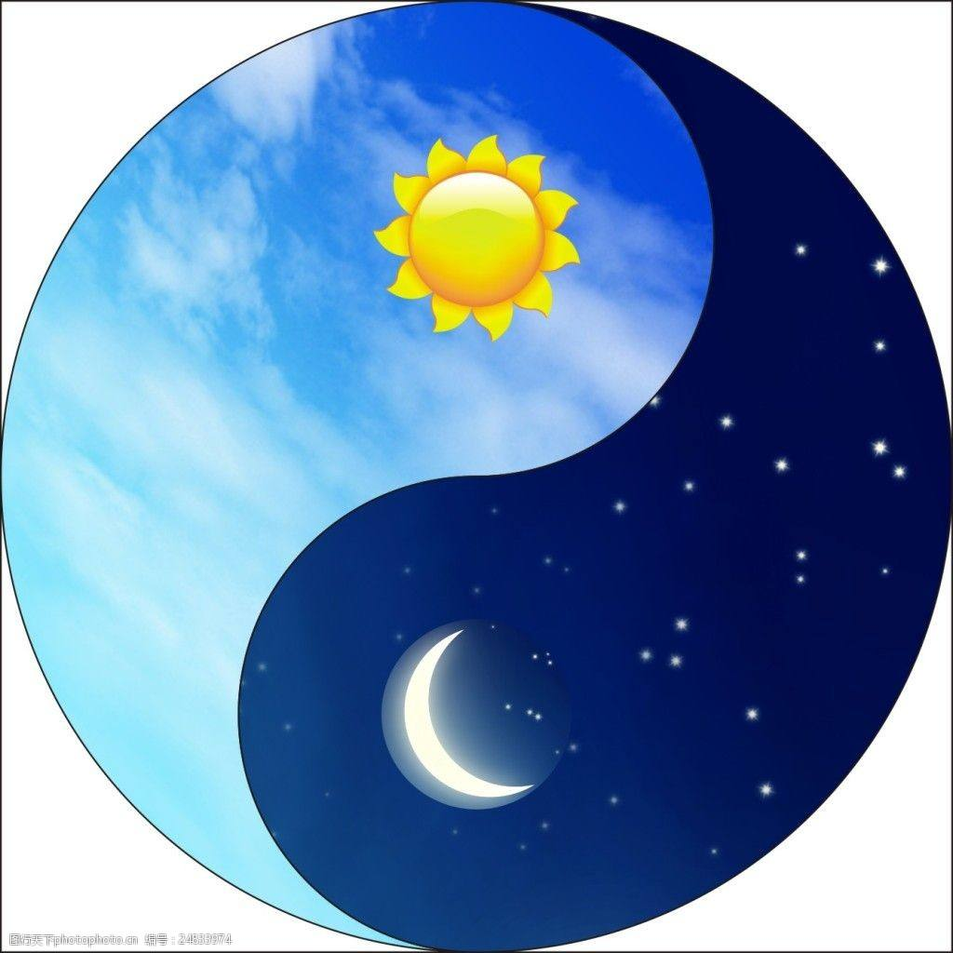
Do you think it is necessary to follow the traditional Chinese living style by following the movement of natural phenomenon?

Slide 5
Part 1
Part 2
Part 3
Part 4
Part 5
Part 6
Lead-in
Listening ＆
Speaking
Reading
Grammar
Watching & Performing
Applied Writing

Slide 6
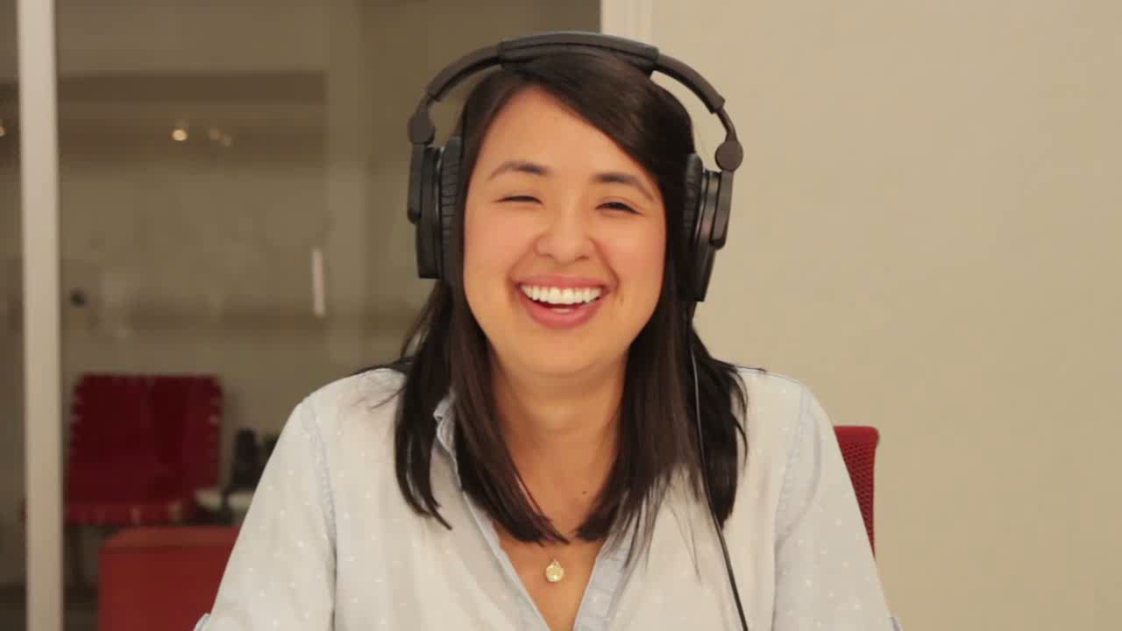
1
There are many technology products and services making our life easier and more joyful. Watch the video and then choose one thing from the items that you can’t live without and explain the reason in one sentence.

Slide 7

Wi-Fi
food delivery ( 外卖)
computer express
cell phone
mobile payment
cell phone data
online shop
I feel bored and don’t know what to do.

Slide 8
2
Watch the video again and choose the correct words to fill in the blanks.
What am I supposed to do right now? I feel bored, I don’t know what to do. I feel bored, what do I do when I don’t have the __________? Do none of us talk to each other anymore? Where is the Wi-Fi? I don’t… No one is _____________. I don’t understand. I’m never gonna see a _______ cat on the Internet again.
Wait, maybe this isn’t so bad. Maybe I’ll have more time to do the things I’ve been meaning to do. I’ll be so free! There’s _________, there’s _________, there’s things to be seen! Maybe life will be better without… (Wi-Fi is back on.) Oh thank god! Oh, phew ( 哎呀)! Now back to what I was doing.
Internet
connected
funny
nature
beauty

Slide 9
3
Match the words to form phrases about new lifestyles and then make a sentence with each phrase.
online shopping
online sharing ( 共享) ____________________________________
mobile lifestyle ____________________________________
bike payment ____________________________________
low-carbon ( 低碳的) pooling ( 共用) ____________________________________
car shopping ____________________________________
electric delivery ____________________________________
express ( 快捷的) car ____________________________________
mobile payment
bike sharing
low-carbon (低碳的) lifestyle
car pooling
electric car
express delivery

Slide 10
Part 1
Part 2
Part 3
Part 4
Part 5
Part 6
Lead-in
Listening ＆
Speaking
Reading
Grammar
Watching & Performing
Applied Writing

Slide 11
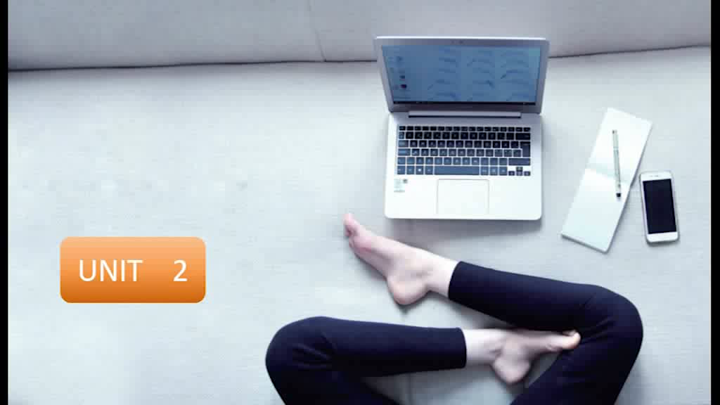
1
Listen to the dialogues and fill in the blanks.

Slide 12
Words and Expressions
convenient 方便的 open an account 开户
online bank 网上银行 revolution 改革；革命
simulate 模仿 rush hours 交通拥挤时间
traffic jam 交通拥堵 get off work 下班

Slide 13
Dialogue 1
online
S: Aunt Cindy, do you shop ___________ often?
C: Yes. It’s very convenient and the price is even ___________.
S: Last week, I tried to buy some books online, but I didn’t know how to pay for them.
C: You should open an account at the online bank first.
S: Are there many things online?
C: Sure. You can fi nd things all over the ___________. Let’s check it out online!
S: That’s amazing. Oh, an online virtual supermarket?
C: Let’s ___________ to check it out.
S: Oh, I got it. It simulates the real supermarket, which makes it feel so real. Mom will love it. She loves shopping in supermarkets.
C: No doubt about it. Shopping online will get more and more ___________. It’s a real revolution
about people’s consuming habits.
lower
world
click
popular

Slide 14
Dialogue 2
A: Here we are on the subway.
M: Yes, we are travelling in rush hours. It could be very crowded in the ___________ and after 6
o’clock in the afternoon.
A: I heard that many people ____________.
M: Yes, many families have their own cars.
A: Why don’t they drive? Isn’t a car more convenient than the subway?
M: Well, it is _______ to find a parking place in the city. Besides, parking is expensive in the downtown.
A: I see. I saw many public bicycles ___________ the subway station. I think we can go back home
by bike ____________.
M: OK. Bike riding will help us do some exercise. And we won’t have to worry about traffic jam
after getting off work.
morning
have cars
hard
near
tomorrow

Slide 15
2
Listen to the dialogues again and check your answers, and then make a dialogue according to the situation given below. The following sentence patterns are for your reference.
Situation: You are going to ride a bicycle with your friend to go out of campus. You find that all the bikes around you are broken or unavailable. So you decide to go further and find the good ones. On the way you start talking about bike sharing.

Slide 16
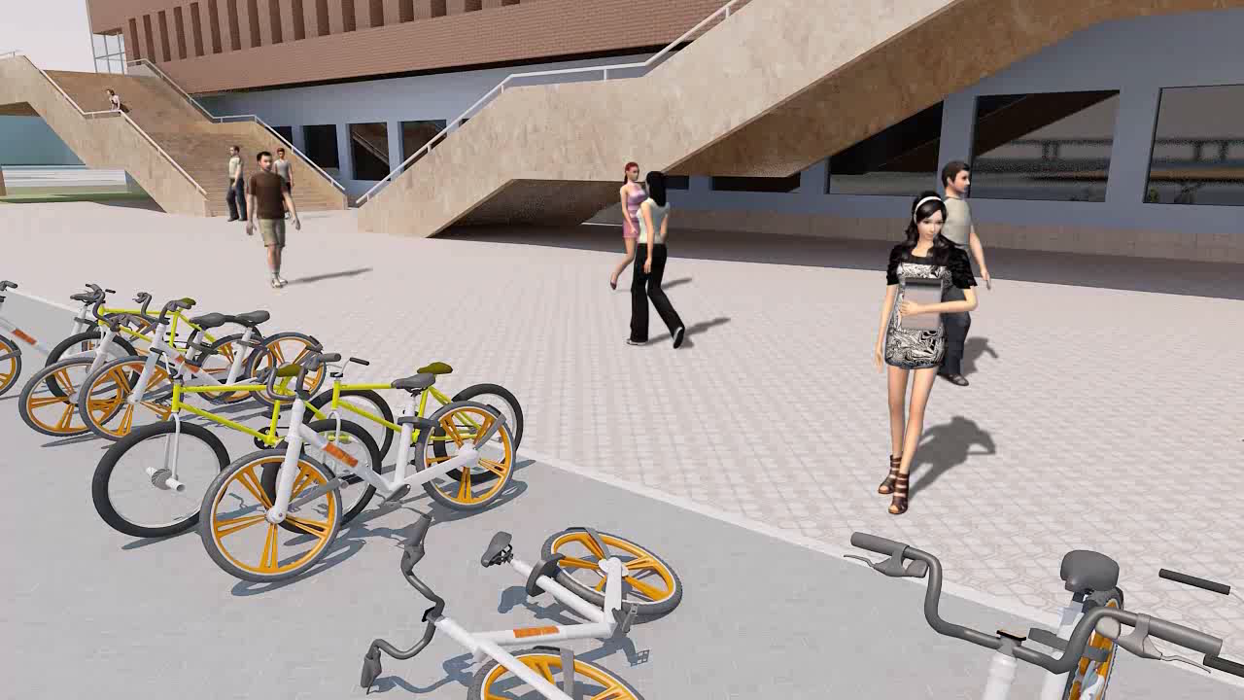

Slide 17
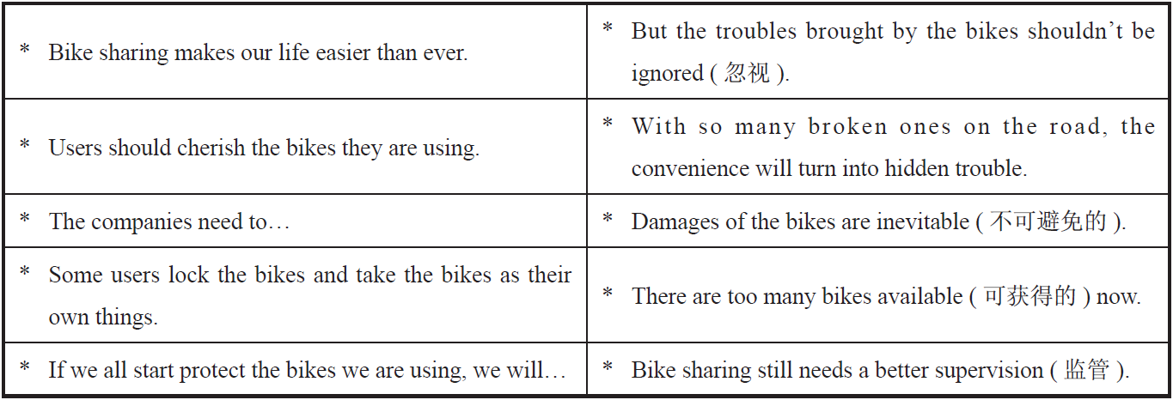

Slide 18


Slide 19

3
Listen to the song Amazing Life and fill in the blanks.
given
It’s a beau-, beau-, beautiful world we’ve been ___________
From the top of the sky to the ocean
I’ll never understand it all (understand it all)
It must be supernatural ( 超自然的)
It’s a ma-, ma-, magical thing, a starry night
Feel, feel so small under a billion lights
Never understand it all (never understand it all)
It must be supernatural
Amazing life, amazing life
___________ higher than I’ve ever dreamed
From the top of the world I could scream
Amazing life, amazing life
Flying

Slide 20


bright
It’s a colorful, colorful world painted so ___________
Gonna walk on air, gonna take flight
I’ll never understand it all (never understand it all)
It must be supernatural
I wanna drink, drink, drink every drop of sunshine
Got a smile on my face, I won’t apologize
I’ll never understand it all (never understand it all)
It must be supernatural
You’re the burning in my heart that never dies, never dies
Without you here my world is black and white, black and white
Like a show without a ___________
Like a storm without the rain
You’re the one I can’t ___________
Need you by my side
Need you by my side
stage
replace

Slide 21
Part 1
Part 2
Part 3
Part 4
Part 5
Part 6
Lead-in
Listening ＆
Speaking
Reading
Grammar
Watching & Performing
Applied Writing

Slide 22


Slide 23
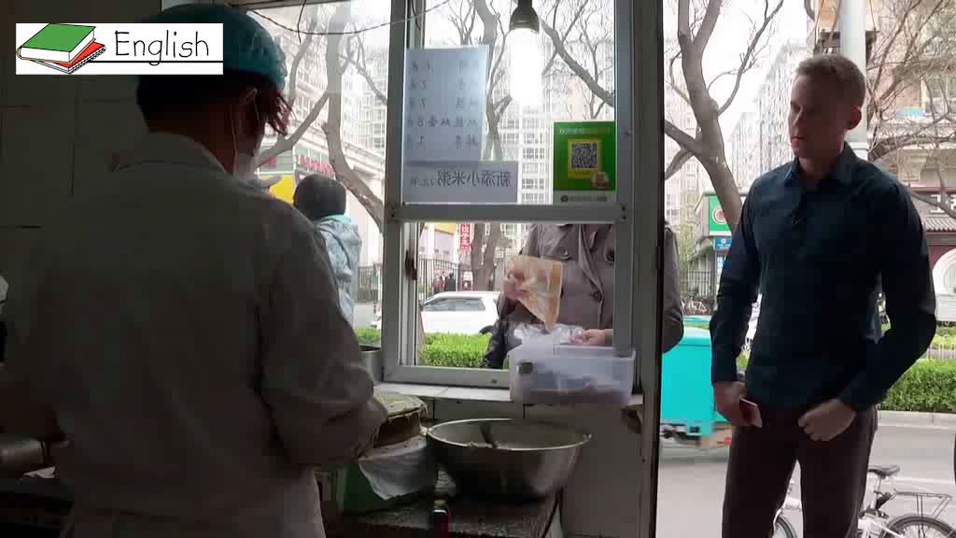

Slide 24

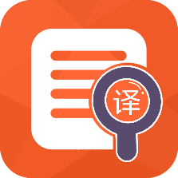



Part Ⅲ
Text A Intensive Reading 1
Minimalism¹: Can Living with Less Make You Happier?
★ single /'sɪŋɡl/ adj.
(a) not married; not having a girlfriend or boyfriend 未婚的；单身publishing /'pʌblɪʃɪŋ/ n. 出版；发行的
e.g. It is difficult being a single mother.
做一个单身妈妈不容易。
(b) (a room) intended for one person to stay or live in 单人的
e.g. It is $65 for a single and $98 for a double.
单人间65美元一晚，双人间98美元一晚。
1 Let me tell you a bit about myself. I’m 35 years old, male, single², never been married. I work as an editor³ at a publishing⁴ company. Some of you may think that I’m a loser⁵: an unmarried adult with not much money. But I honestly don’t care about things like that any more. The reason is very simple: I’m perfectly happy just as I am.
极简主义：生活简单会带给你幸福吗？
我先来简单介绍下自己：35岁，男，单身，从未结过婚，在一家出版公司当编辑。你们中的一些人可能会认为我是个失败者——一个没什么钱的未婚成年人。但我真的不在乎这样的事情。原因很简单：我非常快乐。
★ minimalism /'mɪnɪməlɪzm/
n. 简约主义，极简主义
★ publishing /'pʌblɪʃɪŋ/ n. 出版；发行
★ editor /'edɪtə(r)/ n. 编辑，编者
★ loser /'luːzə(r)/ n. 失败者
★ care about 关心；在乎
e.g. You don’t care about anything but yourself and your precious face.
除了你自己和那张娇贵的脸，你什么都不关心。

Slide 25
Part Ⅲ
Text A Intensive Reading 2-3
★ essential /ɪ'senʃl/
adj. completely necessary; extremely important
完全必要的；必不可少的
e.g. Money is not essential to happiness.
金钱对于幸福并非必不可少。
n. sth. that is needed in a particular situation or in order to do a particular thing
必不可少的东西；必需品（意同Text B中的necessity）
e.g. The studio had all the essentials like heating and running water.
工作室里备有基本设施，如暖气装置和自来水。
2 The reason? I got rid⁶ of most of my material⁷ possessions⁸.
3 Minimalism is a lifestyle⁹ in which you reduce¹⁰ your possessions to the least possible. Living with only the bare essentials¹¹ has not only provided superficial¹² benefits¹³ such as the pleasure¹⁴ of a tidy room or the simple ease¹⁵ of cleaning, but it has also led to a more fundamental¹⁶ shift¹⁷. It has given me a chance to think about what it really means to be happy.
★ got rid of to make yourself free of sb. / sth. that is annoying you 丢掉，扔掉；摆脱
e.g. We got rid of all the old furniture.
我们扔掉了所有的旧家具。
I can’t get rid of this headache.
我的头疼老也不好。
★ material /mə'tɪəriəl/ adj. 物质的
★ shift /ʃɪft/ n.
(a) a change in position or direction 改变；转移
e.g. fundamental shift 根本的改变
(b) a period of time worked by a group of workers who start work as another group finishes 轮班
e.g. to work an eight-hour shift
按每班八小时轮班工作
Language Point:
Living with only the bare essentials为现在分词做主语，谓语动词为单数。
★ possession /pə'zɛʃən/
n. sth. that you own or have with you at a particular time
个人财产；私人物品
e.g. This ring is one of her most treasured possessions.
这只戒指是她最珍贵的财产之一。
原因何在？很大程度上，是因为我摆脱了物质财富的束缚。
极简主义是将物质财富减到最少的一种生活方式。只依靠简单的必需品生活，不仅使我获得了表面上的好处，如一个简单整洁、容易打扫的房间，更为我带来了最根本的转变。它使我有机会思考幸福的真正含义。
★ lifestyle /'laɪfstaɪl/ n. 生活方式；工作方式
★ reduce /rɪ'djuːs/ v. 减少，缩小
★ superficial /ˌsuːpə'fɪʃl/
adj. (often disapproving) not studying or looking at sth. thoroughly; seeing only what is obvious 表面的；粗略的；肤浅的
e.g. The book shows only a superficial understanding of the historical context.
这部书表现出对历史背景肤浅的理解。
★ benefit /'benɪfɪt/ n. 益处，好处
★ pleasure /'pleʒə(r)/ n. 愉快，令人高兴的事
★ lead to 导致
e.g. Technological changes will inevitably lead to unemployment
技术变革必然会导致失业。
★ ease /iːz/ n. 舒适，自在
★ fundamental /ˌfʌndə'mentl/
adj. 十分重大的，根本的

Slide 26
Part Ⅲ
Text A Intensive Reading 4
4 So I said goodbye to a lot of things, many of which I’d had for years. And yet now I live each day with a happier spirit¹⁸. I feel more content¹⁹ now than I ever did in the past.
★ content /'kɒntent/
n. the things that are contained in sth.
内容；所包含的东西
e.g. He tipped the contents of the bag onto the table.
他把包里的东西倒在桌上。
(b) adj. happy or satisfied 满意的；知足的
e.g. I’m perfectly content with the way the campaign has gone.
我对竞选活动的进展十分满意。
因此，我舍弃了许多保存多年的东西。而现在，我每天都过着快乐的生活。我比过去更感到满足。
★ spirit /'spɪrɪt/ n. 情绪；心境

Slide 27
Part Ⅲ
Text A Intensive Reading 5
5 I wasn’t always a minimalist²⁰. I used to buy a lot of things, believing that all those possessions would increase my self-worth and lead to a happier life. At the same time, though, I was always comparing myself with other people who had more or better things, which often made me miserable²¹. I couldn’t focus²² on anything, and I was always wasting time.
★ minimalist /'mɪnɪməlɪst/ n. 简约主义者
★ used to 过去时常
e.g. I used to live in London. 我过去住在伦敦。
Language Point:
believing that… 为现在分词做伴随状语。其中that后的内容为believe的宾语。
在过去，我并不总是一个极简主义者。我过去常常买很多东西，并相信所有这些物品能够提升我的自我价值，并使我过上更幸福的生活。同时，我总是把自己与那些拥有更多或更好东西的人进行比较。这常常使我感到痛苦，使我不能集中精力做任何事情，浪费了很多时间。
★ compare with... 和……比较
e.g. Write down a list and compare with your partner.
★ miserable /'mɪzrəbl/
adj. 痛苦的，非常难受的
★ focus on... 致力于；使聚焦于
e.g. Today we’re going to focus on the question of air pollution

Slide 28
Part Ⅲ
Text A Intensive Reading 6
6 On a usual day, there were books stacked²³ everywhere in my apartment because there wasn’t enough room on my bookshelves. Most I had thumbed²⁴ through once or twice, thinking that I would read them when I had time.
★ thumb /θʌm/
v. to touch or move sth. with your thumb 用拇指摸
e.g. She thumbed through the book on the shelf.
她翻阅了书架上那本书。
thumb through 浏览，快速翻阅
e.g. He had the drawer open and was thumbing through the files.
他打开抽屉，翻看着档案。
由于书架上空间不够，我的房间常常到处堆满了书。这些书中大部分我只翻阅过一两次，以为等有时间了就会拿来阅读。
★ stack /stæk/ v. 堆成堆，一堆

Slide 29
Part Ⅲ
Text A Intensive Reading 7
7 The closet²⁵ was crammed²⁶ with what used to be my favorite clothes, most of which I’d only worn a few times. The room was filled with all the things I’d taken up as hobbies and then gotten tired of. There were some conversational English workbooks I’d planned to study once I had more free time.
★ closet /'klɒzɪt/ n. 储藏室，衣柜
★ cram /kræm/
to push or force sb. / sth. into a small space
把……塞进；塞满
be crammed with 塞满；堆满
e.g. The house is crammed with priceless furniture and works of art.
房子里摆满了昂贵的家具和艺术品。
衣柜里塞满了我最喜欢的衣服，大部分只穿了几次。房间里堆满了许多我心血来潮买的东西，最后却被搁置。还有不少我计划在空闲时间拿来学习的英语会话练习册。

Slide 30
Part Ⅲ
Text A Intensive Reading 8-10
8 But by having fewer things around, I’ve started feeling happier each day. I’m slowly beginning to understand what happiness is.
9 After what I’ve been through, I think saying goodbye to your things is more than an exercise in tidying up. I think it’s an exercise in learning about true happiness.
10 Maybe that sounds grandiose²⁷. But I seriously think it’s true.
但是，当身边的东西变少了，我却开始变得更加快乐。慢慢地，我开始明白什么是幸福。
在这之后，我认为，舍弃一些东西不仅仅是一种整理，更是学会幸福的一项练习。
也许这一切听起来很夸张，但在我看来，事实如此。
★ grandiose /'grændiəʊs/ adj. 华而不实的，浮夸的

Slide 31

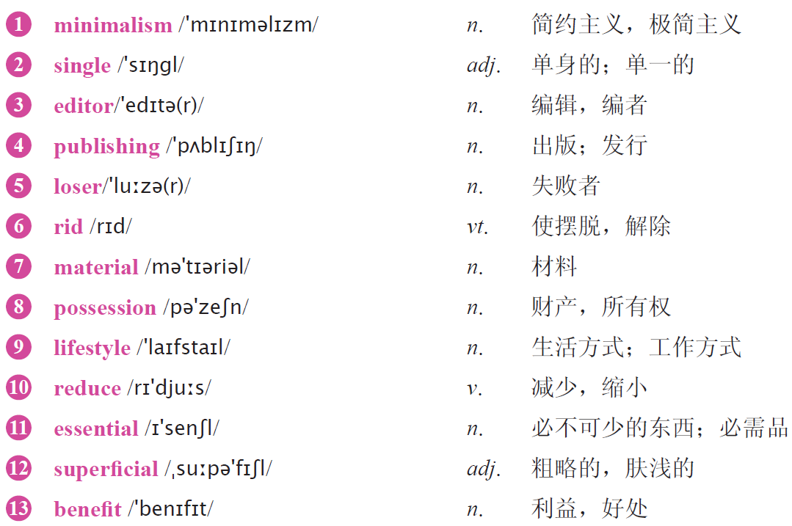
Text A Intensive Reading
Minimalism : Can Living with Less Make You Happier?
New Words

Slide 32
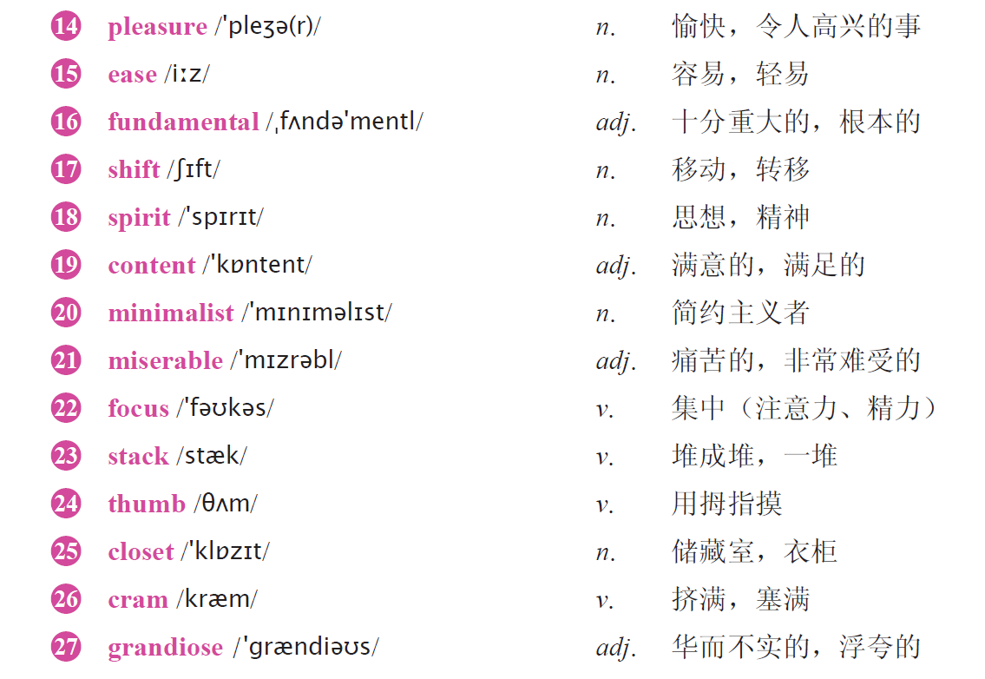


Slide 33

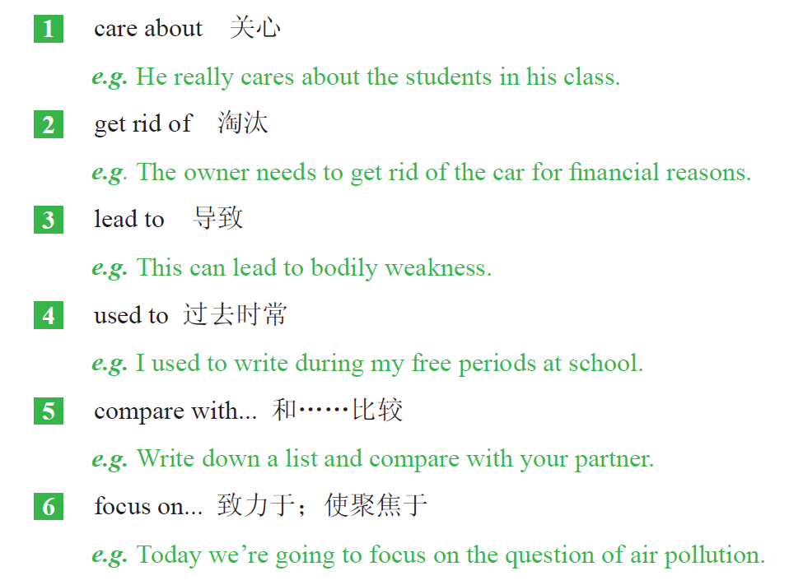

Slide 34

1 Living with only the bare essentials has not only provided superficial benefits such as the pleasure of a tidy room or the simple ease of cleaning, but it has also led to a more fundamental shift. (Para. 3)
Living with only the bare essentials 是动名词短语作主语，谓语动词用单数形式。not only... but also… 是固定用法，意思是“不仅……而且……”。
2 At the same time, though, I was always comparing myself with other people who had more or better things, which often made me miserable. (Para. 5)
though 是连词，意思是“虽然，尽管”，表示转折的关系。who had more or better things 是定语从句，修饰限定先行词other people。which 引导的是非限定性定语从句，修饰前面的一整句话。

Slide 35
3 On a usual day, there were books stacked everywhere in my apartment because there wasn’t enough room on my bookshelves. (Para. 6)
on a usual day 意思是“在一个平常的日子里”。“there were books…”是there be 句型，表示某处存在有某物。because there wasn’t enough room on my bookshelves 是由because 引导的原因状语从句。
4 After what I’ve been through, I think saying goodbye to your things is more than an exercise in tidying up. (Para. 9)
what I’ve been through 是what 引导的名词性从句，作介词after 的宾语。be through 意思是“完成，做完”。saying goodbye to your things is more than an exercise in tidying up 作think 的宾语，省略了关系词that，saying goodbye to your things 是动名词短语作主语，谓语动词用单数形式。More than 在此句中的意思是“不仅仅是，不只是”。

Slide 36


1
Read Text A and then complete the following passage.
buy
Before I was a minimalist, I used to _______ a lot of things, _________ with others and I could __________ focus on anything. After I was a minimalist, I have __________ things around, and I have started feeling ___________each day than before, and beginning to understand what _____________ is.
compare
not
fewer
happier
happiness

Slide 37

2
Answer the following questions and then discuss with your partners.
1 How did the author feel when he had a lot of things around?
2 How did the author feel when he had fewer things?
3 Why did the author change so much?

Slide 38
3
Please read the 3rd paragraph aloud and recite it.
Minimalism is a lifestyle in which you reduce your possessions to the least possible. Living with only the bare essentials has not only provided superficial benefits such as the pleasure of a tidy room or the simple ease of cleaning, but it has also led to a more fundamental shift. It has given me a chance to think about what it really means to be happy.

Slide 39
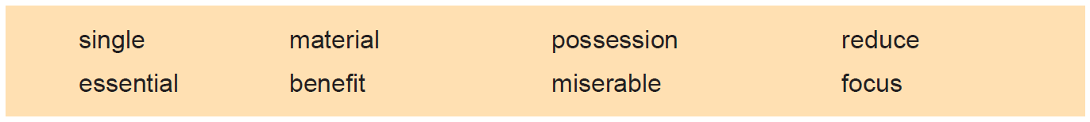
4
Fill in the blanks with the words given below. Change the form where necessary.
essential
It is _____________ that your diet is varied and balanced.
The conference may help to _____________ our attention on the economy.
We should spend the money on something that will _____________ everyone.
They ended by making themselves _____________.
The land is in the _____________ of the merchant.
The company produces its own training _____________.
Costs have been _____________ by 30% in the past years.
These days, work plays an important part in a _____________ woman’s life.
focus
benefit
miserable
possession
material
reduced
single

Slide 40
5
Add -ist, -ness or -ive to the following words to form new words and give the
corresponding Chinese meanings of the new words.
Affix | Words | New Words | Chinese Meanings
-ist | ideal
 | science
 | physics
-ness | kind
 | useful
 | lonely
-ive | effect
 | create
 | progress
idealist
理想主义者
scientist
科学家
physicist
物理学家
kindness
善意
usefulness
有用
loneliness
孤独
effective
有效的
creative
有创造力的
progressive
进步的

Slide 41
6
There are two sentences chosen from the text. Choose the best Chinese translation for each sentence.
A
1 Minimalism is a lifestyle in which you reduce your possessions to the least possible.
A. 极简主义是将自己的财产减到最少的一种生活方式。
B. 极简主义是将自己的财产尽可能减少的一种生活方式。
C. 极简主义是一种生活方式，在这里，你将你的财产减到最少的可能。
2 I used to buy a lot of things, believing that all those possessions would increase my self-worth and lead to a happier life.
A. 我习惯买很多东西，并坚信所有的这些财产能增加我的自尊并导致更幸福的生活。
B. 我习惯买很多东西，并坚信所有的这些财产能增加我的自我价值并导致更幸福的生活。
C. 我过去时常买很多东西，我相信所有的这些财产能够增加我的自尊并会使我过上更幸
福的生活。
C

Slide 42
7
Complete the following sentences with the given sentence structures.
It has given sb. a chance... to do 有机会做……
e.g. It has given me a chance to travel alone. 这给我一个独自旅行的机会。
1 __________________________________________ (这给了她一个向同学学习的机会)
2 __________________________________________ (这给他了一个继续深造的机会)
be filled with... 装满了……
e.g. The bottle is filled with water. 瓶里装满了水。
1 His room_____________________________ (装满了书).
2 The office ____________________________ (充满了奇怪的味道).
It has given her a chance to learn from her classmates.
It has given him a chance to study further.
is filled with books
is filled with strange smell

Slide 43


Slide 44
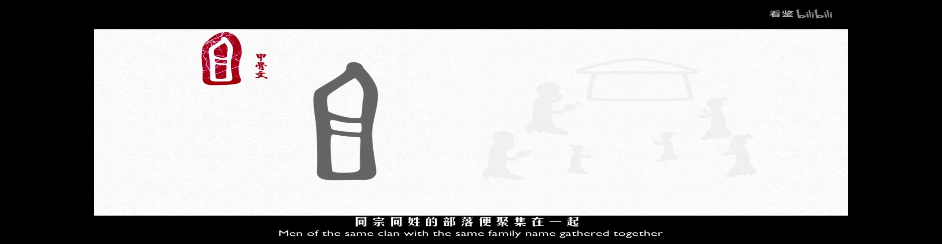
Watch the following video and give your own opinion about the relationship between Chinese character and Chinese peoples’ lifestyles?
https://b23.tv/VavrYgs?share_medium=android&share_source=qq&bbid=XY7BC137649171613BA88827379C5600CA2D3&ts=1638669279780

Slide 45
Part Ⅲ
Text B Extensive Reading 1-2
How to Get by in Beijing Without a Wallet
1 In many places, if you leave the house without your wallet, you’ll be in a tough¹ spot² all day. No way to pay for food, transportation or any of life’s other necessities³.
2 But in China’s largest cities, you can definitely survive without carrying a pocket full of cash and credit⁴ cards — as long as you’ve got your smartphone.
没有钱包在北京怎么生活
在很多地方，如果你出门不带钱包，那么一整天都会过得非常艰难——你没有办法支付食物、交通或其他任何生活必需品的费用。
但在中国的大城市，只要带好智能手机，你无须带装现金和信用卡的钱包，就完全可以活下来。
★ tough /tʌf/ adj. 艰苦的，艰难的
★ spot /spɒt/ n. 地点，场所
★ pay for 为……付钱
e.g. I have had to pay for repairs to the house.
我不得不支付房屋维修费用。
★ necessity /nə'sesəti/ n.
sth. that you must have in order to live properly or do sth. 必需品
e.g. Water is a basic necessity of life.
生命离不开水。
★ credit /ˈkredɪt/ n. 信誉，信用；赊购；赊欠

Slide 46
Part Ⅲ
Text B Extensive Reading 3-4
3 When I lived in the United States, I didn’t pay cash very often but I always carried my credit or debit cards. I wrote checks for my rent and paid most of my bills online.
4 China’s fast-developing mobile⁵ commerce⁶ industry is estimated⁷ to dwarf⁸ that of the U.S., so I set out to see how far a phone would get me in the country’s capital.
我在美国生活的时候，一般都不使用现金支付，但我总是带着信用卡或借记卡，付房租的时候开发票，而且大部分账单都在网上支付。
中国快速发展的移动商业预计将远超美国，所以我打算来到中国首都北京，看看仅带一部手机能让我走多远。
★ estimate /'estɪmət/ v.
to make an approximate judgment or calculation of it 估计；估价；估算
e.g. I estimate that the total cost for treatment will be $12,500.
我估计治疗费用总共有1.25万美元。
be estimated to 据估计……
★ dwarf /dwɔːf/ v.
to make sth. seem small or unimportant compared with sth. else 使显得矮小；使相形见绌
e.g. The old houses were dwarfed by the huge new tower blocks.
这些旧房子在新建的高楼大厦的映衬下显得十分矮小。
★ mobile /ˈməʊbaɪl/ adj. 可移动的
★ commerce /ˈkɒmɜːs/ n. 贸易，商业，商务
★ set out 动身，出发

Slide 47
Part Ⅲ
Text B Extensive Reading 5
5 Admittedly, I was a bit skeptical⁹ about going out an entire day in Beijing without my wallet, but I was surprised to discover just how easy and convenient¹⁰ it is.
★ skeptical /'skeptɪkəl/ adj.
having doubts about sth. 充满怀疑的
be skeptical about 对……表示怀疑
e.g. Others here are more skeptical about the chances for justice being done.
这里的其他人对正义能否得到伸张持更加怀疑的态度。
不可否认，开始我对不带钱包在北京玩一整天这件事表示怀疑。但当我发现这样既简单又方便时，还有些惊喜。
★ convenient /kənˈviːniənt/ adj. 方便的，便利的

Slide 48
Part Ⅲ
Text B Extensive Reading 6
6 I pay for breakfast by scanning a QR code on the window of a hole-in-the-wall restaurant that sells jianbing, a delicious fried crepe¹¹ that’s one of China’s most popular street breakfasts. My purchase¹² costs 6 yuan (about 93 cents) and takes just a few seconds. All I have to do is to input a password¹³ and the transaction¹⁴ is complete.
我在一家煎饼（一种美味的薄煎饼，中国最受欢迎的街头早餐之一）小铺买了早餐，扫了窗户上的二维码付款，一共花了六元（大约93美分），我要做的只是输入密码，整个过程只用了几秒，交易就完成了。
★ crepe /kreɪp/ n. 薄煎饼
★ purchase /ˈpɜːtʃəs/ n. 购买的东西
★ transaction /trænˈzækʃn/ n. 交易，业务
★ password /ˈpɑːswɜːd/ n. 密码，口令

Slide 49
Part Ⅲ
Text B Extensive Reading 7-8
7 At a nearby coffee shop, the barista¹⁵ scans a QR code on my Chinese friend Shen Lu’s phone.
8 As we sip¹⁶ our coffee, Shen Lu pays her household¹⁷ water bill at the table. In seconds, she is able to transfer¹⁸ funds from one of several linked accounts. She regularly uses the same simple process to pay other bills and even her rent.
★ barista /bəˈriːstə/ n. 咖啡馆准备咖啡的员工
在附近的一家咖啡店，店员在我朋友沈璐的手机上扫了一下二维码，我们便完成了支付。
我们喝咖啡时，沈璐用手机支付了水费账单。几秒钟之内，她就在几个绑定账户中完成了转账。她经常用这样简单的方法支付其他账单甚至房租。
★ sip /sɪp/ v. 小口喝，抿
★ household /ˈhaʊshəʊld/ n. 家庭
★ be able to do sth. 有能力做某事
★ transfer /trænsˈfɜː (r)/ v. 转移，搬迁

Slide 50
Part Ⅲ
Text B Extensive Reading 9-10
9 In Beijing, I can also pay by phone for movie tickets, takeout¹⁹ food and to shop for goods for delivery²⁰.
10 I use my phone to hail²¹ a taxi so I can meet Gu Yu, co-founder of a new payment²² app, Mileslife. Ride sharing using a mobile payment app allows us to save money by ordering multiple²³ taxi stops and splitting²⁴ the fare²⁵ at the end.
★takeout /ˈteɪkaʊt/ n. 外卖食品
在北京，我也可以使用手机支付电影票、外卖和网购的商品。
我用手机叫了车去见顾宇。他是一个新型支付应用迈生活的联合创始人。用手机应用支付拼车费用可以给我们省下一笔钱，因为可以预定多个出租车站点，最后把费用都分摊掉。
★ delivery /dɪˈlɪvəri/ n. 传递，递送
★ hail /heɪl/ v. 招手（请出租车或者公共汽车停下）
★ payment /ˈpeɪmənt/ n. 付款，支付
★ multiple /ˈmʌltɪpl/ adj. 数量多的，多种多样的
★ allow sb. to do sth. 允许某人做某事
★ split /splɪt/ v. 分担，分摊
★ fare /feə(r)/ n. 车费

Slide 51
Part Ⅲ
Text B Extensive Reading 11-12
11 After arriving at our destination²⁶ in Beijing’s trendy²⁷ Sanlitun area, we eat lunch and split the check — also using our phones.
12 From tiny street vendors²⁸ to large chains, a huge number of businesses in Beijing accept mobile payments, mostly through popular apps, Alipay and WeChat. This new payment system will save a lot of resources²⁹ and is a kind of low carbon³⁰ living style which will benefit our environment.
★ destination /ˌdestɪˈneɪʃn/ n. 目的地，终点
★ trendy /ˈtrendi/ adj. 时髦的，赶时髦的
在到达北京时尚地标三里屯后，我们吃过午餐，并用手机转账分担了餐费。
从街头小贩到大型连锁商店，北京的很多商家都接受移动支付，主要是通过主流的应用程序支付宝和微信来完成支付。这种新的支付方式将会节省大量的资源，是一种利于环境的低碳生活方式。
★ vendor /ˈvendə(r)/ n. 小贩，摊贩
★ resource /rɪˈsɔːs/ n. 资源；资料
★ carbon /ˈkɑːbən/ n. 碳

Slide 52
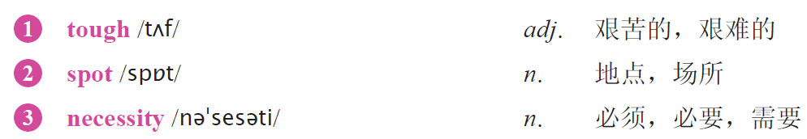
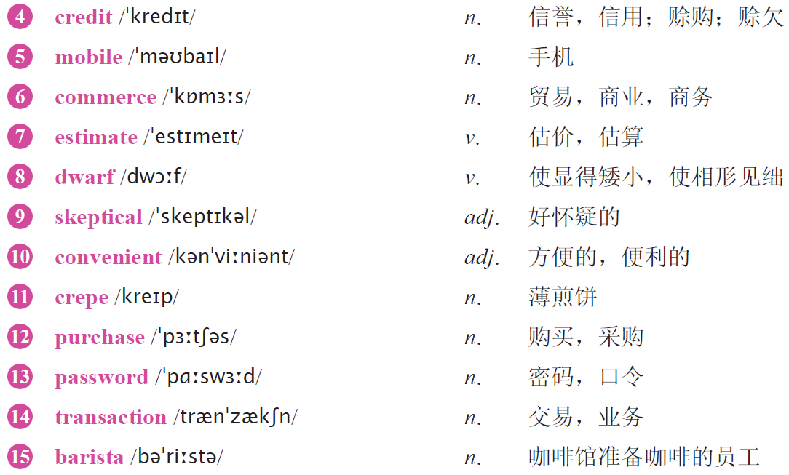
Text B Extensive Reading
How to Get by in Beijing Without a Wallet
New Words

Slide 53
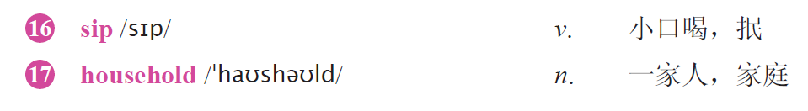

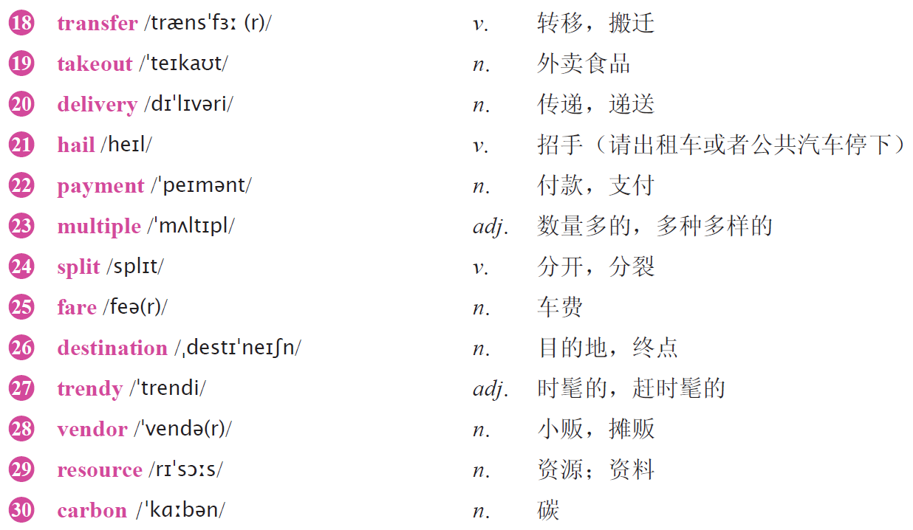

Slide 54

1 pay for 为……付款
2 set out 动身，出发
3 be skeptical about 对……表示怀疑
4 be able to do sth. 有能力做某事
5 allow sb. to do sth. 允许某人做某事

Slide 55

1 In many places, if you leave the house without your wallet, you’ll usually have a ___________ time.
A. good B. wonderful C. difficult D. great
2 When the author lived in the United States, how did he usually pay?
A. Credit cards. B. Debit cards. C. Checks.
D. All of the above.
3 In Beijing, we can pay by phone for ______________.
A. movie ticket B. takeout food
C. goods for delivery D. all of the above.
C
D
D

Slide 56
A
4 Which one of the following statements is NOT true according to the text?
A. All kinds of phones can be used to pay for bills.
B. Mobile commerce industry is developing fast in China.
C. The author found that the mobile payment is very easy and convenient.
D. The mobile payment is friendly to our environment.
5 What is the author’s attitude towards the mobile payments?
A. Negative. B. Positive. C. Don’t care. D. Neutral.
B

Slide 57
Part 1
Part 2
Part 3
Part 4
Part 5
Part 6
Lead-in
Listening ＆
Speaking
Reading
Grammar
Watching & Performing
Applied Writing

Slide 58
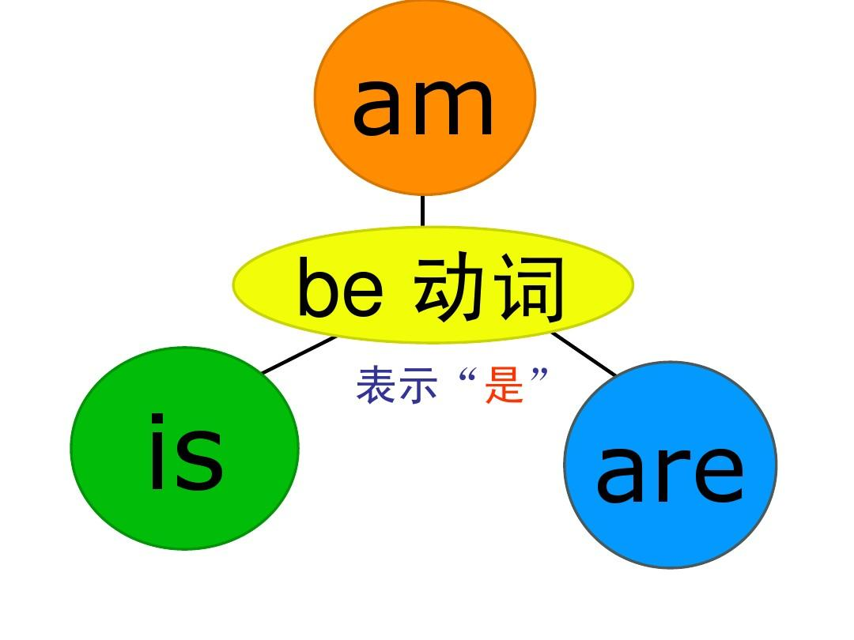
1、be 动词的一般现在时
be 动词的一般现在时形式有am，is，are三种。主语是第一人称单数形式时用am；主语是第三人称单数形式时用is；主语是复数或第二人称单数形式时用are。

Slide 59
1、be 动词的一般现在时
一般疑问句：Be (Am, Is, Are) ＋主语＋其他
e.g. Is he a worker? 他是个工人吗？
肯定回答：Yes, 主语 ( 代词) ＋ be (am, is, are).
e.g. Yes, he is. 是的，他是。
否定回答：No, 主语 ( 代词) ＋ be (am, is, are) ＋ not.
e.g. No, he isn’t. 不，他不是。
be 动词的一般现在时的句式：
否定句：主语＋ be (am, is, are) ＋ not ＋其他
e.g. He is not a worker. 他不是个工人。
2
3
1
4
肯定句：主语＋ be (am, is, are) ＋其他
e.g. He is a worker. 他是个工人。
特殊疑问句：疑问词＋ be (am, is, are) ＋其他
e.g. What color is that bird? 那只鸟是什么颜色的？

Slide 60
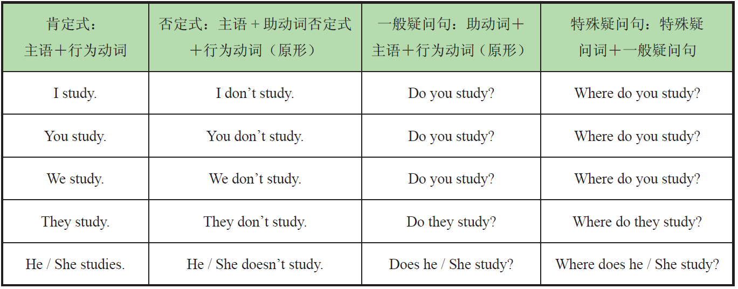
2、行为动词的一般现在时
行为动词的一般现在时结构如下，以study 一词为例：

Slide 61
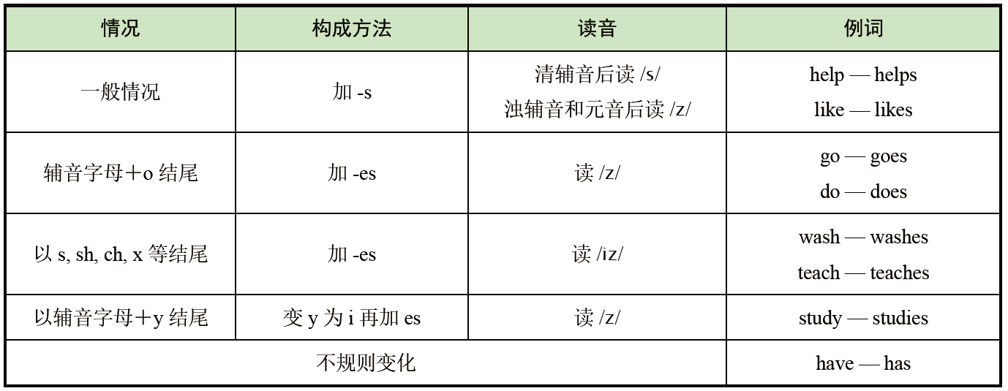
主语为第三人称单数时，行为动词的变化规则如下：

Slide 62
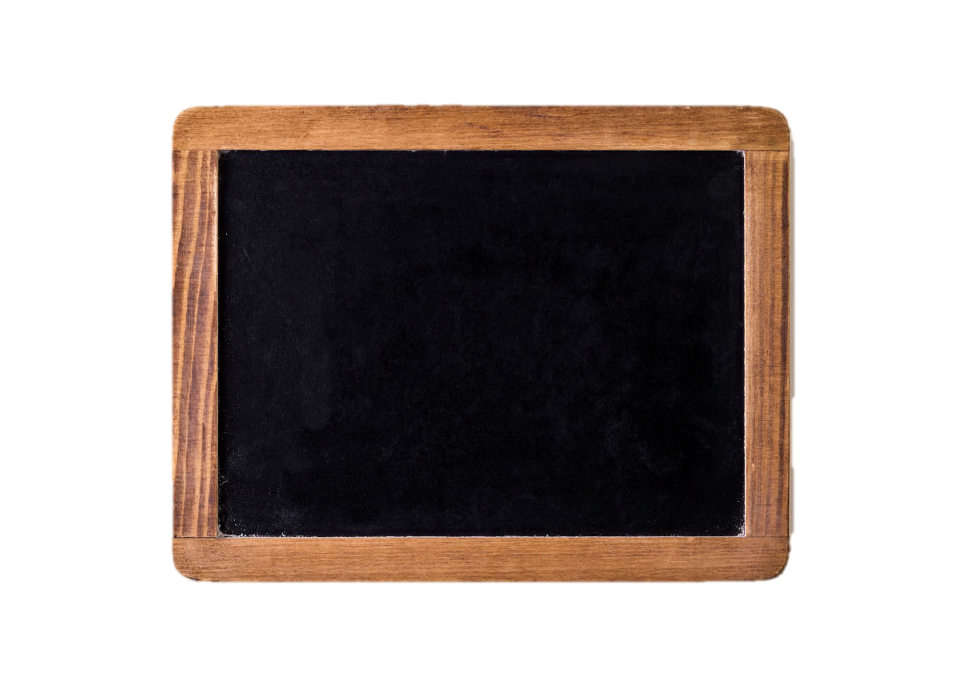
3、一般现在时的基本用法
1）表示经常性或习惯性的动作，常和时间状语连用
e.g. I get up at 7:00 every morning. 我每天早上七点起床。
2）表示客观真理、客观存在的科学事实
e.g. Shanghai lies in the east of China. 上海位于中国东部。
3）表示现在时刻的状态、能力、性格、个性
e.g. He sings well. 他唱歌唱得好。

Slide 63
1
Fill in the blanks with the correct forms of be verbs.（用be动词的适当形式填空。）
am
1 I ________ (be) from Australia.
2 She _______ (be) a student.
3 Jane and Tom _________ (be) my friends.
is
are
2
Write down the third person singular forms of the verbs.
（写出下列动词的第三人称单数形式。）
writes
flies
cries
1 write __________ 2 fly __________ 3 cry __________
4 go __________ 5 have __________ 6 watch _____________
goes
has
watches

Slide 64

3
Change the sentence patterns according to the directions.（按要求转换句型。）
1 Peter has breakfast every day.
否定句：___________________________________________________________.
一般疑问句：_______________________________________________________?
肯定回答：_______________________.
否定回答：_________________________.
2 They live in our city.
否定句：___________________________________.
对划线部分提问的特殊疑问句：_____________________________?
Peter doesn’t have breakfast every day
Does Peter have breakfast every day
Yes, he does
No, he doesn’t
They don’t live in our city
Do they live in our city

Slide 65
Part 1
Part 2
Part 3
Part 4
Part 5
Part 6
Lead-in
Listening ＆
Speaking
Reading
Grammar
Watching & Performing
Applied Writing

Slide 66

1
Now watch the movie clip. Read the words closely after the speaker so as to improve
your short-term memory, pronunciation, stress and intonation by imitating what you hear.
Setting: Tadashi brings Hiro to his lab and his friends show Hiro their experimental achievements. Hiro wants to know what Tadashi is working on.

Slide 67
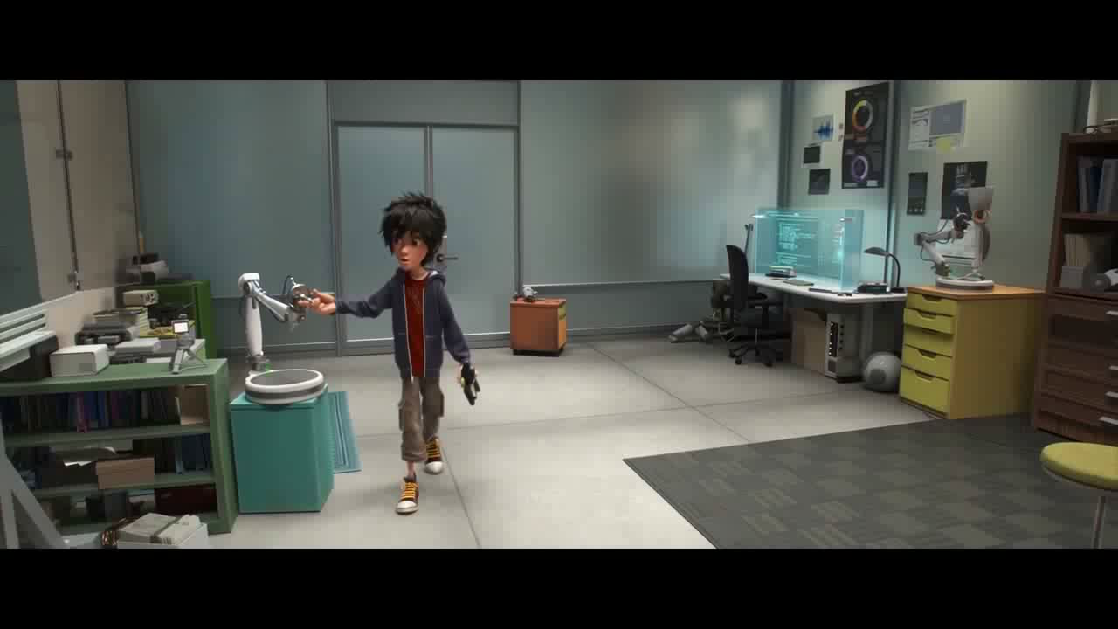

Slide 68
2
Work in pairs. Perform the business dinner situations with the correct and polite table manners. The teacher and students in other teams can give a score for the performance. The following score sheet is for your reference.
Situation: In this video, Brain did something wrong or impolite. Please pick them out and perform the situation in the polite manners.

Slide 69
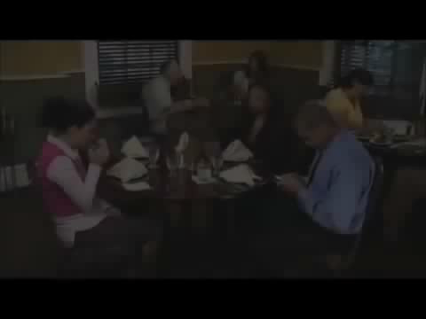

Slide 70
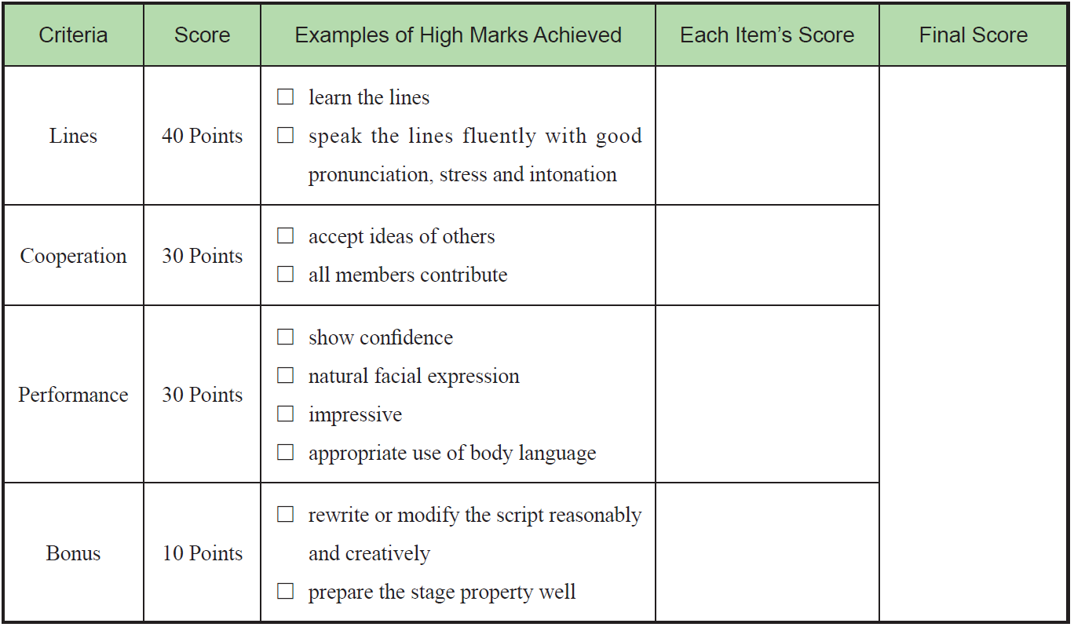

Slide 71
3
Read the lines from the movie Guardians of the Galaxy 2 (银河护卫队2) and try to recite them.
1 Whatever nightmares the future holds, are dreams compared to what’s behind me.
无论未来有多凄惨，跟我的过去相比都不算什么。
2 Sometimes, the thing you’ve been looking for your whole life is right there beside you all along.
有时候你穷极一生寻找的一直都在你的身边从未离开过。
3 When you’re ugly and someone loves you, it means they love you for who you are.
当你丑时依然有人爱你，意味着他们爱的是你这个人而非外表。

Slide 72
Part 1
Part 2
Part 3
Part 4
Part 5
Part 6
Lead-in
Listening ＆
Speaking
Reading
Grammar
Watching & Performing
Applied Writing

Slide 73
Invitation and Reply to Invitation
Useful Expressions
✧ in honor of…
✧ … request the pleasure of…
✧ … accept with pleasure of…
✧ … regret that…
✧ … prevents… acceptance of…

Slide 74
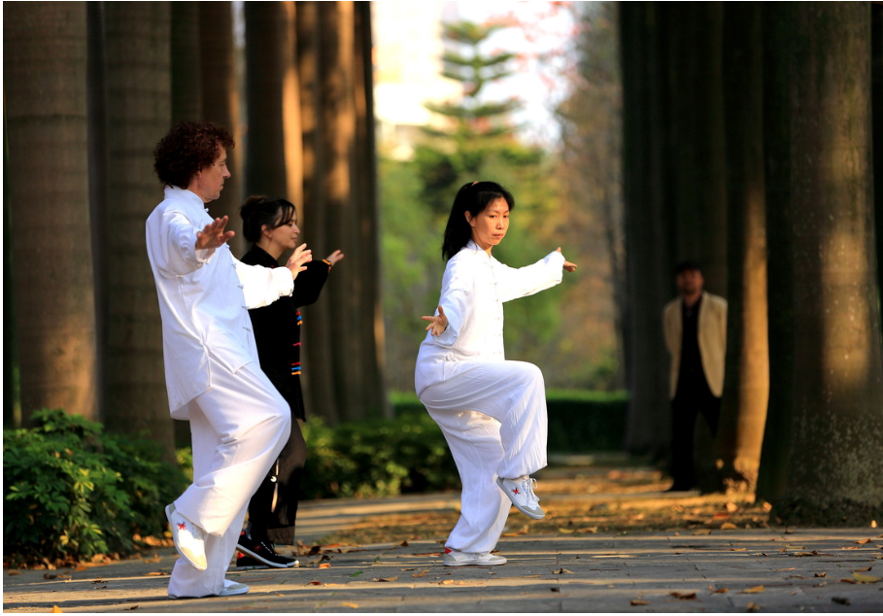
Do you have the habit of playing Tai Ji every day? Do you think the lifestyle of combining our body and mind into one is important or not?

