Slide 1
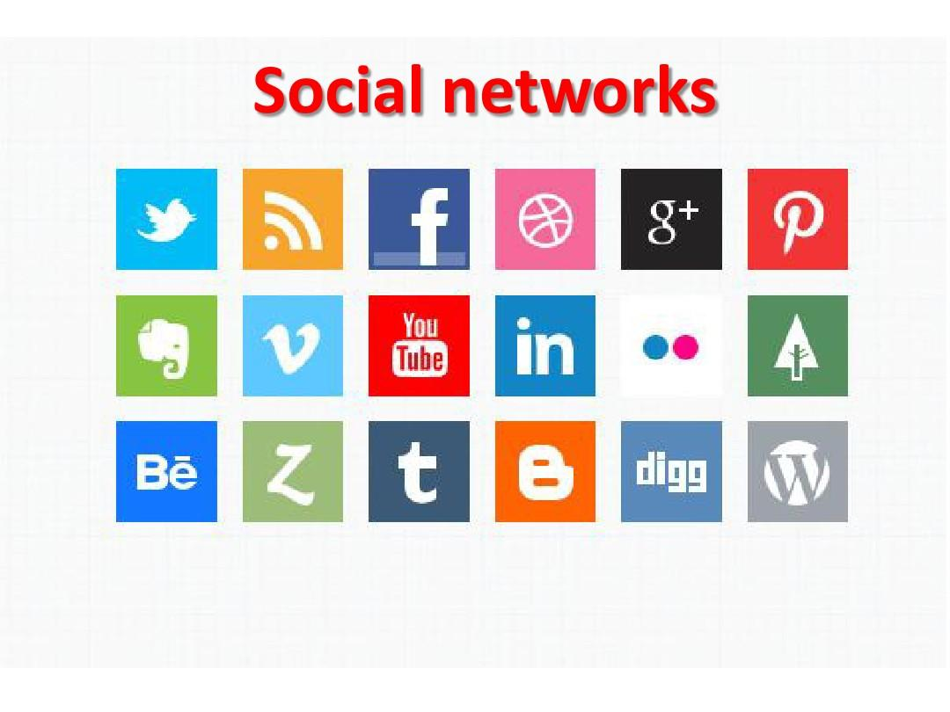

Slide 2
Unit Objectives:
Knowledge and skill（知识、技能目标）:
1.Students should know how to describe a commonly used social network.
2.Students should grasp the new words and expressions.
3.Students should grasp the grammar about passive voice.
4.Students should master how to write a poster.
Feelings, attitudes and values（情感、态度和价值观目标）:
Students should be able to understand the merits and faults of social network.

Slide 3
Unit Objectives:
Ideological and Political Aims（思政目标）
1. Students should know what is social networks.
2. Students should understand the merits and faults of social network.

Slide 4
How many social networks have you used?
https://www.bilibili.com/video/BV1xA411q7Tm/?spm_id_from=333.788.recommend_more_video.2

Slide 5
Part 1
Part 2
Part 3
Part 4
Part 5
Part 6
Lead-in
Listening ＆
Speaking
Reading
Grammar
Watching & Performing
Applied Writing

Slide 6
1
Watch the video by scanning the QR code, and then fill in the blanks.

Slide 7
social networks
I: Do you use ___________________?
W: Yes.
I: What?
W: Facebook, Instagram ( 国外一款图片分享软件)…
I: Why?
W: Why not?

Slide 8
I: Do you use social networking?
J: I try not to.
D: ________________, yes.
C: Yes, we use Facebook.
I: Okay, why don’t you? (to Joanne)
J: I find it invasive ( 侵略性的，攻击性的 ).
I: And why do you use it? (to David)
D: Because I love to _____________ to the people that I don’t see often, and figure out what they are
doing in their life. And I, for one, have nothing to hide, so…
I: And why do you use it? (to Curt )
D: Facebook tell you when people’s birthdays ____________, so you never forget those. And it’s
also a nice way for when we go travelling, we can ____________ Facebook, and our family can
see what we are doing and kinda ( 有一点；有几分) go along for the ride.
I: That’s really cool.
Absolutely
figure out
come up
update

Slide 9
2
Watch the video again, and then discuss the question “Do you use social networks and why?” with your partners. Here are some words, phrases and sentences for your reference.

Slide 10
3
Design an interview form about social networks. And then interview your classmates, friends or family members.

Slide 12
Part 1
Part 2
Part 3
Part 4
Part 5
Part 6
Lead-in
Listening ＆
Speaking
Reading
Grammar
Watching & Performing
Applied Writing

Slide 13
1
Listen to the dialogues and fill in the blanks.

Slide 15
Dialogue 1
K: Are your parents on any social sites like Facebook, Tweeter?
A: My mom and dad are on Facebook. And my mom Twieeter ____________ I did.
K: Oh really?
A: I still don’t have Twieeter. She got it for her _______. She’s working as a chief medical officer so
she got it for her company.
K: How do you __________________ having your parents on these social media sites?
A: You know, Facebook, I don’t know. I think it’s a bit _______honestly. There’s some stuff on there;
it’s for my friends. It’s not really for them, so I don’t know. I feel it can be a bit awkward.
before
job
feel about
odd

Slide 16
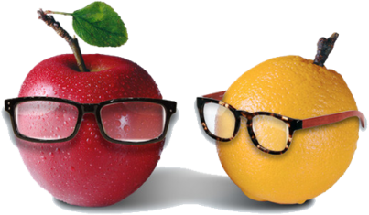
Dialogue 2
A: Hi, Katia, how are you?
K: I’m doing good, and you Alex?
A: I’m doing good. Thank you. I have a question for you. Are you on Facebook?
K: Yes, I’m on Facebook. But I really do not check it very often.
A: OK. How often do you check usually?
K: Em… I actually try not to check it very often. It’s been taken a lot of my time. So right now I
check it about… I try __________________ during the weekends.
A: OK. I used to be on Facebook a lot before. But then I realize that I was losing _______________on it
, and I kind of decide to close my wall. But I don’t know if that’s the right thing, because sometimes I feel that I need to communicate stuff with my friends.
K: It really has become an_____________, hasn’t it? You can get lost from what is actually happening around
you and live in a virtual world. I believe that it should be handled differently than it has up to
now so maybe you’re doing good by closing or, you know, _______________________ at least.
A: Yeah.
K: But how much, that you might have to consider.
once a week
a lot of time
issue
thinking about it

Slide 17
2
Listen to the dialogues again and check your answers, and then make a dialogue
according to the situation given below. The following sentence patterns are for your
reference.

Slide 18
Situation: Your classmate David is so addicted to (沉迷于) chatting on WeChat andupdating (更新) Weibo or other social networks that he neglects (忽略，忽视) his study or even friends around him. As his friend, you need to talk to him and make him realize the importance of real
life.

Slide 19
思政拓展：网络安全
面对网络世界，我们大学生又该如何在网络上保护自己呢？
一、不在网络上公布自己的个人信息、不随意约见网友。
二、面对诈骗信息，不予理会。
三、不在网络上借贷。

Slide 20
3
Listen to the song Anti Social Media and then fill in the blanks.

Slide 21
It’s so dumb how we’re wrapped up in our smart phones
Living through the minutes of a Youtube video
We’re trading kids an iPad for a childhood
As soon as we are online, we shut the world out
Brag about our lives to the friends that never (1) _____________
Who needs to (2) ______________ when I’ve got Facebook
So let’s give some love, not just our likes
Look up and into each other’s eyes
’Cause this seems right
come around
see my face

Slide 22
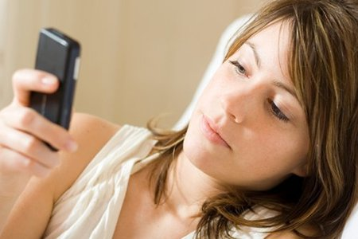
We should disconnect from the internet
’Cause I’m tired of anti-social media
I don’t want to share if nobody’s there
’Cause I’m tired of anti-social media
I’m tired of anti-social media
It’s for the birds, yet we never stop tweeting
Ain’t no fun if we aren’t in front of a computer screen
Let’s go outside, real life doesn’t need a filter
We’re just slaves to our cellular providers
What happened to good old-fashioned talking to one another?
Can’t say hello if it uses up my data

Slide 23
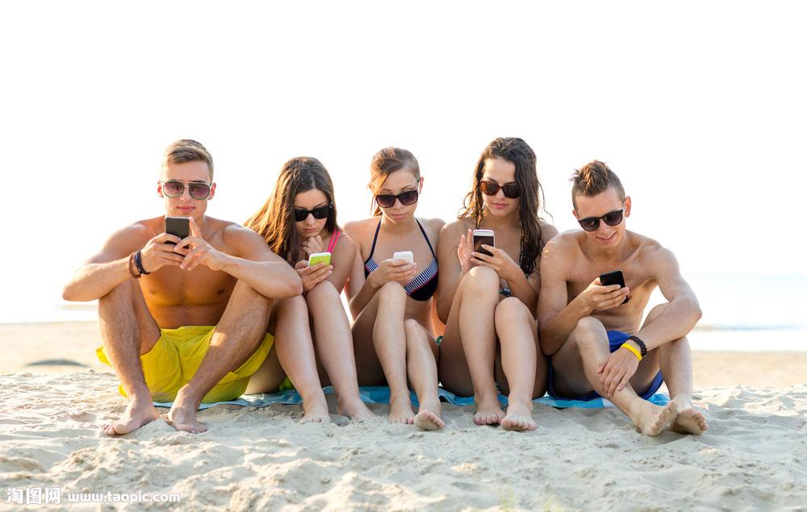
Snapchats and selfies, don’t (3) _________________
I want to see you with (4) ____________________
Cause this seems right
We can’t pay attention for more than 6 seconds
We need to shut it down
Let’s ctrl ＋ alt ＋ delete all this technology
And enjoy right now
waste your time
my own eyes

Slide 24
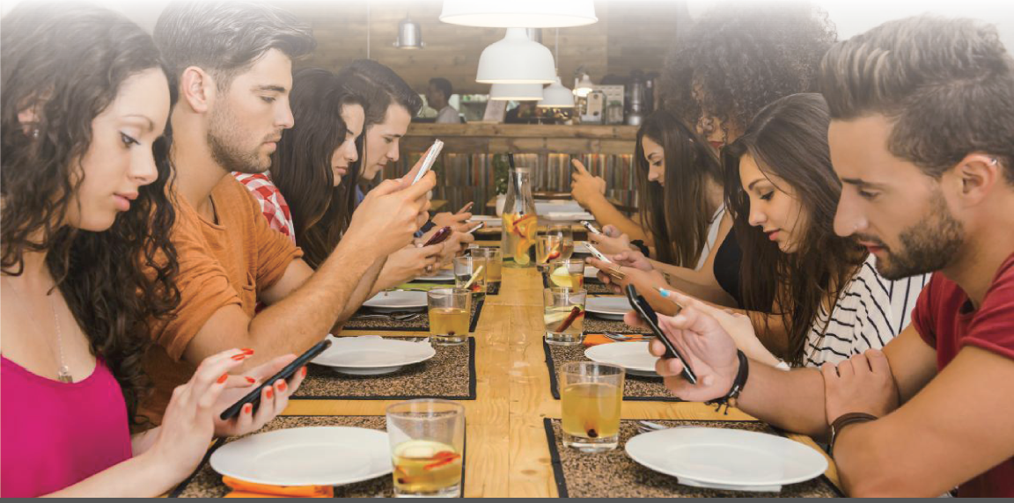
We should disconnect from the internet
’Cause I’m tired of anti-social media
I don’t want to share if nobody’ there
’Cause I’m tired of anti-social media
I’m tired of anti-social media
’Cause I’m tired of anti-social media

Slide 25
Part 1
Part 2
Part 3
Part 4
Part 5
Part 6
Lead-in
Listening ＆
Speaking
Reading
Grammar
Watching & Performing
Applied Writing

Slide 26
Text A Intensive Reading

Slide 27
Text A Intensive Reading

Slide 28
Part Ⅲ
Text A Intensive Reading 1
★ communicate /kəˈmjuːnɪkeɪt/ v.
(a) to exchange information, news, ideas, etc. with sb. （与某人）交流（信息或消息、意见等）；沟通
~ with sb.
e.g. We only communicate by email.
我们只是互通电邮。
I communicate with him regularly by letter.
我与他定期通信。
(b) to make your ideas, feelings, thoughts, etc. known to other people so that they understand them 传达，传递（想法、感情、思想等）
e.g. He was eager to communicate his ideas to the group. 他急于把他的想法传达给小组。
脸书上的友谊有多真实？
在过去的几年里，摄影师塔尼娅·霍兰德对现代友谊的定义非常感兴趣。“我发现在我脸书上的朋友，有一些是我没从没见过的，也有些是在现实生活中从没说过话的。她说，这里有好朋友的前任们、艺术卖家，还有从高中之后20多年都没见过的人。我问我自己，我与他们交流，但我真的与他们都是好朋友吗？”所以她决定带着她唯一熟知的工具——电影摄影机——上路，去拜访她脸书上的626位“朋友”，去他们各自的家里拍点他们正式的照片。
How Real Are Facebook Friendships?
1 For the past few years, photographer¹ Tanja Hollander has been interested in the definition² of friendship in the modern age. “I found some of my Facebook friends whom I’d never met and then a few I wasn’t speaking to in real life,” Hollander said. “There were ex-partners of good friends, art sellers³, people from high school I hadn’t seen in over 20 years. And I asked myself, I communicate⁴ with them, but am I really friends with all of them?” So, she decided to use the only tool she knew — a film camera — and set out to visit all 626 of her Facebook “friends” at their homes to take formal⁵ pictures of them.
★ set out
to leave a place and begin a journey
出发；动身；启程
e.g. They set out on the last stage of their journey. 他们动身踏上最后一段行程。
(b) to begin a job, task, etc. with a particular aim or goal （怀着目标）开始工作，展开任务
e.g. We set out to find the truth behind the mystery.
我们开始着手揭开谜团背后的真相。
★ formal
/ˈfɔːml/ adj.
(a) official; following an agreed or official way of doing things 正式的；合乎规矩的
e.g. formal legal processes 正式法律程序
(b) (of a style of dress, speech, writing, behavior, etc.) very correct and suitable for official or important occasions
适合正式场合的；正规的；庄重的
e.g. The dinner was a formal affair.
这是正式宴会。
★ be interested in
感兴趣
e.g. Since when have you been interested in poetry?
你从什么时候开始对诗歌感兴趣的？
★ definition
/ˌdefɪˈnɪʃn/ n.
what an idea, etc. means 定义
e.g. What’s your definition of happiness?
你对幸福的定义是什么？
★ photographer /fə'tɒgrəfə(r)/ n. 摄影师
★ seller /'selə(r)/ n. 销售者；卖方

Slide 29
Part Ⅲ
★ contact /ˈkɒntækt/n.
(a) the act of communicating with sb., especially regularly
（尤指经常的）联系，联络
~ with sb. / ~ between A and B 与……联系，A与B之间的联系
e.g. I don’t have much contact with my uncle. 我和叔父甚少联系。
(b) the state of touching sth. 触摸；接触
e.g. a fear of physical contact 对身体接触的恐惧感
v. to communicate with sb., for example by telephone or letter 联系，联络（如用电话或信件）
e.g. I’ve been trying to contact you all day. 我整天一直在设法与你联系。
Text A Intensive Reading 2
2 Early in her travels, Hollander was surprised when a professional⁶ contact⁷, Amy Munger, a designer⁸ in Houston, Texas, responded⁹ to her message about the project by inviting Hollander to stay in her home for the weekend. When Hollander arrived, Munger had to leave for an appointment¹⁰, but she gave Hollander a set of keys and told her “to make herself at home.” Munger brought Hollander to a traditional¹¹ Texas rodeo¹², and introduced Hollander to her parents and sisters.
★ appointment
/əˈpɔɪntmənt/ n.
a formal arrangement to meet or visit sb. at a particular time, especially for a reason connected with their work 约会；预约；约定
e.g. She made an appointment for her son to see the doctor.
她为儿子约定了看医生的时间。
★ traditional
/trəˈdɪʃənl/ adj.
being part of the beliefs, customs or way of life of a particular group of people, that have not changed for a long time 传统的；习俗的；惯例的
e.g. It’s traditional in America to eat turkey on Thanksgiving Day.
感恩节时吃火鸡是美国的传统。
旅途初期，当她与德克萨斯州休斯顿市的一名设计师艾米·芒格在因工作联系时，她惊奇地发现，艾米对她的计划做出了回应，并邀请她来家度周末。当霍兰德到达时，芒格给了她一套钥匙并让她把这里当做自己家。芒格带霍兰德去看了传统的德克萨斯竞技表演，并把霍兰德介绍给父母和姐妹。
★ make herself at home
随便，无拘束
e.g. Make the strangers feel at home and care about others more than oneself.
要使陌生人感到亲切，关心别人胜过关心自己。
★ respond
/rɪˈspɒnd/ v.
(rather formal) to give a spoken or written answer to sb. / sth.
（口头或书面）回答，回应
~ to sb. / sth. 回应……，对……予以回应
★ professional
/prəˈfeʃənl/ adj. connected with a job that needs special training or skill, especially one that needs a high level of education
职业的；专业的
e.g. professional qualifications / skills
专业资格 / 技能
★ leave for
出发去（某地）；奔赴
e.g. He will leave for Shanghai on Friday.
他星期五去上海。
★ designer
/dɪ'zaɪnə(r)/ n. 设计师；设计者
★ rodeo
/rəʊdiəʊ/ n. 竞技表演

Slide 30
Part Ⅲ
Text A Intensive Reading 3
3 Hollander was moved by how much personal¹³ time Munger took to share her “real life” with someone who, pre-Facebook, would not have been considered a “friend.” For her to be willing to do that, something must have existed¹⁴ between them before Hollander arrived at Munger’s house.
芒格花费这么多个人的时间与霍兰德——这个仅仅是脸书上认识，且并不是真正的“朋友”的人分享“真实的生活”，这令霍兰德非常感动。芒格之所以愿意这么做，一定是在霍兰德来到她家之前就肯定发生过什么吧。
★ personal
/ˈpɜːsənl/ adj.
your own; not belonging to or connected with anyone else
个人的；私人的
e.g. Of course, this is just a personal opinion. 当然了，这只是个人意见。
★ exist
/ɪgˈzɪst/ v.
to be real; to be present in a place or situation 存在；实际上有
e.g. Does life exist on other planets?
其他行星上有生命吗？
★ be willing to do
愿意做某事
e.g. There are some questions, which she will not be willing to answer.
有些问题她不愿意回答。

Slide 31
Part Ⅲ
Text A Intensive Reading 4
★ estimate
/ˈestɪmət/
v. to form an idea of the cost, size, value, etc. of sth., but without calculating it exactly 估价；估算
~ sth. at 估计有……
e.g. Police estimate the crowd at 30 000.
警方估计聚集的人有3万。
n. a judgement that you make without having the exact details or figures about the size, amount, cost, etc. of sth. （对数量、成本等的）估计；估价
e.g. I can give you a rough estimate of the amount of wood you will need.
我可以粗略估计一下你所需要的木材量。
4 By Hollander’s estimates¹⁵, 95% of her Facebook friends have welcomed her into their homes and sat for a portrait¹⁶, with 74% offering her a meal or a place to stay for the night — which she admits felt strange at the beginning, especially for those “friends” she had never met in real life. Hollander found that people are still extremely proud of where they live, wanting to show her their favorite museums, restaurants, and parks.
据霍兰德估计，她脸书上有95%的朋友邀请过她去家里并拍摄照片，74%的人会为她提供食物和住宿，对于这些，她承认在刚开始会觉得陌生，尤其是对那些在现实生活中从没见过的“朋友”。霍兰德发现人们都非常为他们所居住的地方感到自豪，都非常愿意展示他们最喜欢的博物馆、餐厅和公园。
★ portrait
/ˈpɔːtreɪt/ n.
a painting, drawing or photograph of a person, especially of the head and shoulders
肖像；半身画像；半身照
e.g. a full-length portrait 全身画像

Slide 32
Part Ⅲ
Text A Intensive Reading 5
5 After doing the research, she found that Facebook messaging one friend and writing in pencil to another may be more similar ways of communicating and expressing herself than she thought. In fact, the distinction¹⁷ between online¹⁸ and offline¹⁹ may be less relevant²⁰ than it seems. Facebook flattens²¹ a network²² into a similar group, compared²³ to offline interactions²⁴, where people may share different information about themselves in different contexts²⁵. The separation²⁶ of online interactions from “real life”, doesn’t capture²⁷ relationship dynamics²⁸ in the 21st century.
★ compare /kəmˈpeə(r)/v.
(a) to examine people or things to see how they are similar and how they are different 比较；对比
~ A with / to B
(b) to be similar to sb. / sth. else, either better or worse 与……类似（或相似）
(c) to show or state that sb. / sth. is similar to sb. / sth. else 表明……；与……相似；
将……比作
★ distinction
/dɪˈstɪŋkʃn/ n.
a clear difference or contrast especially between people or things that are similar or related 差别；区别；对比
~ between A and B A与B之间的区别
e.g. We need to draw a distinction between the two events.
我们得把两起事件区别开来。
做完调查后，她发现在脸书上发送消息，或用笔给别人留言的交流与表达自我的方法可能比她想象的更相似。事实上，线上与线下的区别可能不像看上去那么重要。与线下交流相比，脸书把网络变成一个类似的团体，在这里人们可以在不同的环境下分享关于自己不同的信息。线上互动与现实生活的分离，并不能反映二十一世纪的人际关系动态。
★ relevant
/ˈreləvənt/ adj.
closely connected with the subject you are discussing or the situation you are thinking about 紧密相关的；切题的
~ to sth. / sb.
e.g. These comments are not directly relevant to this enquiry.
这些意见与这项调查没有直接联系。
★ online
/ˌɒnˈlaɪn/ adj.
controlled by or connected to a computer or to the Internet
在线的；联网的；联机的
e.g. Online shopping is both cheap and convenient. 网上购物既便宜又方便。
★ offline
/ˌɒfˈlaɪn/ adj.
not directly controlled by or connected to a computer or to the Internet 未联机的；未连线的；脱机的；离线的
e.g. For offline orders, call this number, please. 离线订货，请拨打这个号码。
★ flatten
/ˈflætn/ v.
to become or make sth. become flat or flatter
（使）变平；把……弄平
e.g. Most of the factory was flattened by the explosion.
工厂的大部分被爆炸夷为平地。
★ capture /'kæptʃə(r)/ v.
引起（注意、想象、兴趣）
★ dynamics /daɪ'næmɪks/ n. 动态；活力
★ separation /ˌsepə'reɪʃn/ n.
分离；分开；间隔
★ interaction /ˌɪntər'ækʃn/ n.
合作；互相影响；互动
★ network /'netwɜːk/ n. 网络；网
★ context /'kɒntekst/ n. 环境；语境

Slide 33
How Real Are Facebook Friendships?
New Words
1 photographer /fə'tɒgrəfə(r)/ n. 摄影师
2 definition /ˌdefɪ'nɪʃn/ n. 定义
3 seller /'selə(r)/ n. 销售者；卖方
4 communicate /kə'mjuːnɪkeɪt/ v. 交流
5 formal /'fɔːml/ adj. 正规的
6 professional /prə'feʃənl/ adj. 专业的；职业的
7 contact /'kɒntækt/ n. 联系；接触
8 designer/dɪ'zaɪnə(r)/ n. 设计师；设计者
9 respond /rɪ'spɒnd/ v. 回答，回应；做出反应
10 appointment /ə'pɔɪntmənt/ n. 约会

Slide 34
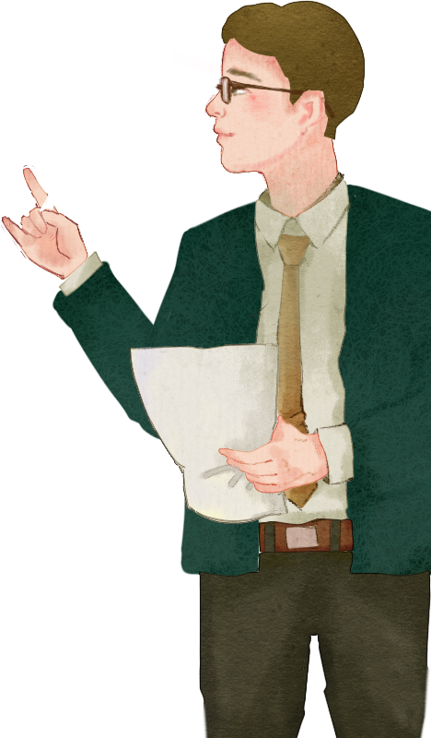
11 traditional /trə'dɪʃənl/ adj. 传统的；惯例的
12 rodeo /rəʊdiəʊ/ n. 竞技表演
13 personal /'pɜːsənl/ adj. 个人的；私人的
14 exist /ɪg'zɪst/ vi. 存在；生存
15 estimate /'estɪmət/ v. 估计；预算；评估
16 portrait /'pɔːtreɪt/ n. 肖像；肖像画；模型
17 distinction /dɪ'stɪŋkʃn/ n. 区别
18 online /ˌɒn'laɪn/ adj. 在线的；联机的
19 offline /ˌɒf'laɪn/ adj. 未连线的，未联机的，脱机的

Slide 35
20 relevant /'reləvənt/ adj. 有关的；相关联的
21 flatten /'flætn/ v. 变平；使失去光泽
22 network /'netwɜːk/ n. 网络；网
23 compare /kəm'peə(r)/ v. 比较；区别；相比
24 interaction/ˌɪntər'ækʃn/ n. 合作；互相影响；互动
25 context /'kɒntekst/ n. 环境；语境
26 separation /ˌsepə'reɪʃn/ n. 分离；分开；间隔
27 capture /'kæptʃə(r)/ v. 引起（注意、想象、兴趣）
28 dynamics /daɪ'næmɪks/ n. 动态；活力

Slide 36
be interested in 对……感兴趣
e.g. Many people are interested in chatting with friends online.
2 communicate with sb. 和某人沟通
e.g. You should communicate with your parents before you choose your major.
set out 打算，着手
e.g. We will set out to visit our friends this weekend.
leave for 离开去某地
e.g. When will you leave for Shanghai?
make oneself at home 随便，无拘无束
e.g. Please make yourself at home.
be willing to do sth. 乐意做某事
e.g. The boy is not willing to share his toys with other boys

Slide 37
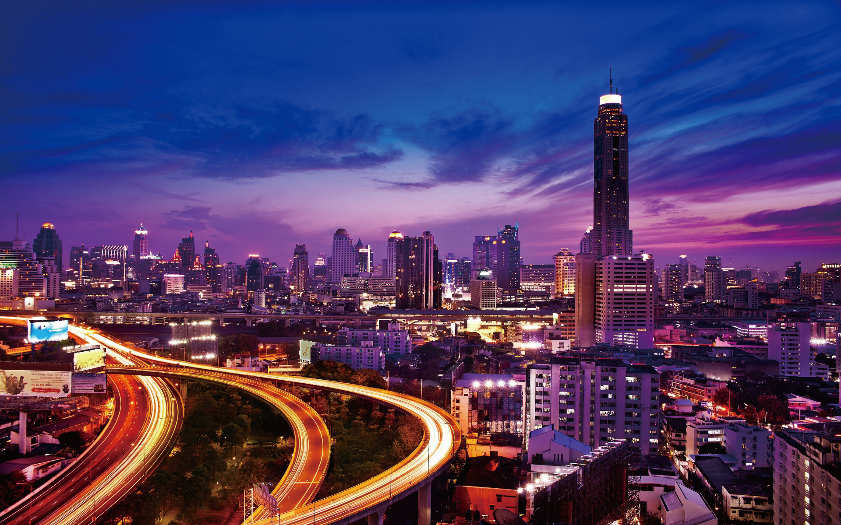

Slide 38
When Hollander arrived, Munger had to leave for an appointment, but she gave Hollander a set
of keys and told her “to make herself at home.” (Para. 2)
句中when 引导的是一个时间状语从句，主句是Munger had to leave for an appointment；but
是表转折的连词；make oneself at home 的意思是“随便，不拘束”。
Hollander was moved by how much personal time Munger took to share her “real life” with
someone who, pre-Facebook, would not have been considered a “friend.” (Para. 3)
“how much personal time Munger took... a ‘friend’” 是由how much 引导的宾语从句， 后
面包含一个由who 引导的定语从句，修饰前面的someone。share sth. with sb. 表示“与……分
享……”。

Slide 39
Hollander found that people are still extremely proud of where they live, wanting to show her
their favorite museums, restaurants, and parks.(Para. 4)
此句中that 引导的是一个宾语从句，作found 的宾语。where they live 是一个由where 引导的
宾语从句，作of 的宾语，where 后面要用陈述语序。“wanting to show her... parks”是现在分词短
语作状语，修饰前面的“people are still... they live”。
After doing the research, she found that Facebook messaging one friend and writing in pencil to another may be more similar ways of communicating and expressing herself than she thought. (Para. 5) After doing the research 是整个句子的状语，表示“在……之后”。found 后面有一个由that引导的宾语从句。在宾语从句中，Facebook messaging one friend and writing in pencil to another 是现在分词短语，作宾语从句的主语。

Slide 40
Facebook flattens a network into a similar group, compared to offline interactions, where people may share different information about themselves in different contexts. (Para. 5)
句中包含一个定语从句“where people may... contexts”，这个从句是对group 的补充说明。
compared to offline interactions 是一个插入语，作整个句子的状语，意思是“（脸书）与线下互动交流相比”。

Slide 41
1
Read Text A and complete the following table.
Facebook messaging one friend and writing in pencil to another may be more similar ways of communicating and expressing herself than she thought.
The distinction between online and offline may be less relevant than it seems.
Facebook flattens a network into a similar group, where people may share different information about themselves in different contexts.

Slide 42
2
Answer the following questions and then discuss with your partners.
Why did Tanji Hollander start the research?
How did Tanji Hollander feel when she stayed in Amy Munger’s home?
What did Tanji Holland find when she visited these online friends?

Slide 43
3
Please read the 5th paragraph aloud and recite it.

Slide 44
4
Fill in the blanks with the words given below. Change the form where necessary.
1 We__________ the cost to be five thousand dollars.
2 There is no generally accepted_________ of success.
3 They can_____________ with each other even when they strongly disagree.
4 I asked his name, but he didn’t_________ .
5 His ___________career spanned 16 years.
6 I tried googling, but couldn’t find any_________ information.
Have you kept in _________ with any of your friends from college?
8 How does your new house__________ to your old one?
estimate
definition
communicate
respond
professional
relevant
contact
compare

Slide 45
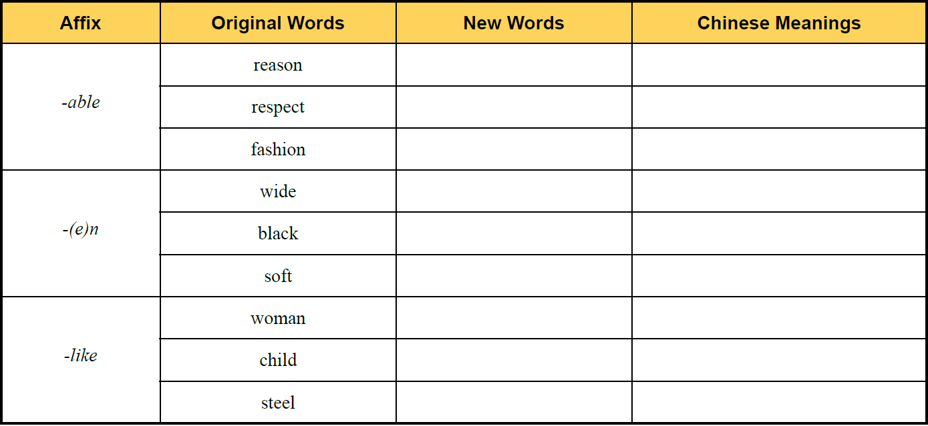
5
Add -able, -(e)n or -like to the following words to form new words and give the corresponding Chinese meanings of the new words.
reasonable
合理的
respectable
值得尊敬的
fashionable
时尚的
widen
加宽
blacken
变黑
soften
变软
womanlike
像女人的
childlike
孩子般的
steellike
钢铁般的

Slide 46
6
There are two sentences chosen from the text. Choose the best Chinese translation for
each sentence.
A
1 Early in her travels, Hollander was surprised when a professional contact, Amy Munger, a designer in Houston, Texas, responded to her message about the project by inviting Hollander to stay in her home for the weekend.
A. 在最初的旅行中，当有一个专业人士，来自德克萨斯州休斯顿的设计师艾米·芒格
和霍兰德联系时，她有些吃惊，这位设计师给她发信息咨询项目情况，并且邀请她在
家里过周末。
B. 在早期的旅行中，霍兰德有些惊讶，来自德克萨斯州休斯顿的设计师艾米·芒格和
霍兰德联系时，回应了这位设计师对她的项目的咨询，并且邀请她在家里过周末。
C. 旅途初期，当得知一位与她有过工作往来的设计师（来自德克萨斯州休斯顿市）艾 米 • 芒格对她的计划做出了回应，并邀请她来家度周末时，霍兰德感到有些惊讶。

Slide 47
6
There are two sentences chosen from the text. Choose the best Chinese translation for
each sentence.
C
2 By Hollander’s estimates, 95% of her Facebook friends have welcomed her into their homes and sat for a portrait, with 74% offering her a meal or a place to stay for the night — which she admits felt strange at the beginning, especially for those “friends” she had never met in real life.
A. 据霍兰德的推测，95% 的脸书好友欢迎她来到家里画一张肖像画，有74% 的脸书好
友会提供饮食或者提供住宿。她承认尤其是和现实生活中从来没有见过的朋友在一起
时，她感到有些奇怪。
B. 据霍兰德的评估，95% 的脸书好友欢迎她来到家里小坐并且拍一张照片，有74% 的
脸书好友会提供一顿饭或者晚上住宿的地方。她承认和现实生活中从来没有见过的朋
友在一起时有些奇怪。
C. 据霍兰德的推测，95% 的脸书好友欢迎她来到家里小坐并且拍一张照片，有74% 的
脸书好友会提供饮食或者提供住宿。她承认，最初，尤其是和现实生活中从来没有见
过的朋友在一起时，她感到奇怪。

Slide 48
7
Complete the following sentences with the given sentence structures
make oneself at home 无拘无束
e.g. Have a seat and make yourself at home. 请坐，不要拘束。
1 Your friend has come, and ______________________( 让他不要拘束).
_____________________ ( 请不要拘束) if you get there earlier.
more... than sb. thought 比预想的更……
e.g. This problem is more difficult than we thought. 这个问题比我们预想的要更难。
1 The traffic in the morning is__________________ ( 比我们预想的更堵).
2 The novel is___________________________ ( 比他预想的更有趣).
tell him make himself at home
Please make yourself at home
heavier than we thought
more interesting than he thought

Slide 49
Text B Extensive Reading

Slide 50
Text B Extensive Reading

Slide 51
Part Ⅲ
Text B Extensive Reading 1
Let’s Stop Pretending¹ Instagram Is Real
1 Former² Instagram model Essena O’Neill made headlines³ earlier this month when she revealed⁴ that pretty much every photo on her page was staged. After seeing the many tan⁵ and toned⁶ models on Instagram, O’Neill began to starve⁷ herself and exercise excessively⁸ all in the hopes of looking like the models she so greatly admired⁹. Her Instagram began to accumulate¹⁰ a mass¹¹ following — almost 700,000 followers!
★ former
/ˈfɔːmə(r)/ adj.
(a) that used to have a particular position or status in the past 昔日的；前
e.g. the former world champion 前世界冠军
(b) that used to exist in earlier times 以前的
e.g. in former times 从前
(c) used to refer to the first of two things or people mentioned （两者中）前者的
★ headline
/ˈhedlaɪn/n.
the title of a newspaper article printed in large letters, especially at the top of the front page （报纸的）大字标题
e.g. The scandal was in the headlines for several days.
这一丑闻连续几天都刊登在头版头条。
不要再假装认为Instagram是真实的
Instagram的前任模特欧尼尔在本月初透漏说她主页上的所有照片都是在表演作秀，这一消息一度成为头条新闻。在Instagram上看了很多棕褐色肌肤，身材健美的模特后，欧尼尔开始节食并大量运动。所有的努力只是想让自己看起来像那些她所羡慕的模特。她的Instagram上也渐渐积累了大批粉丝——将近70万！
★ starve
/stɑːv/v.
to suffer or die because you do not have enough food to eat; to make sb suffer or die in this way （使）挨饿，饿死
e.g. The animals were left to starve to death. 那些动物只能等着饿死。
★ reveal
/rɪˈviːl/v.
to make sth. known to sb. 揭示；显示；透露
~ sth. to sb. 向某人透露……
e.g. to reveal a secret 泄露一条秘密
★ admire
/ədˈmaɪə(r)/ v.
to respect sb. for what they are or for what they have done 钦佩；赞赏；仰慕
~ sb. / sth. for sth. 羡慕……
e.g. I really admire your enthusiasm. 我确实钦佩你的热情。
★ look like
看起来与（某人或某物）相像或相似
★ excessively
/ɪk'sesɪvlɪ/ adv.
greater than what seems reasonable or appropriate 过分的；过度的
e.g. excessively high prices 过高的价格
★ toned /təʊnd/ adj.
（身体）结实的，健美的
★ pretend /prɪ'tend/ vt. 假装，伪装；假称
★ tan /tæn/ adj. 黄褐色的，棕黄色的
★ mass /mæs/ adj.
大量的，大规模的
★ accumulate /ə'kjuːmjəleɪt/ v.
堆积，积累

Slide 52
Part Ⅲ
Text B Extensive Reading 2
★ delete
/dɪˈliːt/ v.
to remove sth. that has been written or printed, or that has been stored on a computer
删去；删除
~ sth. from sth. 从……中删除……
e.g. Your name has been deleted from the list. 你的名字已从名单上删掉。
★ edite
/ˈedɪt/v.
to prepare a piece of writing, a book, etc. to be published by correcting the mistakes, making improvements to it, etc. 编辑，编纂，校订（文章、书籍等）
e.g. This is the edited version of my speech. 这是我的演讲稿选编本。
2 On her since-deleted¹² Instagram account¹³, O’Neill actually edited¹⁴ the captions¹⁵ on all of her old photos to reveal the true nature of each image.
在她最近注销了的Instagram上，欧尼尔对她原来的所有的照片都标注了说明文字，揭示了每张照片的真实面貌。
★ account /ə'kaʊnt/ n. 账户
★ caption /'kæpʃn/ n. 标题，说明文字，字幕

Slide 53
Part Ⅲ
Text B Extensive Reading 3
★ similar
/ˈsɪmələ(r)/ adj.
like sb. / sth. but not exactly the same 相像的；相仿的；类似
be ~ to sb. / sth. 与……相似
e.g. My teaching style is similar to that of most other teachers.
我的教学风格和多数教师相似。
be ~ in sth. 在……方面相似
e.g. The two houses are similar in size. 两座房子大小差不多。
3 In one, she stands effortlessly¹⁶ on a mountain top in a bikini¹⁷, flipping¹⁸ her hair to one side and smiling sweetly off into the distance. “NOT REAL LIFE”, her new caption read. “Took over 100 in similar¹⁹ poses trying to make my stomach²⁰ look good. Would have hardly eaten that day. Would have yelled²¹ at my little sister to keep taking them until I was somewhat proud of this.”
★ yell
/jel/ v.
to shout loudly, for example because you are angry, excited, frightened or in pain
叫喊；大喊；吼叫
yell at 对……吼叫
e.g. He yelled at the other driver. 他冲着另一位司机大叫。
有一张照片，她毫无压力地穿着比基尼站在山顶上，轻抚着一侧的头发,带着恬淡的微笑望向远方。她也在上面注释着“这不是真实的生活，我设法摆出100个相似的造型，就是想让我的腹部看起来好看。那天几乎我没有吃饭。为了保持那些造型，我吵着让我的小妹妹不停地拍照，直到我满意为止。”
★ bikini
/bɪ'kiːni/ n. 比基尼式泳衣
★ flip
/flɪp/ v. 轻弹，按，急挥
★ stomach
/'stʌmək/ n. 胃；腹部
★ effortlessly
/'efətləsli/ adv. 不作努力地，不费力地

Slide 54
Part Ⅲ
Text B Extensive Reading 4
4 In another, O’Neill is pictured on a beach in a bikini after a run with her face simply turned away from the camera. “This is what I like to call the perfectly man-made frank²² shot,” she wrote, “Nothing is frank about this.”
★ frank
/fræŋk/ adj.
honest and direct in what you say, sometimes in a way that other people might not like 坦率的；直率的
e.g. a full and frank discussion 坦诚的充分讨论
在另外一张照片上，欧尼尔穿着比基尼站在海滩上。她刚跑完步，脸直接移开了相机。“这就是我喜欢称之为完美地人工清晰拍摄，这里没有什么是真实的。”她写到。

Slide 55
Part Ⅲ
Text B Extensive Reading 5
★ expose
/ɪk'spəʊz/ v.
to tell the true facts about a person or a situation, and show them / it to be immoral, illegal, etc. 揭露，揭发
e.g. She was exposed as a liar and a fraud.
他说谎和欺骗的谎言被揭穿。
5 By bravely²³ exposing²⁴ herself, O’Neill shed light on a very important yet underrated²⁵ issue²⁶: the cheating²⁷ of Instagram.
★ issue
/ˈɪʃuː/ n.
an important topic that people are discussing or arguing about 重要议题；争论的问题
e.g. This is a big issue; we need more time to think about it.
这是个重大问题，我们需要花较多的时间考虑。
★ shed light on
为……提供线索；对……透露情况；使……清楚地显出；阐明……
e.g. This report could shed light on the origins of life in general.
这篇报告能告诉人们生命起源的大致情况。
欧尼尔大胆地曝光，也揭露了一个重要的负面问题：Instagram的欺骗性。
★ underrated /ˌʌndə'reɪtɪd/ adj.
对（某人或某事物）评价过低的
★ bravely /'breɪvli/ adv. 勇敢地；鲜艳地
★ cheating /'tʃiːtɪŋ/ n. 欺骗，哄骗

Slide 56
Part Ⅲ
Text B Extensive Reading 6
6 Even if it’s not a celebrity’s²⁸ feed, people in general²⁹ tend³⁰ to only post what they think is “the best”; because no matter how delicious that greasy³¹ burger from your local pub was, you’d much rather Instagram the weird-tasting duck dish that you ordered from TAO. It’s sad, but it’s true.
★ no matter how / who / where etc.
不管；不论
e.g. No matter how well you know Paris, it is easy to get lost.
不管你对巴黎多么熟悉，也很容易迷路。
即使这不是名人的影视节目，人们通常都只发布他们认为最好的。因为不管附近饭馆做出的油腻的汉堡多么美味，你还是宁愿选择从TAO订购Instagram上味道奇怪的烤鸭。这是多么悲哀啊，但这是事实。
★ would rather
宁愿，宁可
e.g. She’d rather die than give a speech.
她宁愿死也不愿意演讲。
★ in general
通常；大体上；一般而言，总的来说
e.g. She had a confused idea of life in general. 总的来说，她对生活非常困惑。
★ celebrity /sə'lebrəti/ n.
名人，知名人士；名流
★ greasy /'griːsi/ adj.
油腻的；谄媚的；含脂肪多的
★ tend /tend/ v.
倾向（于），趋向（于）
★ even if 即使，纵然；虽然

Slide 57
Part Ⅲ
Text B Extensive Reading 7
★ pressure
/ˈpreʃə(r)/ n.
the force or weight with which sth. presses against sth. else 压力；挤压
e.g. She was unable to attend because of the pressure of work.
由于工作紧张她不能出席。
★ perfect
/ˈpɜːfɪkt/ adj.
having everything that is necessary; complete and without faults or weaknesses
完备的；完美的；完全的
e.g. in perfect condition 状况极佳
She speaks perfect English. 她讲一口地道的英语。
7 The pressure³² to be perfect³³ on Instagram has gotten so intense³⁴ recently³⁵ that this year’s newest trend³⁶ is creating fake³⁷ Instagrams in which people can be more... well, themselves.
★ intense
/ɪnˈtens/ adj.
serious and often involving a lot of action in a short period of time
严肃紧张的；激烈的
e.g. It was a period of intense activity.
那是活动激烈的时期。
★ recently
/ˈriːsntli/ adv.
not long ago 不久前；最近
e.g. We received a letter from him recently. 我们不久以前收到了他的一封信。
最近，要求完善Instagram的压力越来越大，所以今年的最新趋势是创造假的Instagram，这样，人们可以拍摄得更加……呃，像自己。
★ fake
/feɪk/ adj.
(disapproving) not genuine; appearing to be sth. it is not 假的，伪装的；冒充的
e.g. a fake American accent 伪装的美国口音
★ trend /trend/ n. 趋势，方位，倾向

Slide 58
Part Ⅲ
Text B Extensive Reading 8
8 So, the moral of the story here is to take everything you see on Instagram with a grain³⁸ of salt. Most likely, what you’re viewing is not real. Nobody eats delicious food 24/7 (24 hours a day, 7 days a week). Nobody leads a life that is free of worry, no matter how many times they post a picture of themselves at the beach with the caption “Livin’ on island time.” Nobody’s life is as perfect as their Instagram wants you to believe³⁹.
所以，这个故事是在告诉你，从Instagram上看到的任何东西不必尽信。你看到的很可能都不是真的。没有人时时刻刻都在享受美味。无论一个人发布过多少他们在海边的照片并标注着“生活在小岛上”，他的生活也不可能完全没有烦恼。没有人的生活会像是Instagram想要告诉你的那般完美。
★ grain
/greɪn/ n.
（沙，金，盐等的）颗粒；谷物，粮食
with a grain of salt
半信半疑地，对某事持保留态度
e.g. You should take what he says with a grain of salt. 你对他讲的话不可尽信。
★ believe
/bɪ‘liːv/ v.
相信；以为，认为，对……信以为真

Slide 59
Let’s Stop Pretending1 Instagram Is Real
1 pretend /prɪ'tend/ vt. 假装，伪装；假称
2 former /'fɔːmə(r)/ adj. 以前的，从前的；前任的
3 headline /'hedlaɪn/ n. 大字标题；新闻提要；头 条新闻
4 reveal /rɪ'viːl/ vt. 显露；揭露
5 tan /tæn/ adj. 黄褐色的，棕黄色的
6 toned /təʊnd/ adj. （身体）结实的，健美的
7 starve /stɑːv/ vt. 使挨饿；饿死
8 excessively /ɪk'sesɪvli/ adv. 过度地；过分地；极度地
9 admire /əd'maɪə(r)/ v. 赞赏；称赞；欣赏
10 accumulate /ə'kjuːmjəleɪt/ v. 堆积，积累
11 mass /mæs/ adj. 大量的，大规模的
12 delete /dɪ'liːt/ v. 删除
New Words

Slide 60
14 edit /'edɪt/ v. 剪辑（影片，录音）；编辑；校订
15 caption /'kæpʃn/ n. 标题，说明文字，字幕
16 effortlessly /'efətləsli/ adv. 不作努力地，不费力地
17 bikini /bɪ'kiːni/ n. 比基尼式泳衣
18 flip /flɪp/ v. 轻弹，按，急挥
19 similar /'sɪmələ(r)/ adj. 类似的；同类的；相似的
20 stomach /'stʌmək/ n. 胃；腹部
21 yell /jel/ v. 叫喊，大声叫
22 frank /fræŋk/ adj. 坦白的，直率的；清楚表明的
23 bravely /'breɪvli/ adv. 勇敢地；鲜艳地
24 expose /ɪk'spəʊz/ v. 使暴露；使遭受；使曝光
25 underrated /ˌʌndə'reɪtɪd/ adj. 对（某人或某事物）评价过低的
26 issue /'ɪʃuː/ n. 问题

Slide 61
27 cheating /'tʃiːtɪŋ/ n. 欺骗，哄骗
28 celebrity /sə'lebrəti/ n. 名人，知名人士；名流
29 general /'dʒenrəl/ adj. 大致的；综合的；总的；普遍的
30 tend /tend/ v. 倾向（于），趋向（于）
31 greasy /'griːsi/ adj. 油腻的；谄媚的；含脂肪多的
32 pressure /'preʃə(r)/ n. 压（力）；压力；压（迫）感
33 perfect /'pɜːfɪkt/ adj. 完美的；正确的；优秀的
34 intense /ɪn'tens/ adj. 热情的，强烈的，紧张的
35 recently /'riːsntli/ adv. 最近，近来；不久以前
36 trend /trend/ n. 趋势，方位，倾向
37 fake /feɪk/ n. 冒牌货，赝品；冒充；欺骗
38 grain /greɪn/ n. （沙，金，盐等的）颗粒；谷物，粮食
39 believe /bɪ'liːv/ v. 相信；以为，认为，对……信以为真

Slide 62
1 look like 看起来与（某人或某物）相像或相似
2 even if 即使，纵然；虽然
3 shed light on 阐明
4 in general 通常；大体上；一般而言
5 no matter 不管；不论
6 would rather 宁愿，宁可
7 with a grain of salt 半信半疑地，对某事持保留态度

Slide 63
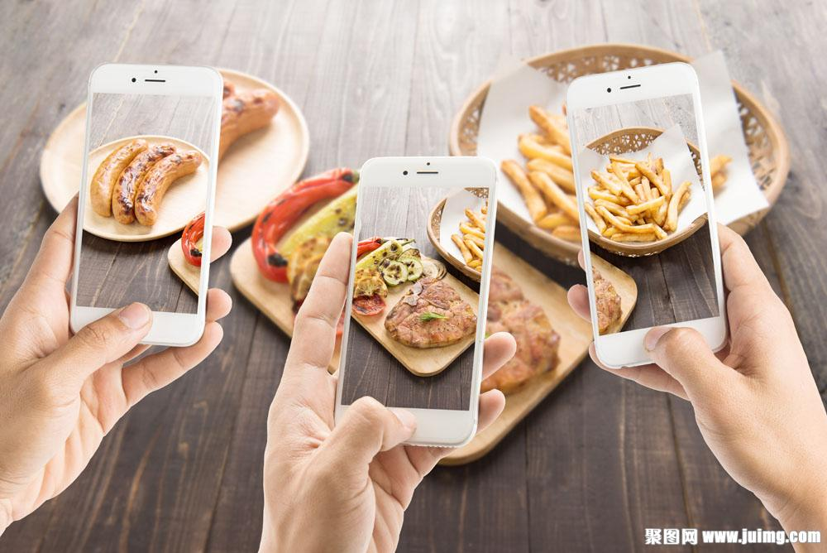

Slide 64
B
1 Why did O’Neil starve herself and exercise excessively?
A. She only wanted to lose weight ( 减肥).
B. She wanted to look like the tan and toned models.
C. She didn’t want to eat.
D. She wanted to do sports.
2 The capitalized words “NOT REAL LIFE” in para. 3 means______ .
A. things in the picture are not real in life
B. in real life O’Neil won’t wear bikini and smile to others
C. in real life O’Neil won’t yell at her little sister
D. in real life O’Neil won’t stand on a mountain top
A

Slide 65
D
3 In what way did O’Neil show the cheating of Instagram?
A. The pictures about her were not taken but edited actually.
B. O’Neil’s real life was very bad.
C. O’Neil didn’t like taking pictures in real life.
D. O’Neil’s real life was not really like what showed in the pictures.
4 According to the text, what kind of pictures DIDN’T O’Neil post through Instagram?
A. A picture in which she stood on a mountain top in a bikini.
B. A picture in which she flipped her hair to one side and smiled sweetly.
C. A picture in which she turned away her face from the camera.
D. A picture of the weird-tasting duck dish ordered from TAO.
D

Slide 66
C
5 The sentence “Nobody eats delicious food 24/7.” in the last paragraph means .
A. nobody eats food on July 24th
B. nobody thinks food from 24/7 is delicious
C. nobody eats delicious food in each hour of a day and each day of a week
D. 7/24 of people eat delicious food5

Slide 67
Part 1
Part 2
Part 3
Part 4
Part 5
Part 6
Lead-in
Listening ＆
Speaking
Reading
Grammar
Watching & Performing
Applied Writing

Slide 68
被动语态
“语态”表示主语和谓语动词之间的关系。英语中常用的语态包括主动语态与被动语态。主动语态表示主动关系，即主语是动作的执行者；被动语态表示被动关系，即主语为动作的承受者。被动语态由“助动词be ＋及物动词的过去分词”组成，be 的时态反应整个句子的时态。
把主动语态改为被动语态非常简单，可以遵循以下几个步骤：① 先找出谓语动词；② 再找出谓语动词后的宾语；③ 把宾语用作被动语态中的主语；④ 注意人称、时态和数的变化。
若主动语态句子中的宾语为人称代词，须将宾格变为主格；主动结构的谓语动词需变为be ＋ done，保持时态和人称的一致。
e.g. Many people speak English in the world. 世界上许多人说英语。
→English is spoken by many people in the world.

Slide 69
被动语态
1）表示被动关系
为了强调动作的承受者，一般使用被动语态。使用被动语态时，根据语境，判断是否需要使
用by 短语，即“by ＋动作执行者”。当不说明动作的执行者会导致歧义的时候，需要使用by 短语。
e.g. This toy was made by the man. 这个玩具是那个人做的。
The professor is respected by everybody on campus. 这位教授受到校园里每个人的尊敬。

Slide 70
被动语态
2）表示不知道动作执行者
在不确定或无须说明动作的执行者的情况下，通常使用被动语态，此时一般不用by 短语。
e.g. The book is written for children. 这本书是为儿童写的。
3）表示动作的承受者是谈话的中心
此用法起到突出主题的作用。本可以用主动形式表达的句子，而用被动语态表达可以使上下文保持连贯一致。
e.g. The company is run by the trade union. 这家公司是工会办的。

Slide 71
被动语态

Slide 72
There Be 句型
Complete the sentences with the correct forms of the words in brackets.（用括号中单词的适当形式完成句子。）
1 His new novel __________________ (finish) next month.
2 The bridge _____________ (build) by the workers.
3 Which language _____ the most widely ___________ (speak) in the world?
4 This kind of books __________ (sell) in the bookstore.
5 The cake ___________ (taste) delicious.
will be finished
is built
is
spoken
is sold
tastes

Slide 73
Part 1
Part 2
Part 3
Part 4
Part 5
Part 6
Lead-in
Listening ＆
Speaking
Reading
Grammar
Watching & Performing
Applied Writing

Slide 74
1
Now watch the drama clip. Read the words closely after the speaker so as to improve
your short-term memory, pronunciation, stress and intonation by imitating what you hear.
Setting: On the way to Naomi’s wedding, Lacie’s car is out of power. So she has to thumb a lift ( 搭便车). An old woman accepts her.

Slide 75
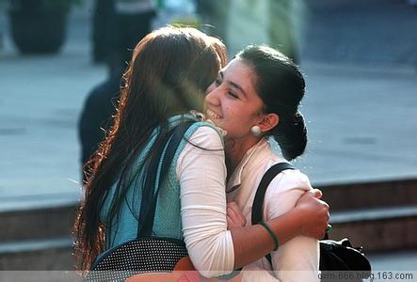
2
Work in pairs. Make a dialogue according to the given situation and useful expressions, and then perform it. The teacher and students in other teams can give a score for the performance. The following score sheet is for your reference.
Setting: You are the secretary of Mr. Smith. Mr. Smith’s client Joy Jones will visit him tomorrow morning. So you should meet her at the airport on behalf of Mr. Smith.

Slide 77
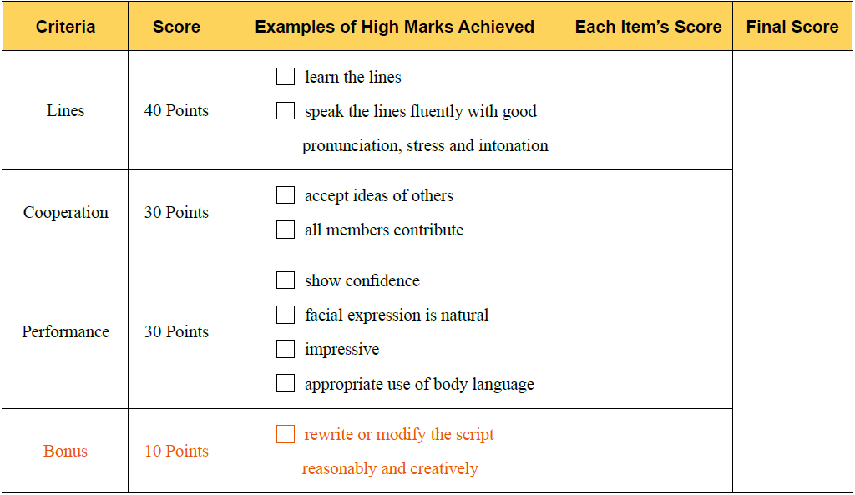

Slide 78
3
Read the lines from the movie Logan 《金刚狼 》and try to recite them.

Slide 79
Part 1
Part 2
Part 3
Part 4
Part 5
Part 6
Lead-in
Listening ＆
Speaking
Reading
Grammar
Watching & Performing
Applied Writing

Slide 80
Poster
Useful Expressions for Poster

