Slide 1
Unit 5
Culture Diversity

Slide 2
Unit Objectives:
Knowledge and skill（知识、技能目标）:
1.Students should know how to talk about the culture of our country.
2.Students should grasp the new words and expressions.
3.Students should grasp the grammar about sentence pattern of “There Be”.
4.Students should master how to write advertisement.
Feelings, attitudes and values（情感、态度和价值观目标）:
Students should be able to understand the culture diversity of the world.

Slide 3
Unit Objectives:
Ideological and Political Aims（思政目标）
Students should know what is culture diversity.
Students should get the proper views on the diversity of culture.
Enable students to cultivate a global sight of the culture diversity, and try to spread
Chinese culture in diverse ways.

Slide 4
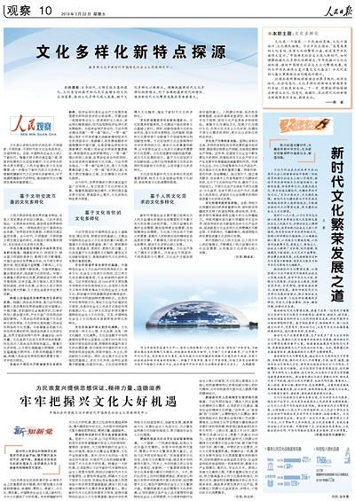
基于文明交流互鉴的文化多样化
基于文化自信的文化多样化
基于人民文化需求的文化多样化

Slide 5
Part 1
Part 2
Part 3
Part 4
Part 5
Part 6
Lead-in
Listening ＆
Speaking
Reading
Grammar
Watching & Performing
Applied Writing

Slide 6
1
Watch the video by scanning the QR code, and then share your opinions about the reason why Fei doesn’t want to go to a party with your partners. Here are some sentences for your reference.

Slide 7
2
Watch the video again and then fill in the blanks.
A: Fei, there’s a huge party tonight! So you’d better get your ass ready because we’re leaving soon.
B:_________________ , get ready! There are free drinks for girls at Whiskey River tonight.
A: Fei, don’t tell me you’re not going again!
B: Yeah, don’t be a buzz kill ( 扫兴，泼凉水).
F: I don’t know… Last time the party was just OK… I don’t really know what to do there… I guess
I’ll have to think about it.
A: ____________________________________?
B: I don’t know… Maybe she’s just really_____________ ? Whatever.
Come on
Why doesn’t Fei want to go
shy

Slide 8
3
Watch the video by scanning the QR code, and then discuss the following questions.

Slide 9
3
Watch the video by scanning the QR code, and then discuss the following questions.
If you were an exchange student or a freshman in America, will you say yes to an invitation of a party? Why?
Do you know what is culture shock? And do you think the experience of Fei is a kind of culture shock?
What other culture shock do you know?

Slide 10
Culture shock is an experience a person may have when one moves to a cultural environment which is different from one's own; it is also the personal disorientation a person may feel when experiencing an unfamiliar way of life due to immigration or a visit to a new country, a move between social environments, or simply transition to another type of life.[

Slide 12
Part 1
Part 2
Part 3
Part 4
Part 5
Part 6
Lead-in
Listening ＆
Speaking
Reading
Grammar
Watching & Performing
Applied Writing

Slide 13
1
Listen to the dialogues and fill in the blanks.

Slide 15
Dialogue 1
A: Matthew, do you know much about body language in countries around the world?
M: Sure. I’ve picked up a few things from travelling around for work.
A: Well, I had a meeting today with a woman from Japan and she wouldn’t stop bowing! I didn’t know what to do!
M: Did you bow back?
A: No, I tried to __________her hand , but her hand was so limp I was a bit offended.
M: Well, Japanese businessmen and women typically bow to greet each other in Japan. She might
have been offended by your strong handshake.
A: But she is in America! Shouldn’t she have known that strong handshakes in America signify
confidence and respect?
M: Things are different in Japan. You know, in some countries, making _______________ with others is considered rude.
shake
eye contact

Slide 16
Dialogue 1
A: Is that why she wouldn’t look at me in the meeting?
M: I think it’s highly possible, yes.
A: The meeting really didn’t go down well at all. I think I need to read up about intercultural
communication before I have another ____________ with someone from another country.
M: That’s a good idea. When you don’t know much about other cultures, the simplest thing can
offend someone.
A: That’s so true. It’s great that we see eye to eye on this.
meeting

Slide 17
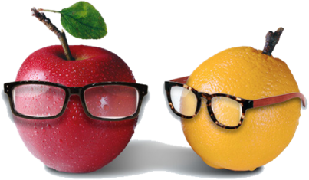
Dialogue 2
dinner
D:Good evening, Mrs. Li! Thank you for inviting me to __________.
L: David, I’m glad you came! You know, today is a ___________ for Chinese people. It is
Mid-Autumn Festival.
D: Oh! I’ve heard of the festival, but I know little about it. Could you please tell me something
about it?
L: Sure! Mid-Autumn Festival is a traditional Chinese festival. It is on the ________________ the 8th month
of the lunar calendar. It is so called because it is the middle of the lunar calendar, which is a _________
moon.
D: What do people usually do on that day?
L: We used to celebrate the full moon by eating fruit and mooncakes. Children played with their
neighbors and lanterns. The round shape of the moon symbolizes family______________, harmony and luck.
D: Why should people celebrate the moon?
L: It is because of a story that happened a long time ago in China. I’ll tell you the story when we eat
the moon-cakes.
D: Ah! I can’t wait!
special
15th day of
full
reunion

Slide 18
2
Listen to the dialogues again and check your answers, and then make a dialogue
according to the situation given below. The following sentence patterns are for your
reference.

Slide 19
Situation: It’s Thanksgiving Day, your American friend invites you to his house for Thanksgiving dinner. Before the dinner, you start talking about Thanksgiving.

Slide 20
3
Listen to the song All Over This World and then fill in the blanks.

Slide 21
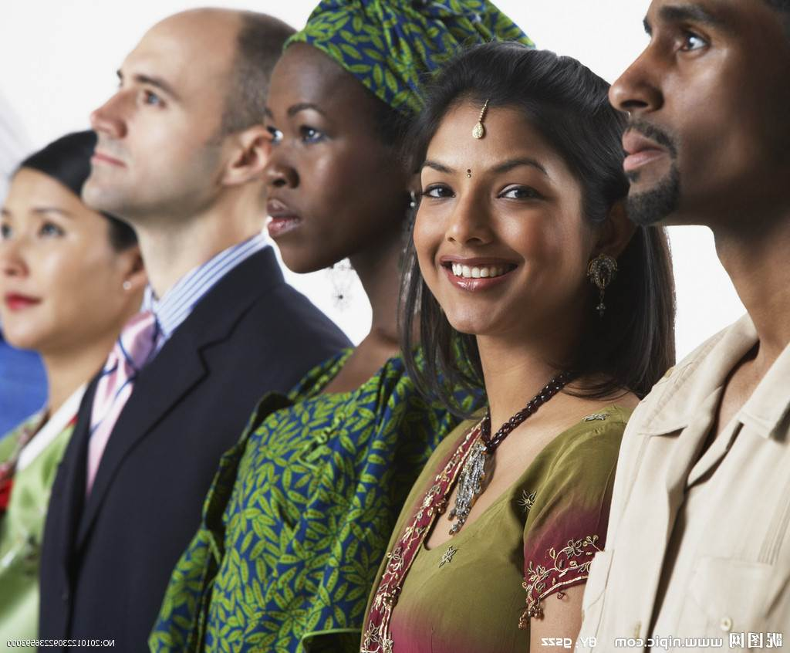
All over this world
All over this world
People are (1) _________, but not the same
All over this world
In France, it’s called a crepe
In China, they are called Moo-shoo
In Ethiopia, it doubles as a plate, and they use it to eat with, too
There’s Mexican tortillas, latkes in Israel
In Denmark, they’re called pandekager
And just about everywhere around the world
You’ll find some kind of pancake there
alike

Slide 22
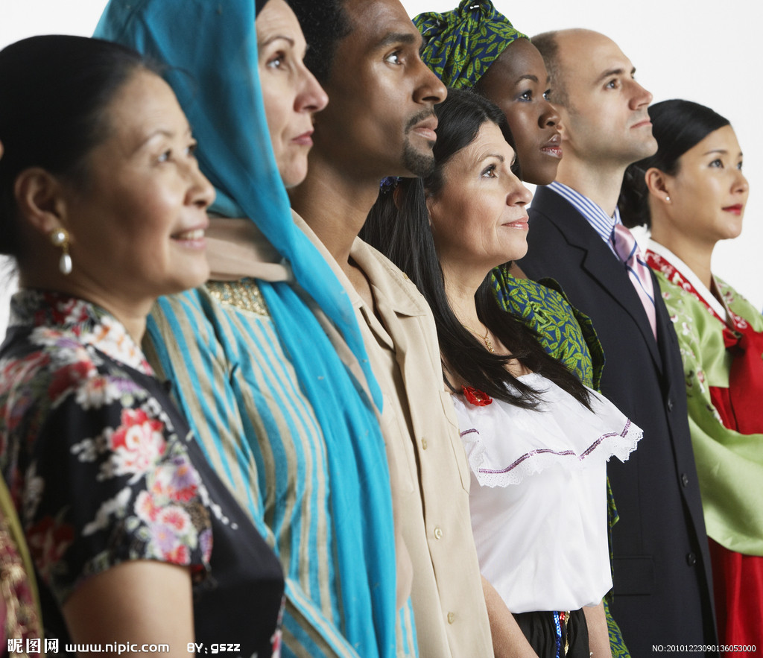
have always been amazed, wherever I do roam
There’s always a lot that’s new to me
And so much that makes feel at home
We speak different (2) _______
We sing different songs
We have different religions and (3) ______
But we share so many hopes and dreams
Though we come from different places
words
races

Slide 23
In Arabic, they say “salaam”; They say “shantee” in Hindu
“Paz” is the word in Spanish, and “shalom” is the word in Hebrew
These words of peace in every land, they make such a beautiful (4) _________
And we all share the hope for peace, this whole (5) _____________________
All over this world, all over this world
We all share the hope for peace
All over this world
All over this world
sound
wide world around

Slide 24
Part 1
Part 2
Part 3
Part 4
Part 5
Part 6
Lead-in
Listening ＆
Speaking
Reading
Grammar
Watching & Performing
Applied Writing

Slide 25
Text A Intensive Reading

Slide 26
Text A Intensive Reading

Slide 27
Part Ⅲ
Text A Intensive Reading 1
★ present /ˈpreznt/
v. (a) to show or describe sth. / sb. in a particular way （以某种方式）展现，显示，表现
e.g. You need to present yourself better.
你需要更善于展示自己。
(b) to give sth. to sb., especially formally at a ceremony 把……交给；颁发；授予
~ sb. with sth. / ~ sth. to sb.
e.g. The sword was presented by the family to the museum. 这家人把宝剑捐赠给了博物馆。
n. (a) a thing that you give to sb. as a gift 礼物；礼品
e.g. What can I get him for a birthday present?
我给他送点什么生日礼物呢？
(b) the time now 目前；现在
e.g. I’m sorry he’s out at present.
很抱歉，他这会儿不在。
Drowned¹ in the Culture Gap
1 The first time our family was invited out to dinner in America, we disgraced² ourselves while eating celery³. In China we never ate celery raw⁴. When we were presented⁵ with our first relish⁶ tray⁷, the raw celery caught us unprepared.
★ disgrace
/dɪsˈgreɪs/ v.
to behave badly in a way that makes you or other people feel ashamed 使丢脸；使蒙受耻辱
e.g. He had disgraced the family fame. 他玷污了家族的名声。
n. the loss of other people’s respect and approval because of the bad way sb. has behaved 丢脸；耻辱；不光彩
e.g. There is no disgrace in being poor. 贫穷并不耻辱。
★ relish /ˈrelɪʃ/ n.
a cold thick spicy sauce made from fruit and vegetables that have been boiled, that is served with meat, cheese, etc.
风味佐料（用水果和蔬菜煮后制成的冷稠酱汁）
e.g. Spices give relish to a dish. 调味香料使菜肴味美。
v. to get great pleasure from sth.; to want very much to do or have sth.
享受；从……获得乐趣；渴望；喜欢
★ raw
/rɔː/ adj.
(a) not cooked 生的；未烹制的；未煮的
e.g. These fish are often eaten raw.
这些鱼常常生吃。
(b) in its natural state; not yet changed, used or made into sth. else 未经加工的；自然状态的
e.g. raw sugar 原糖
深陷在文化差异的泥淖
在美国，我们家第一次受邀出去吃饭时，就因为吃芹菜而丢尽了脸。在中国，我们从来不吃生的芹菜。主人呈上第一道美味时，摆在我们面前的生芹菜着实让我们措手不及。
★ be invited to 受邀参加
e.g. Our family are invited to attend a dinner party.
★ drown /draʊn/ v. 淹死，淹没
★ tray /treɪ/ n. 盘子；托盘
★ celery /'seləri/ n. 芹菜

Slide 28
Part Ⅲ
Text A Intensive Reading 2-3
2 We had been invited to dinner by our neighbors, the Gleasons. Mrs. Gleason offered the relish tray to my mother. “Do try some of the celery, Mrs. Lin,” she said.
3 Mother picked up one of the green stalks⁸, and we all did, too. Mrs. Gleason went off with the relish tray to the other guests, and we carefully watched to see what they did. Everyone seemed to eat the raw vegetables quite happily.
我们是受邻居格里森一家之邀去吃饭。格里森太太递给我母亲一道菜，说道“林太太，吃点芹菜吧！”
母亲选了一根绿色的茎，我们也都照做了。然后格里森太太就拿着菜盘去招呼别的客人了。我们很谨慎地看着别人都是怎么做的，每个人似乎都吃得很开心。
★ stalk
/stɔːk/ n. 茎，叶柄

Slide 29
Part Ⅲ
Text A Intensive Reading 4-6
4 Mother took a bite⁹ of her celery. Crunch¹⁰. “It’s not bad!” she whispered¹¹.
5 Father took a bite of his celery. Crunch. “Yes, it is good,” he said, looking surprised.
6 I took a bite, and then my brother. Crunch, crunch.
母亲咬了一口芹菜，嘎吱嘎吱地咀嚼了起来，并轻声跟我们说：“味道还不错”。
父亲也咬了一口，嘎吱嘎吱地咀嚼了起来。说道“挺好吃的”，看起来很以外。
我咬了一口，紧接着弟弟也吃了起来。
★ crunch /krʌntʃ/ v. 嘎吱嘎吱地咀嚼
★ whisper /'wɪspə(r)/ v. 低声说；私下说
★ bite /baɪt/ n. 咬

Slide 30
Part Ⅲ
Text A Intensive Reading 7-8
7 There was only one problem: long strings¹² ran through the length¹³ of the stalk, and they got caught in my teeth.
★ string
/strɪŋ/ n.
(a) material made of several threads twisted together, used for tying things together; a piece of string used to fasten or pull sth. or keep sth. in place 细绳；线；带子
e.g. a piece/length of string 一根/一段细绳
(b) a set or series of things that are joined together, for example on a string 一串
e.g. a string of success 接二连三的成功
★ length
/leŋθ/ n.
the size or measurement of sth. from one end to the other 长；长度
e.g. This room is twice the length of the kitchen. 这个房间的长度是厨房的两倍。
at length 长时间；详尽地
e.g. We have already discussed this matter at great length.
我们已经十分详尽地讨论了这个问题。
只有一个问题：芹菜秆上都是长长的纤维，而且塞到我的牙缝里。
我把纤维从芹菜秆里抽出来，发出“嗤嗤嗤嗤”的声音，我弟弟也跟着我做。“嗤嗤嗤嗤”。在我的左手边，我的父母亲也在摆弄着他们的各自的芹菜，“嗤嗤嗤嗤”。
★ follow suit
跟着某人做；仿效某人；照着做
e.g. Father bowed his head; she followed suit. 父亲点头，她也跟着点头。
8 I pulled the strings out of my stalk. Z-z-zip¹⁴, z-z-zip. My brother followed suit. Z-z-zip, z-z-zip. To my left, my parents were taking care of their own stalks. Z-z-zip, z-z-zip.
★ zip /zɪp/ v. 用拉拉链的方式拉

Slide 31
Part Ⅲ
Text A Intensive Reading 9-10
9 Suddenly I realized that there was dead silence except for our zipping. Looking up, I saw that the eyes of everyone in the room were on our family.
忽然，我意识到除了我们撕拉芹菜的“嗤嗤嗤嗤”声，周围一片沉寂。我抬头一看，屋子里所有人的目光都聚焦到我们一家人身上。
有一天，我父母说想要请客吃饭。除我们的中国朋友外，还要邀请格里森一家。
★ except for
除……之外；若不是
e.g. Except for her illnesses, she had had a particularly happy childhood.
除了体弱多病外，她的童年特别幸福。
★ announce
/əˈnaʊns/ v.
to tell people sth. officially, especially about a decision, plans, etc.
宣布，宣告（决定、计划等）
10 The day came when my parents announced¹⁵ that they wanted to give a dinner party. Besides some Chinese friends, we were going to invite the Gleasons.

Slide 32
Part Ⅲ
Text A Intensive Reading 11
★ individual
/ˌɪndɪˈvɪdʒuəl/ adj.
considered separately rather than as part of a group 单独的；个别的
e.g. We interviewed each individual member of the community.
我们采访了社区中的每个成员。
n. a person considered separately rather than as part of a group 个人
e.g. Treatment depends on the individual involved. 治疗方式因人而异。
11 Mother decided not to take a chance with chicken gizzards¹⁶. Since we had western guests, she set the table with large dinner plates¹⁷ never used in Chinese meals. In fact, we didn’t use individual¹⁸ plates at all, but picked up food from the platters in the middle of the table and brought it directly to our bowls.
★ plate /pleɪt/ n. 盘子，盆子
我母亲决定不做鸡胗了，那有一点冒险。因为我们有西方国家的客人，她用从来不在中餐中用的很大的餐盘布置餐桌。事实上，我们根本不用个人餐盘，而是从餐桌中间的大浅盘中取餐，然后直接放在自己的碗里。
★ take a chance with 抓住机会
e.g. We will take a chance with the weather and go for a picnic.
★ gizzard /'gɪzəd n. （鸟的）胃

Slide 33
Part Ⅲ
Text A Intensive Reading 12-13
12 The dinner started well.
晚餐开始得很顺利。
当我扭会头看格里森先生时我震惊了。他正在他的盘子里追着夹一颗豌豆。好几次他将豌豆弄到盘子边缘，但试着用筷子夹起时，豌豆又溜到了盘子中间。最后，他放下筷子，用手指捏起豌豆。他的确这么做了，作为一个成年人！
13 I was horrified when I turned to look at Mr. Gleason. He was chasing¹⁹ a pea around his plate. Several times he got it to the edge²⁰, but when he tried to pick it up with his chopsticks²¹, it rolled²² back toward the center of the plate again. Finally he put down his chopsticks and picked up the pea with his fingers. He really did! A grown man!
★ edge /edʒ/ n.
the outside limit of an object, a surface or an area; the part furthest from the centre
边；边缘；边线；边沿
e.g. He stood on the edge of the cliff. 他站在悬崖边上。
★ chase /tʃeɪs/ v.
to run, drive, etc. after sb. / sth. in order to catch them 追赶；追逐；追捕
~ after sb. / sth.
e.g. My dog likes chasing rabbits. 我的狗喜欢追捕兔子。
★ roll /rəʊl/
turn over and over and move in a particular direction; to make a round object do this
（使）翻滚，滚动
e.g. The ball rolled down the hill. 球滚下了山。
★ chopstick /'tʃɒpstɪk/ n. 筷子

Slide 34
Part Ⅲ
Text A Intensive Reading 14
14 All of us, our family and the Chinese guests, stopped eating to watch the activities of the Gleasons. For some reasons I thought of celery strings.
我们所有人，包括我们全家和中国客人们，都停下筷子看格里森的“表演”。这一刻，让我想起来了芹菜秆。
★ think of 考虑，想起
e.g. I can’t think of a better way to spend my spare time.

Slide 35
After reading and watching the videos, you must have a better understanding of “Culture Gap” ,so try to set some examples of it in your life.
https://haokan.baidu.com/v?pd=wisenatural&vid=11847313424853885577

Slide 36
Drowned in the Culture Gap
1 drown /draʊn/ v. 淹死，淹没
2 disgrace /dɪs'greɪs/ v. 使丢脸，使受耻辱
3 celery /'seləri/ n. 芹菜
4 raw/rɔː/ adj. 生的，未加工的
5 present /preznt/ v. 产生；出现
6 relish /'relɪʃ/ n. 味道；滋味；调味品
7 tray /treɪ/ n. 盘子；托盘
8 stalk /stɔːk/ n. 茎，叶柄
9 bite /baɪt/ n. 咬
10 crunch /krʌntʃ/ v. 嘎吱嘎吱地咀嚼
11 whisper /'wɪspə(r)/ v. 低声说；私下说
New Words

Slide 37
12 string /strɪŋ/ v. 植物纤维；绳子；线丝
13 length /leŋθ/ n. 长度
14 zip /zɪp/ v. 用拉拉链的方式拉
15 announce /ə'naʊns/ v. 宣布；预报；声称
16 gizzard /'gɪzəd/ n. （鸟的）胃
17 plate /pleɪt/ n. 盘子，盆子
18 individual /ˌɪndɪ'vɪdʒuəl/ adj. 个人的；个别的
19 chase /tʃeɪs/ v. 追求；追寻
20 edge /edʒ/ n. 边缘；边线；边沿
21 chopstick /'tʃɒpstɪk/ n. 筷子
22 roll /rəʊl/ v. 翻滚；滚动

Slide 38
be invited to 受邀参加
e.g. Our family are invited to attend a dinner party.
follow suit 跟着做，如法炮制
e.g. In the wake of his success, other filmmakers began to follow suit.
except for 除了
e.g. Except for the remarkably tidy kitchen, the place is a mess.
take a chance with 抓住机会
e.g. We will take a chance with the weather and go for a picnic.
think of 考虑，想起
e.g. I can’t think of a better way to spend my spare time.

Slide 39
The first time our family was invited out to dinner in America, we disgraced ourselves while
eating celery. (Para. 1)
The first time 后面引导的是一个同位语从句，从句用陈述句语序。主句是后面的we disgraced
ourselves while eating celery。
Mrs. Gleason went off with the relish tray to the other guests, and we carefully watched to see what they did. (Para. 3)
句中and 连接的是两个并列句，其中后面的句子包含一个由what 引导的宾语从句，作see 的宾语。
In fact, we didn’t use individual plates at all, but picked up food from the platters in the middle of the table and brought it directly to our bowls. (Para. 11)
此句中应注意“not... but...”的用法，意思是“不是……而是……”。另外，not...at all 也是固定搭配，意思是“一点也不；根本不”。

Slide 40
Several times he got it to the edge, but when he tried to pick it up with his chopsticks, it rolled
back toward the center of the plate again. (Para. 13)
句中but 后面是转折句，包含一个由when 引导的时间状语从句。
All of us, our family and the Chinese guests, stopped eating to watch the activities of the Gleasons.(Para. 14)
our family and the Chinese guests 是对All of us 的补充说明。stop doing sth. to do sth. 表示“停止做……去做……”，最终发生的动作是to 后面的动词。

Slide 41
1
Read Text A and complete the following table.
The American people eat raw celery in the dinner party.
We Chinese people never use individual plates but pick up food from the platters in the middle of the table.
We Chinese people use chopsticks but Americans use fork and knife.

Slide 42
2
Answer the following questions and then discuss with your partners.
Why did the author feel disgraced when the family was invited to a dinner party?
Have you heard anything about the foreigners’ attitude towards “chicken gizzard”?
Have you ever experienced culture shocks? Share them with your classmates.

Slide 43
3
Please read the 3rd and the 13th paragraph aloud and recite them.

Slide 44
4
Fill in the blanks with the words given below. Change the form where necessary.
chased
1 She__________ the thief for 100 meters.
2 Station staff ____________the arrival of the train.
3 As soon as we_______ something was wrong, we moved the children away.
4 They wait for the group to decide rather than making____________ decisions.
5 “Keep your voice down,” I __________.
6 I have myself by the actions I have ___________taken.
7 Her dream is to_________ a lifestyle shown on television.
8 She arrived at the bus station looked like a rat___________.
announced
raw
individual
whispered
disgraced
presented
drown

Slide 45
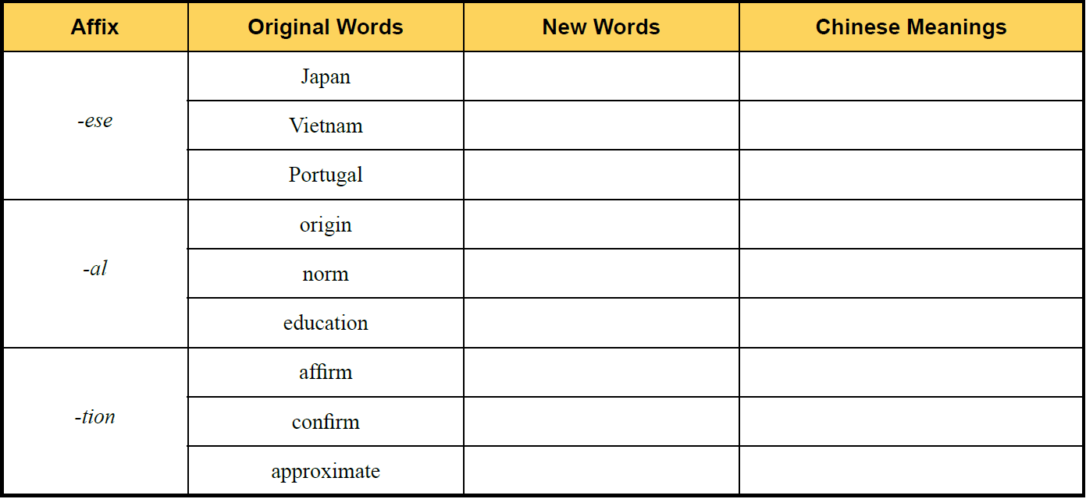
5
Add -ese , -al or -tion to the following words to form new words and give the corresponding Chinese meanings of the new words.
Japanese
日本人
Vietnamese
越南人
Portuguese
葡萄牙人
original
原来的
normal
正常的
educational
教育的
affirmation
主张
confirmation
确认
approximation
接近

Slide 46
6
There are two sentences chosen from the text. Choose the best Chinese translation for
each sentence.
B
1 When we were presented with our first relish tray, the raw celery caught us unprepared.
A. 当给我们上了第一盘调味料之后，我们对生芹菜毫无准备。
B. 主人呈上第一道美味时，摆在我们面前的生芹菜着实让我们措手不及。
C. 主人呈上第一道美味时，我们没有准备面对眼前的芹菜。

Slide 47
6
There are two sentences chosen from the text. Choose the best Chinese translation for
each sentence.
A
2 Suddenly I realized that there was dead silence except for our zipping.
A. 突然间，我意识到周围一片静寂，只有我们发出的吱吱声。
B. 突然间，我意识到周围一片死的沉默，只有我们发出的吱吱声。
C. 突然间，我意识到周围一片静寂，只有我们拉拉链的声响。

Slide 48
7
Complete the following sentences with the given sentence structures
There is one problem...问题是
e.g. There was one problem: who will be in charge of the class. 问题是，谁来负责班级事务呢。
1 ______________________ ( 问题是): who was the last one to leave.
2 ______________________ ( 那么有一个问题): how should we solve the problem.
The day come when...这一天来临了
e.g. The day came when we realized that we made a mistake.
我们意识到我们犯了一个错误的这一天来临了。
1 _______________ ( 这一天终于到了) we finished our high school.
2 _______________ ( 这一天到了) we knew who should be blamed for the accident.
There was one problem
So there is one problem
The day came
The day came

Slide 49
Text B Extensive Reading

Slide 50
Text B Extensive Reading

Slide 51
Part Ⅲ
Text B Extensive Reading 1
I Love You = Wo Ai Ni?
1 Language¹ is so much more than the words we utter². Take the usage of the phrase “I love you” for example, I have heard Americans say those three words to people they’ve hardly met. I slowly get used to hearing these words of affection³ thrown around like a greeting⁴.
★ language
/ˈlæŋgwɪdʒ/ n.
the system of communication in speech and writing that is used by people of a particular country or area 语言；语言文字
e.g. It takes a long time to learn to speak a language well.
学好一种语言需要花很长时间。
★ utter
/ˈʌtə(r)/ v.
(formal) to make a sound with your voice; to say sth. 出声；说；讲
e.g. She did not utter a word during lunch. 进午餐时，她一言未发。
adj. used to emphasize how complete sth. is 完全的；十足的；彻底的
e.g. He felt an utter fool. 他觉得自己蠢到家了。
I Love You = Wo Ai Ni吗？
语言远不止我们讲的话。就拿“我爱你”这个短语的用法来看，我听说美国人会对他们不常见面的人也说这三个字。我也渐渐习惯听到这种传达喜爱的表达被像问候语一样随意使用。
★ affection
/əˈfekʃn/ n.
he feeling of liking or loving sb. / sth. very much and caring about them 喜爱；钟爱
e.g. Children need lots of love and affection.
孩子需要多多疼爱和关怀。
★ take… for example
以……为例；譬如
e.g. Take, the two images above, for example. 譬如说, 看看上面这两幅图像。
★ get used to
习惯于……
e.g. I have get used to live in Paris.
我已经习惯在巴黎生活。
★ greeting
/ˈgriːtɪŋ/ n.
sth. that you say or do to greet sb. 问候；招呼；迎接；致意
e.g. She waved a friendly greeting. 她友好地挥手致意。

Slide 52
Part Ⅲ
Text B Extensive Reading 2
2 My American friend recently admitted⁵ to me sometimes she feels those words are cheapened⁶. Being Chinese I’ve had to learn this cultural phenomenon⁷ and I’ve observed⁸ the following situations⁹ in the way Americans say “I love you”.
★ admit
/ədˈmɪt/ v.
to agree, often unwillingly, that sth. is true
（常指勉强）承认
~ to (doing) sth.
e.g. She admits to being strict with her children. 她承认对自己的孩子很严厉。
★ phenomenon
/fəˈnɒmɪnən/ n.
a fact or an event in nature or society, especially one that is not fully understood 现象
e.g. Globalization is a phenomenon of the 21st century. 全球化是21世纪的现象。
★ situation
/ˌsɪtʃuˈeɪʃn/ n.
all the circumstances and things that are happening at a particular time and in a particular place 情况；状况；形势；局面
e.g. to be in a difficult situation 处境困难
我的美国朋友最近也承认说，很多时候她觉得这些表达变得廉价了。作为一个中国人，我得习惯这种文化现象。同时，我也观察到了以下一些美国人说“我爱你”的情形。
★ in the way of…
以……的方式；挡道
e.g. There was something peculiar in the way he smiled. 他笑起来有点怪。
This table is too close to the door, it gets in the way.
这张桌子离门口太近了，挡住道了。
★ observe
/əbˈzɜːv/ v.
to see or notice sb. / sth.
看到；注意到；观察到
★ cheapen
/'tʃiːpən/ v. 使减价；使降价

Slide 53
Part Ⅲ
Text B Extensive Reading 3
3 A family who respect¹⁰ one another may express “I love you” frequently¹¹ as a sign of authentic¹² love for each other. They see the importance of leaving no room to doubt¹³ for their children or spouse¹⁴ to truly receive the heart behind the spoken words.
★ respect
/rɪˈspekt/ v.
have a very good opinion of sb. / sth.; to admire sb. / sth. 尊敬；尊重；仰慕
~ sb. / sth. for
e.g. She had always been honest with me, and I respect her for that.
她一直对我很诚实。我非常敬重她这一点。
★ authentic
/ɔːˈθentɪk/ adj.
known to be real and genuine and not a copy 真正的；真品的；真迹的
e.g. I don’t know if the painting is authentic. 我不知道这幅画是不是真迹。
★ leave no room
不留余地
e.g. The house if full of boxes, leaving no room for a piano.
房子里堆满了箱子，没有给钢琴留下一点余地。
★ frequently
/ˈfriːkwəntli/ adv.
often 频繁地；经常
e.g. Buses run frequently between the city and the airport.
公共汽车频繁地来往于市区与机场之间。
★ doubt
/daʊt/ v.
to not trust sb. / sth.; to not believe sb.
怀疑，不相信，不信任
相互尊重的家庭成员之间可以频繁地表达“我爱你”，这是彼此真诚相爱的标志。他们懂得到不给孩子或配偶留下任何疑虑，让他们真正地感受话语背后的真心的重要性。
★ spouse /spaʊs/ n. 配偶

Slide 54
Part Ⅲ
Text B Extensive Reading 4
4 “I love you” becomes an acquiescence¹⁵ in society. Imagine¹⁶ a parent who is never around and drops the L-bomb at the end of a phone talk in order to soothe¹⁷ their guilt. Or a marriage¹⁸ whose passion¹⁹ has grown cold but continue the ritualistic²⁰ “I love you” each morning as they go off to work in order to keep up the appearance²¹ of a healthy bond.
“我爱你”已经成为社会默许的表达。想象一下，从未陪伴在你身边的父母。只是在电话那头传达爱意，以此来减轻他们的负罪感。或者是激情已经退却的婚姻，却在形式上保持着每天早晨上班前说“我爱你”，以便看起来他们的婚姻关系维持得很好。
★ acquiescence
/ˌækwiˈesns/ n.
the fact of being willing to do what sb. wants and to accept their opinions, even if you are not sure that they are right
默然接受；默认；默许；顺从
e.g. He bowed his head in sign of acquiescence. 他点头表允许。
★ marriage
/ˈmærɪdʒ/ n.
the legal relationship between a husband and wife 结婚；婚姻
e.g. She has two children by a previous marriage. 她和前夫有两个孩子。
★ passion
/ˈpæʃn/ n.
a very strong feeling of love, hatred, anger, enthusiasm, etc. 强烈情感；激情
e.g. He’s a man of violent passions.
他是个性情暴烈的人。
★ imagine
/ɪˈmædʒɪn/ v.
to form a picture in your mind of what sth. might be like 想象；设想
★ appearance /ə'pɪərəns/ n. 外貌，外观；出现，露面
★ in order to 为了……
★ ritualistic /ˌrɪtʃuə'lɪstɪk/ adj.
仪式的，固守仪式的；惯例的
★ at the end of 在……结尾，在……末端
★ soothe /suːð/ vt. 安慰；缓和；使平静

Slide 55
Part Ⅲ
Text B Extensive Reading 5
5 Sadly there are truly broken, perhaps even abusive²², homes where family members have never been loved nor been told they are loved.
可悲的是，那些家庭成员不相互爱戴也没有表达过爱意的家庭早已破碎了，甚至恶语相向。
★ abusive
/ə'bjuːsɪv/ adj. 骂人的；滥用的；虐待的

Slide 56
Part Ⅲ
Text B Extensive Reading 6
6 The problem appears when Americans meet Chinese families who have never uttered those precious²³ three words, “wo ai ni”. I’m afraid the American easily concludes²⁴ the Chinese must be a family of three. I’m even more afraid when Christian Americans make it their mission²⁵ to express true love to Chinese families, as they assume²⁶ Chinese must not know how to love if they don’t say it. Actually, Chinese families know how to love fiercely²⁷. They do it through immense generosity²⁸, unwavering²⁹ loyalty³⁰, and a lot of food. We love differently, not better, not worse, but definitely different.
★ mission
/ˈmɪʃn/ n.
(a) he work of teaching people about Christianity, especially in a foreign country; a group of people doing such work （尤指在海外的）传教，布道；布道团
e.g. a Catholic mission in Africa 在非洲的天主教传教士
(b) an important official job that a person or group of people is given to do, especially when they are sent to another country 官方使命；使团的使命
e.g. a trade mission to China 赴华贸易使命
当美国人见到从来不会讲“我爱你”三个宝贵的字的中国家庭时，问题就来了。恐怕是美国人会简单地认为中国家庭都是三口之家。我更害怕，美国的基督徒把向中国家庭传达什么是真爱当作他们的使命，因为他们以为如果不说出来的话，中国人不懂得如何去爱。事实上，中国家庭知道怎么去爱。他们通过无私与慷慨，坚定不移的忠诚，还有很多食物来表达。我们爱的方式不同，不是哪种更好，或是哪种更糟，而是明显的不同。
★ precious
/ˈpreʃəs/ adj.
rare and worth a lot of money 珍奇的；珍稀的
e.g. a precious vase 稀世花瓶
You are wasting precious time! 你在浪费宝贵的时间！
★ assume
/əˈsjuːm/ v.
to think or accept that sth. is true but without having proof of it 假定；假设；认为
★ conclude
/kənˈkluː:d/ v.
to decide or believe sth. as a result of what you have heard or seen 断定；推断出；得出结论
★ loyalty /'lɔɪəlti/ n.
忠诚，忠实；忠心
★ be afraid 恐怕，害怕
★ unwavering /ʌn'weɪvərɪŋ/ adj. 不动摇的，坚定的
★ generosity /ˌdʒenə'rɒsəti/ n. 慷慨，大方；宽容或慷慨的行为
★ fiercely /'fɪəsli/ adv.
凶猛地；残酷地；猛烈地；激烈地

Slide 57
Part Ⅲ
Text B Extensive Reading 7
7 This is not to say verbal³¹ expression of love is useless. Some non-traditional Chinese families are starting to freely say “I love you” to each other and I believe that can be a healthy development³². But I do believe the community³³ should decide for themselves when or how they want to exhibit³⁴ the love.
★ community
/kəˈmjuːnəti/ n.
all the people who live in a particular area, country, etc. when talked about as a group
社区；社会
e.g. The local community was shocked by the murders.
当地社会对这些谋杀案感到震惊。
★ exhibit
/ɪgˈzɪbɪt/ v.
to show sth. in a public place for people to enjoy or to give them information
展览；展出
e.g. They will be exhibiting their new designs at the trade fairs.
他们将在商品交易会上展出他们新的设计。
不是说口头表达的爱是没用的，一些不是非常传统的中国家庭开始经常地对彼此说 “我爱你”，我相信这是一个良好的发展趋势。但我也认为，人们应该自主决定何时，以及怎样地表达爱意。
★ verbal
/ˈvɜːbl/ adj.
spoken, not written 口头（而非书面）的
e.g. verbal instructions 口头指示
★ development
/dɪ'veləpmənt/ n. 发展，进化

Slide 58
I Love You = Wo Ai Ni?
1 language /'læŋgwɪdʒ/ n. 语言，语言文字
2 utter /'ʌtə(r)/ v. 发出声音；说，讲
3 affection /ə'fekʃn/ n. 喜爱，慈爱；情感或感情
4 greeting /'griːtɪŋ/ n. 招呼，问候；敬礼
5 admit /əd'mɪt/ v. 许可进入；承认
6 cheapen /'tʃiːpən/ v. 使减价；使降价
7 phenomenon /fə'nɒmɪnən/ n. 现象，事件；奇迹
8 observe /əb'zɜːv/ v. 观察，研究
9 situation /ˌsɪtʃu'eɪʃn/ n. （人的）情况；局面，形势，处境
10 respect /rɪ'spekt/ vt. 尊重；尊敬；关心；遵守
New Words

Slide 59
11 frequently /'friːkwəntli/ adv. 频繁地，屡次地；往往
12 authentic /ɔː'θentɪk/ adj. 真的，真正的；可信的，可靠的
13 doubt /daʊt/ v. 怀疑，疑惑
14 spouse /spaʊs/ n. 配偶
15 acquiescence /ˌækwi'esns/ n. 默认，默许
16 imagine /ɪ'mædʒɪn/ v. 想，设想；想象；料想
17 soothe /suːð/ vt. 安慰；缓和；使平静
18 marriage /'mærɪdʒ/ n. 结婚；婚姻生活
19 passion /'pæʃn/ n. 激情，热情；热心，爱好
20 ritualistic /ˌrɪtʃuə'lɪstɪk/ adj. 仪式的，固守仪式的；惯例的
21 appearance /ə'pɪərəns/ n. 外貌，外观；出现，露面
22 abusive /ə'bjuːsɪv/ adj. 骂人的；滥用的；虐待的
23 precious /'preʃəs/ adj. 珍贵的，宝贵的

Slide 60
24 conclude /kən'kluːd/ v. 结束，终止；推断
25 mission /'mɪʃn/ n. （基督教徒的）传教，布道
26 assume /ə'sjuːm/ v. 假定，认为
27 fiercely /'fɪəsli/ adv. 凶猛地；残酷地；猛烈地；激烈地
28 generosity /ˌdʒenə'rɒsəti/ n. 慷慨，大方；宽容或慷慨的行为
29 unwavering /ʌn'weɪvərɪŋ/ adj. 不动摇的，坚定的
30 loyalty /'lɔɪəlti/ n. 忠诚，忠实；忠心
31 verbal /'vɜːbl/ adj. 言语的，口头的
32 development /dɪ'veləpmənt/ n. 发展，进化
33 community /kə'mjuːnəti/ n. 社区；社会团体
34 exhibit /ɪg'zɪbɪt/ v. 表现，显示，显出（感情、品质或能力）

Slide 61
1 take... for example 以……为例
2 get used to 习惯于
3 in the way 以……方式；挡道
4 leave no room 不留余地
5 at the end of 在……结尾，在……末端
6 in order to 为了……
7 be afraid 恐怕，害怕

Slide 62
1 According to the text, in what situations do Americans say “I love you”?
A. A family who respect one another.
B. A parent who is around and never drops the L-bomb at the end of a phone talk in order to soothe their guilt.
C. A marriage full of passion.
D. A traditional American-born Chinese family in America.
2 Which one is NOT the reason why the author’s American friend feel “I love you” cheapened?
A. These words become an acquiescence in society.
B. People say those three words to those they’ve hardly met.
C. These words of affection are thrown around like a greeting.
D. People don’t say them exactly.
A
D

Slide 63
B
3 What problem appears when Americans meet Chinese families?
A. The Americans teach the Chinese to say “wo ai ni”.
B. Christian Americans make it their mission to express true love to Chinese families, as they
assume Chinese must not know how to love if they don’t say it.
C. Chinese hate to say “I love you”.
D. The American easily concludes the Chinese must be a family of five.
4 How do Chinese people show their feeling of love?
A. Say “I love you” frequently.
B. Do it through immense generosity, unwavering loyalty, and a lot of food.
C. Do the same as the Americans.
D. Say “wo ai ni” frequently.
B

Slide 64
C
5 Which one is NOT correct according to the author?
A. Some non-traditional Chinese families are starting to freely say “I love you” to each other.
B. Chinese families show their love differently.
C. Verbal expressions of love is useless.
D. The culture between America and China is different.

Slide 65
Part 1
Part 2
Part 3
Part 4
Part 5
Part 6
Lead-in
Listening ＆
Speaking
Reading
Grammar
Watching & Performing
Applied Writing

Slide 66
There Be 句型
There be 句型在英语中很常见，其基本用法是表示“某地（或某时）存在有某人（或某物）”。There 这个地点副词位于句首作引导词，无实际意义，而真正的主语是be 后面的名词，There be句末多是表示时间或是地点的状语。
there be 结构中的be 是谓语动词，它在人称和数上应和其后的主语保持一致。若有两个或两
个以上的名词，be 动词采取就近原则，与最近的一个名词的数一致。例如：
1）若句子的主语是可数名词单数或不可数名词，动词be 要用is
e.g. There is a book on the desk. 桌子上有一本书。
There is some apple juice in the bottle. 瓶子里有些苹果汁。
2）当其后所接的名词是复数的可数名词时，be 动词用复数are
e.g. There are two boys behind the tree. 树后面有两个男孩。

Slide 67
There Be 句型
1）There be 句型的肯定结构用陈述句语序，常表示“某处（某地）存在有某人或某物”
e.g. There is a bird in the tree. 树上有一只鸟。
2）There be 句型的否定结构是直接在be 动词后加not。not 与be 动词连写时常写作isn’t 或aren’t
【结构】There ＋ be（is / are）＋ not ＋某物/ 某人＋地点/ 时间。
e.g. There isn’t a bird in the tree. 树上没有鸟。
3）There be 句型的一般疑问结构是把be 动词移到句首，再在句尾加上问号
【结构】Be（Is / Are）＋ there ＋某物/ 某人＋地点 / 时间?
e.g. Is there a bird in the tree? 树上有一只鸟吗？
4）There be 句型的特殊疑问结构是在疑问词后面用there be 的一般疑问形式
【结构】疑问词＋某物 / 某人＋ Be（Is / Are）＋ there ＋地点 / 时间?
e.g. How many birds are there in the tree? 树上有几只鸟？

Slide 68
There Be 句型
1）There be 句型和have 都表示“有”的含义。区别如下：
There be 表示“某处存在某物或某人”；have 表示“某人拥有某物 / 某人”，它表示所有、
拥有关系。
e.g. He has two sons. 他有两个儿子。
There are two men in the office. 办公室里有两个男人。
2）当have 表示“包括”“存在”的含义时，There be 句型可与其互换
e.g. A week has seven days.
=There are seven days in a week. 一个星期有七天。

Slide 69
There Be 句型
Change the sentences according to the directions.（按照要求改写句子。）
1 There are four birds in the tree. ( 变为否定句和对划线部分提问的特殊疑问句)
___________________________________________________________
___________________________________________________________
2 There is some fish in this river. ( 变为否定句和一般疑问句)
___________________________________________________________
___________________________________________________________
How many birds are there in the tree?
There are not four birds in the tree.
There are not any fish in this river.
How much fish are there in this river?

Slide 70
Part 1
Part 2
Part 3
Part 4
Part 5
Part 6
Lead-in
Listening ＆
Speaking
Reading
Grammar
Watching & Performing
Applied Writing

Slide 71
1
Watch the drama clip and then role-play this scene.
Setting: It is Todd’s first day in India.

Slide 72
2
Work in pairs. Make a dialogue according to the given situation and useful expressions, and then perform it. The teacher and students in other teams can give a score for the performance. The following score sheet is for your reference.
Situation: You are an automobile salesman. One day, a customer calls and says he wants to buy a Dodge Caravan for his large family.

Slide 73
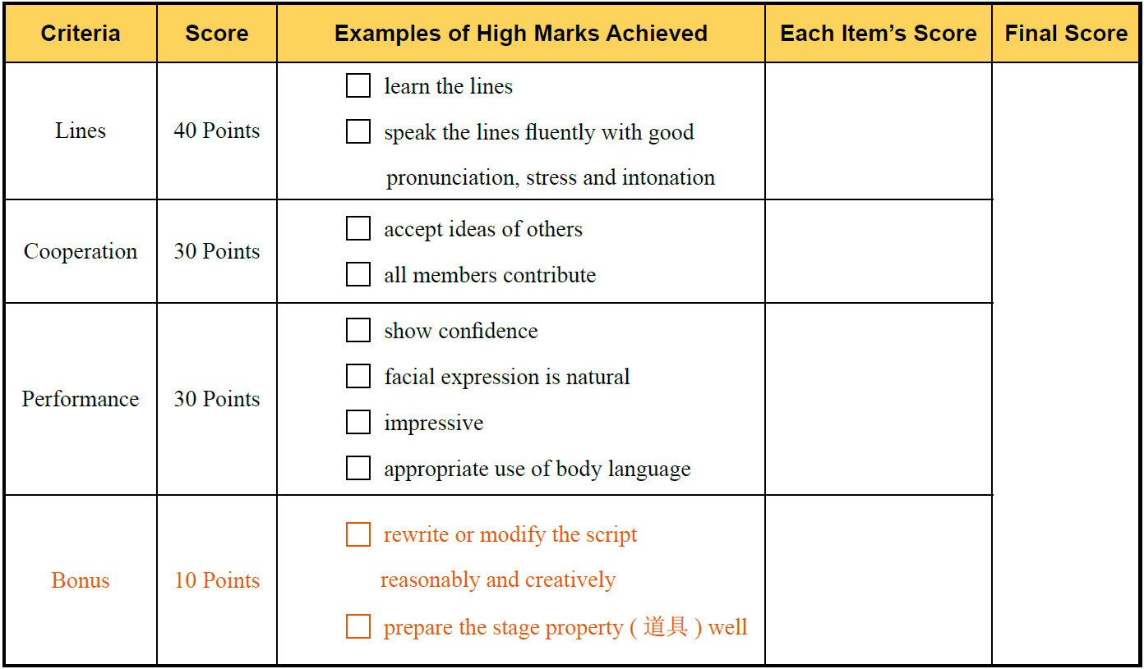

Slide 74
3
Read the lines from the movie La La Land 《爱乐之城 》and try to recite them.

Slide 75
Part 1
Part 2
Part 3
Part 4
Part 5
Part 6
Lead-in
Listening ＆
Speaking
Reading
Grammar
Watching & Performing
Applied Writing

Slide 76
Advertisement
广告的文字应尽量做到：
使用简洁明了的单词和句子。
用词要准确，不使用模棱两可的词句。
既要新颖，又要读起来朗朗上口。
语言学家G. H. Leech 将英语广告中经常出现的形容词按其频率高低依次排列，前二十个是：

