Slide 1
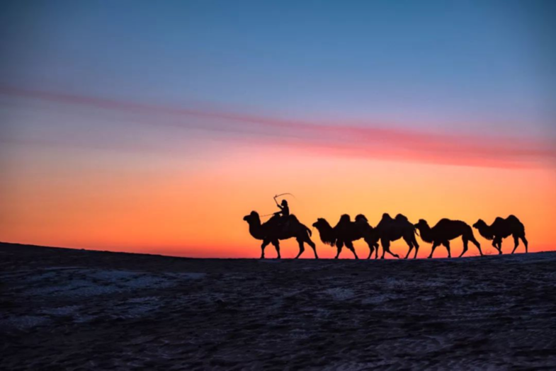
Unit 3 Amazing Travel

Slide 2
Unit Objectives:
Knowledge and skill（知识、技能目标）:
1.Student should acquire the new words and expressions.
2.Students should grasp the grammar of verbs and articles.
3.Students should master how to write notes.
4.Students should know how to describe a trip and scenery
Feelings, attitudes and values（情感、态度和价值观目标）:
Students should know the meaning of travel, and enjoy the beauty of nature.

Slide 3
Unit Objectives:
Ideological and Political Aims（思政目标）
Students should know the meaning of travel.
Enable students to enjoy the beautiful scenery, which may help to stimulate learning interest and enthusiasm

Slide 4
1
Watch the video by scanning the QR code, and then discuss the
question “Which kind of places do you want to travel to and why?” with your partners. Here are some words and phrases for your reference.

Slide 5
2
Watch the video again and choose the correct words to fill in the blanks.
thirst to
What is it about new places that attract us to them? We___________ wander, explore and discover. What drives us to fly around the world, to touch a wall, to find our likes and our__________ ? It’s in our veins ( 血管). It’s human nature that drives us farther, that pushes us higher, that shows us who we are and breaks us________.
Once you’ve touched the world, you’ve changed yours_____________ . It’s a craving ( 雕像；雕刻品) that exists in all of us, which leaves you with only one_________ . You pick a place, you buy a ticket, you pack a bag,__________________ , and you go again.
dislikes
free
forever
option
make a plan

Slide 6
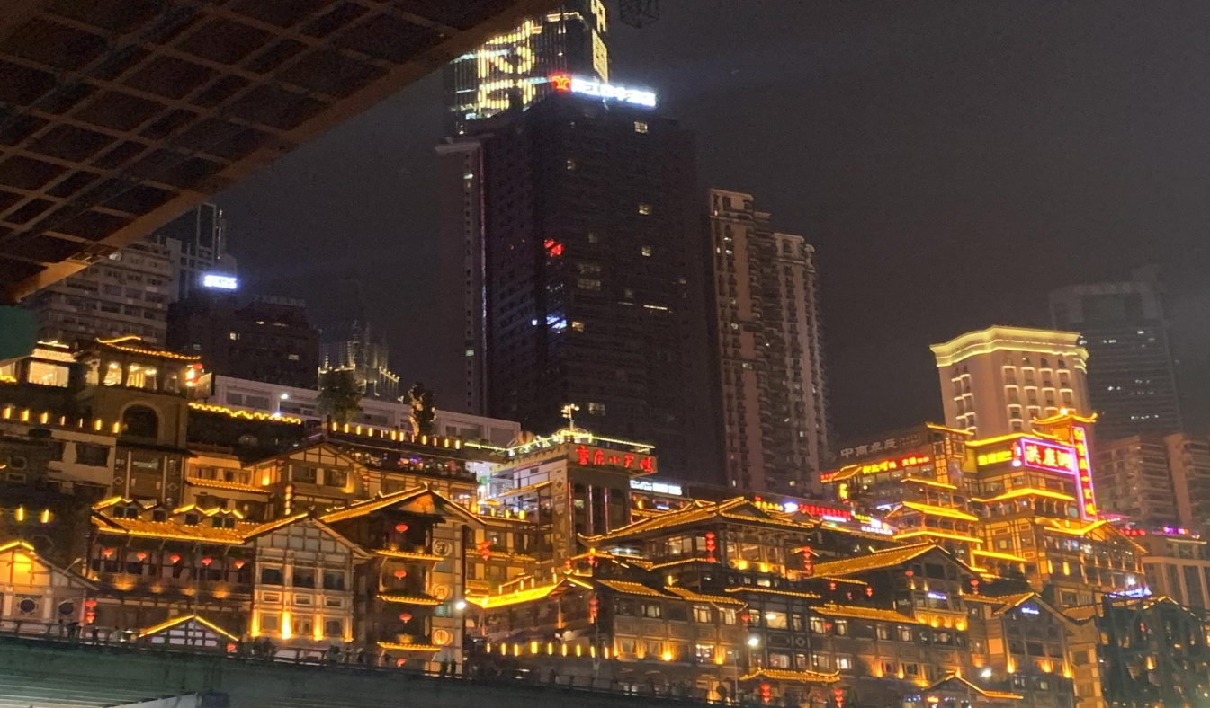
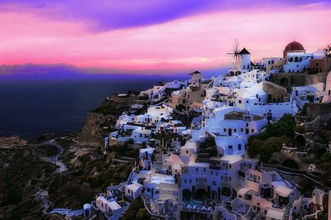
famous tourist attraction
著名的旅游胜地
spend
one’s holiday
度假
travel abroad
出国旅行
seaside(海边)

Slide 7
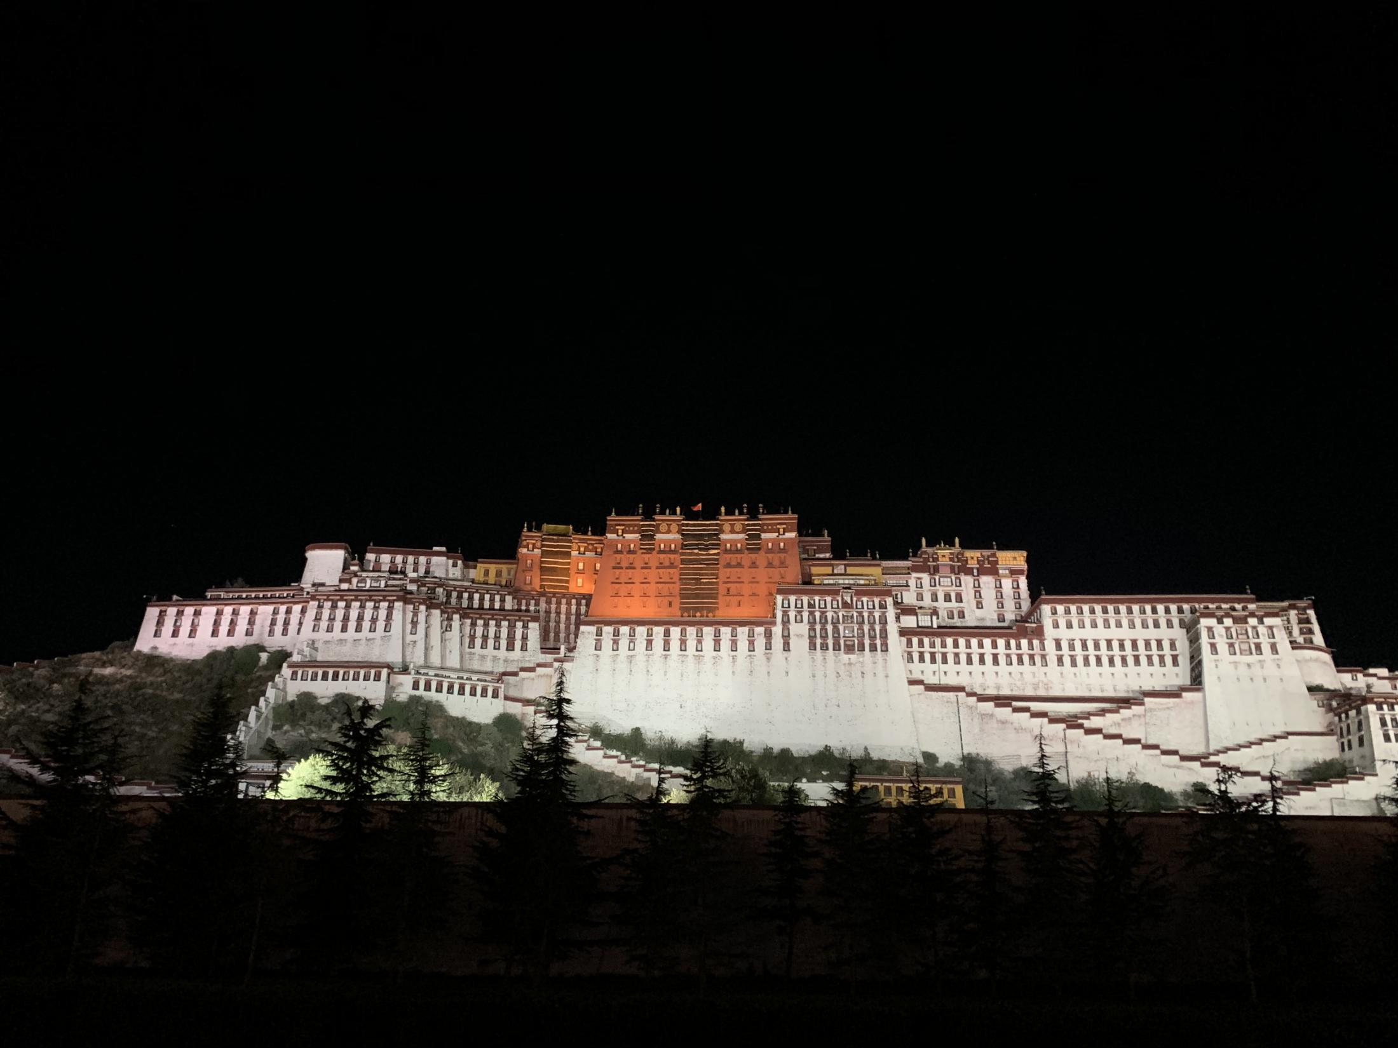
amazing 不可思议的
motivate
刺激，
激发...的积极性
Tibet 西藏t

Slide 8
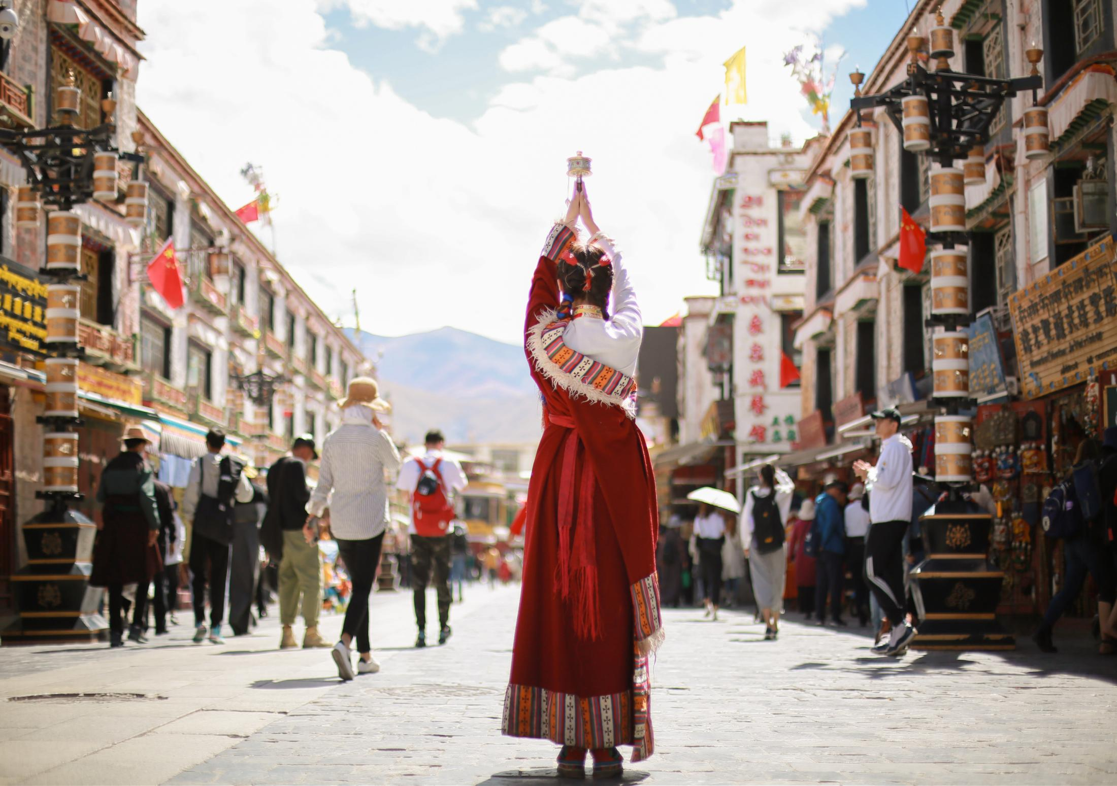
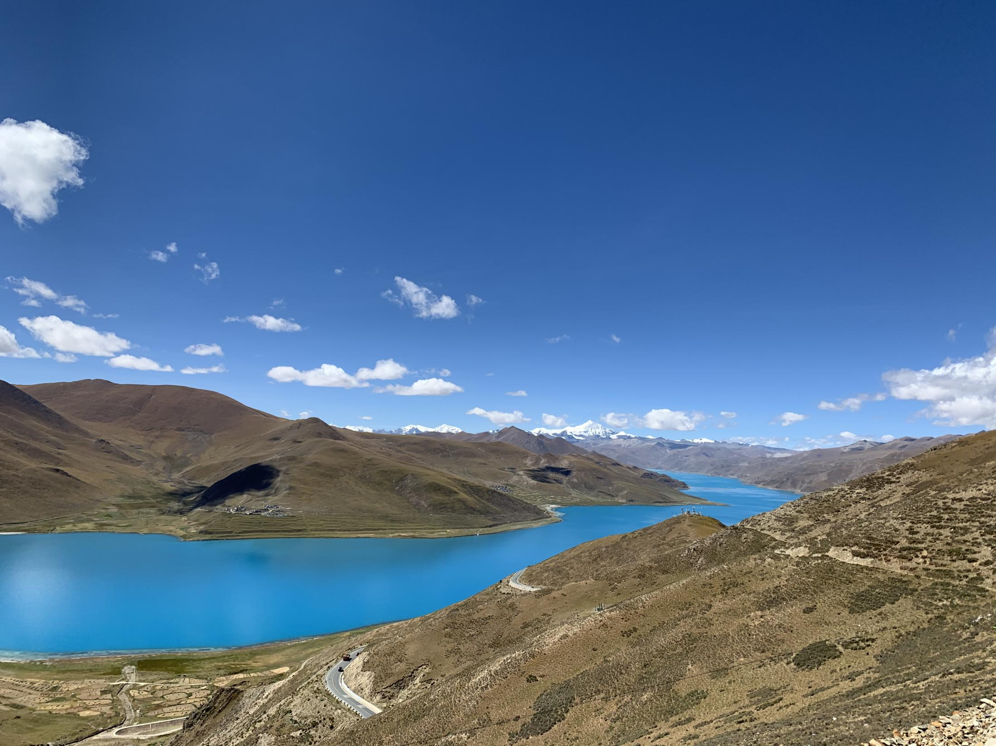
fantastic 极好的，不可思议的
picturesque views 景色如画

Slide 9
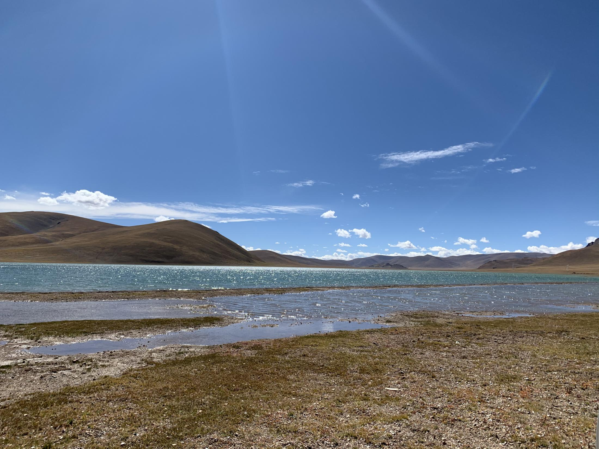
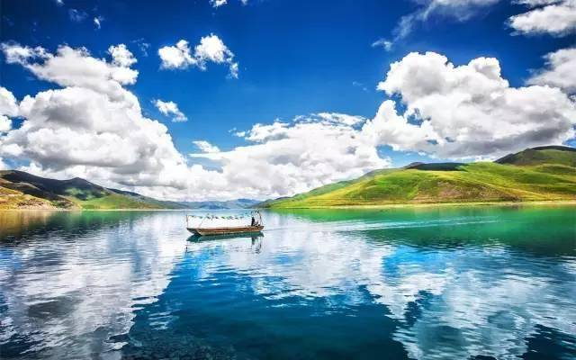
beautiful mountains and clear waters 山清水秀
landscape of lakes and hills
湖光山色

Slide 10
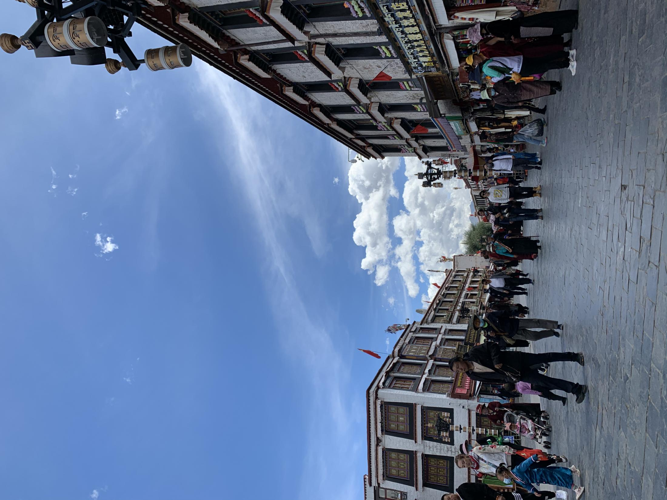
beyond my imagination
超乎想象
a novel experience
全新感受

Slide 11
思政拓展：Belt and Road Initiative
http://www.xinhuanet.com/silkroad/

Slide 13
Dialogue 1
Can I help you
S: Good morning. ___________________?
C: Good morning. Would you show me some typical Chinese souvenirs? I’d like to buy a gift for
my wife.
S: We’ve got plenty of silk scarves and silk dresses for you to choose from.
C: The dress is very nice. _______________ is it ?
S: Fifty-five US dollars.
C: It’s a little more than I expected. Could you give me a _______________?
S: I’d like to, but I’m afraid I can’t. You see, it’s already 5% off the regular price.
C: Then I’m _________ I can’t afford it.
S: Well, let me ask the manager if it’s all right… I’m sorry to have kept you waiting. The best we
can do is to give you a 10% discount.
C: OK. I’ll _________.
How much
discount
afraid
take it

Slide 14
Dialogue 2
R: Good morning! Welcome to Holiday Hotel. What can I do for you?
M: I have a ________________ with you.
R: May I have your name, please?
M: Michael Han.
R: Let me check. Yes, there it is. A double room for one night. Mr. Han, may I have a _______ at your
passport, please?
M: OK, here you are.
R: Would you please __________ the registration form?
M: All right. What’s the rate for one person per night?
R: 59 dollars.
M: Do you accept traveler’s checks?
R: Sure. Here is the key card to room 3316. The bell-man will show you the way.
M: Thanks. I will be leaving tomorrow. When shall I ____________out ?
R: Any time before 11:00 a.m.
M: All right. I’ll remember that.
reservation
look
fill out
check

Slide 15
Situation: You are checking in a hotel where you have already made a reservation. But the receptionist tells you that they don’t have your reservation record ( 预订记录). Now you have to deal with this problem.

Slide 16
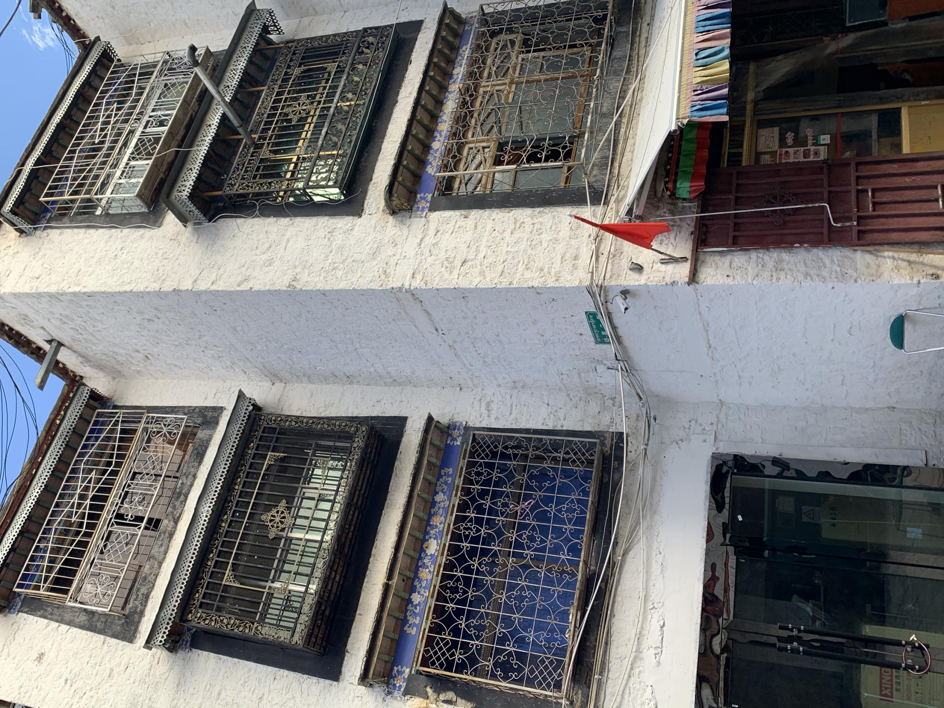
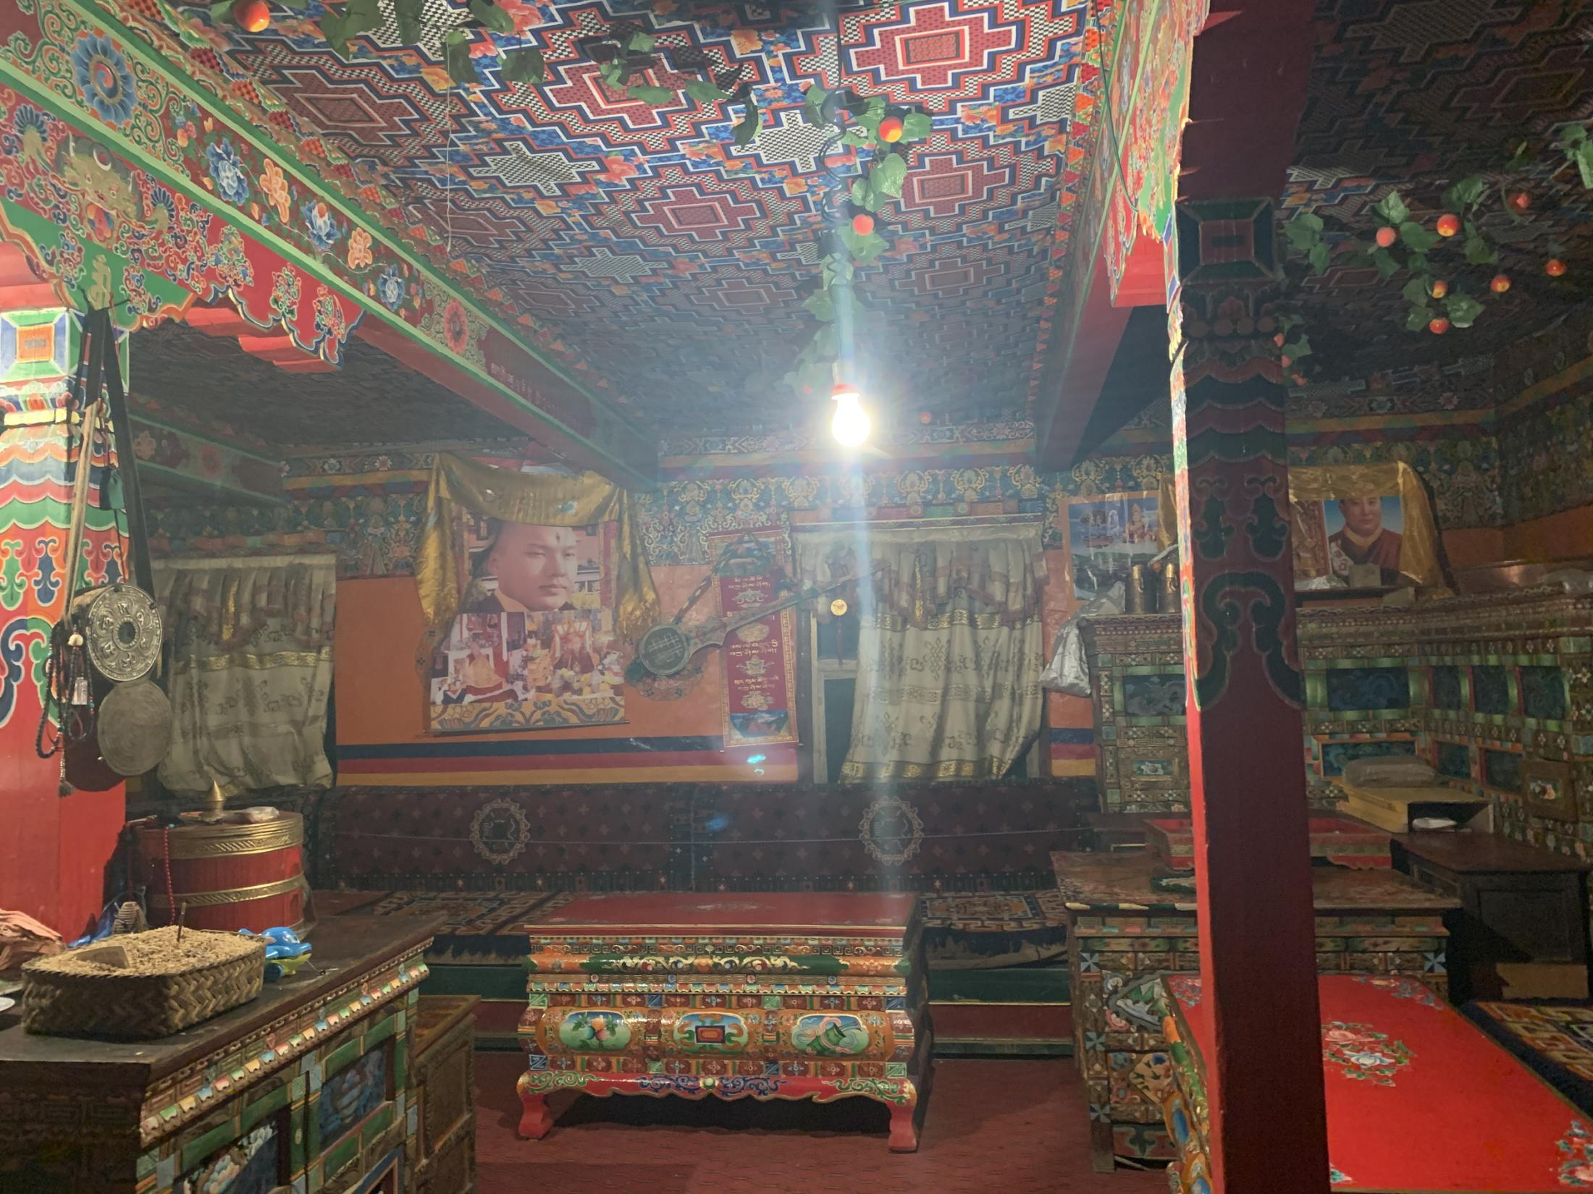

Slide 17
Part Ⅲ
Text A Intensive Reading 1-2
★ uphold /ʌpˈhəʊld/ v.
① keep or maintain in unaltered condition; cause to remain or last
维持；秉承
e.g. The village still upholds its tradition. 这个村庄仍然保持着传统。
② to support sth. that you think is right and make sure that it continues to exist 支持，维护（正义等）
e.g. We have a duty to uphold the law. 维护法律是我们的责任。
How Travel Transformed¹ Me
1 Recently I went on a trip to Tibet with my family. The trip really opened my eyes to a completely different reality².
2 Having lived in China for the past six months, Tibet showed me a completely different side of the country. Tibet has its own colors and its own unique³ traditions that are still upheld⁴ after thousands of years.
★ reality /riˈæləti/ n.
the true situation and the problems that actually exist in life, in contrast to how you would like life to be
现实；实际情况
e.g. She refuses to face reality. 她不肯面对现实。
in reality 事实上
e.g. He looks like a teacher, but in reality he is not.
他看起来像个老师，但实际上并非如此。
旅行是如何改变我的
最近我和家人一起去了西藏旅行。这次旅行真的让我大开眼界，我也认识了一个截然不同的世界。
我已经在中国生活了六个月，而西藏向我展示了这个国家完全不同的一面。西藏有它自己的颜色，有自身数千年来仍旧秉持的传统。
★ unique /juˈniːk/ n.
being the only one of its kind
唯一的；独一无二的
e.g. Everyone’s fingerprints are unique.
每个人的指纹都是独一无二的。
★ open one’s eyes…
打开眼界；（使人）长见识（或开眼界、认清事实）
e.g. Travelling really opens your eyes to other cultures.
旅游真的能使人开阔眼界，认识其他文化。
★ transform /træns'fɔːm/ vt.
改变；改观；变换

Slide 18
Part Ⅲ
Text A Intensive Reading 3
★ highlight /ˈhaɪlaɪt/
n. the best, most interesting or most exciting part of sth.
最好（或最精彩、最激动人心）的部分
e.g. The highlights of the match will be shown later this evening.
比赛最精彩的片段将于今晚稍后播出。
v. to emphasize sth., especially so that people give it more attention 突出；强调
e.g. The report highlights the major problems facing society today.
报告特别强调了当今社会所面临的主要问题。
3 I could go on and on about how wonderful and interesting Tibet is, but the highlight⁵ of my trip was the Tibetans I met on my journey and their unique stories.
我可以继续说西藏有多么奇妙、多么有趣，但此次旅行的精彩之处在于途中遇到的藏民和他们独特的故事。

Slide 19
Part Ⅲ
Text A Intensive Reading 4
4 The first Tibetan I met was Nobu, the tour guide for my family. I learned that she came from a small village close to the border⁶ of Nepal, to Lhasa to study English before eventually⁷ becoming a tour guide. Once, in a conversation, my mother asked Nobu if she had seen the sea. She said no, and asked, “I’ve only seen lakes. Is the sea similar to lakes?”
★ border /ˈbɔːdə(r)/
n. the line that divides two countries or areas; the land near this line
国界；边界；边疆；边界地区
e.g. Denmark’s border with Germany
丹麦和德国的国界线
v. to share a border with another country or area 和……毗邻；与……接壤
e.g. The large garden is bordered by a stream. 大花园紧临着一条小溪。
我遇到的第一位藏民叫诺布，她是我家此次旅行的导游。我了解到她的家乡位于靠近尼泊尔边界一个小村庄，去拉萨学习了英语后，最终成为一名导游。有一次，在聊天时，母亲问诺布是否见过海。她回答说没有，还问道：“我只见过湖，海和湖一样吗？”
★ eventually /ɪˈventʃuəli/ adv.
at the end of a period of time or a series of events 最后；终于
e.g. Our flight eventually left five hours late.
我们的班机最终晚了五个小时起飞。
★ be similar to
与……相似；类似于
e.g. Your output should be similar to Listing 2. 您的输出应该与请单2所示类似。

Slide 20
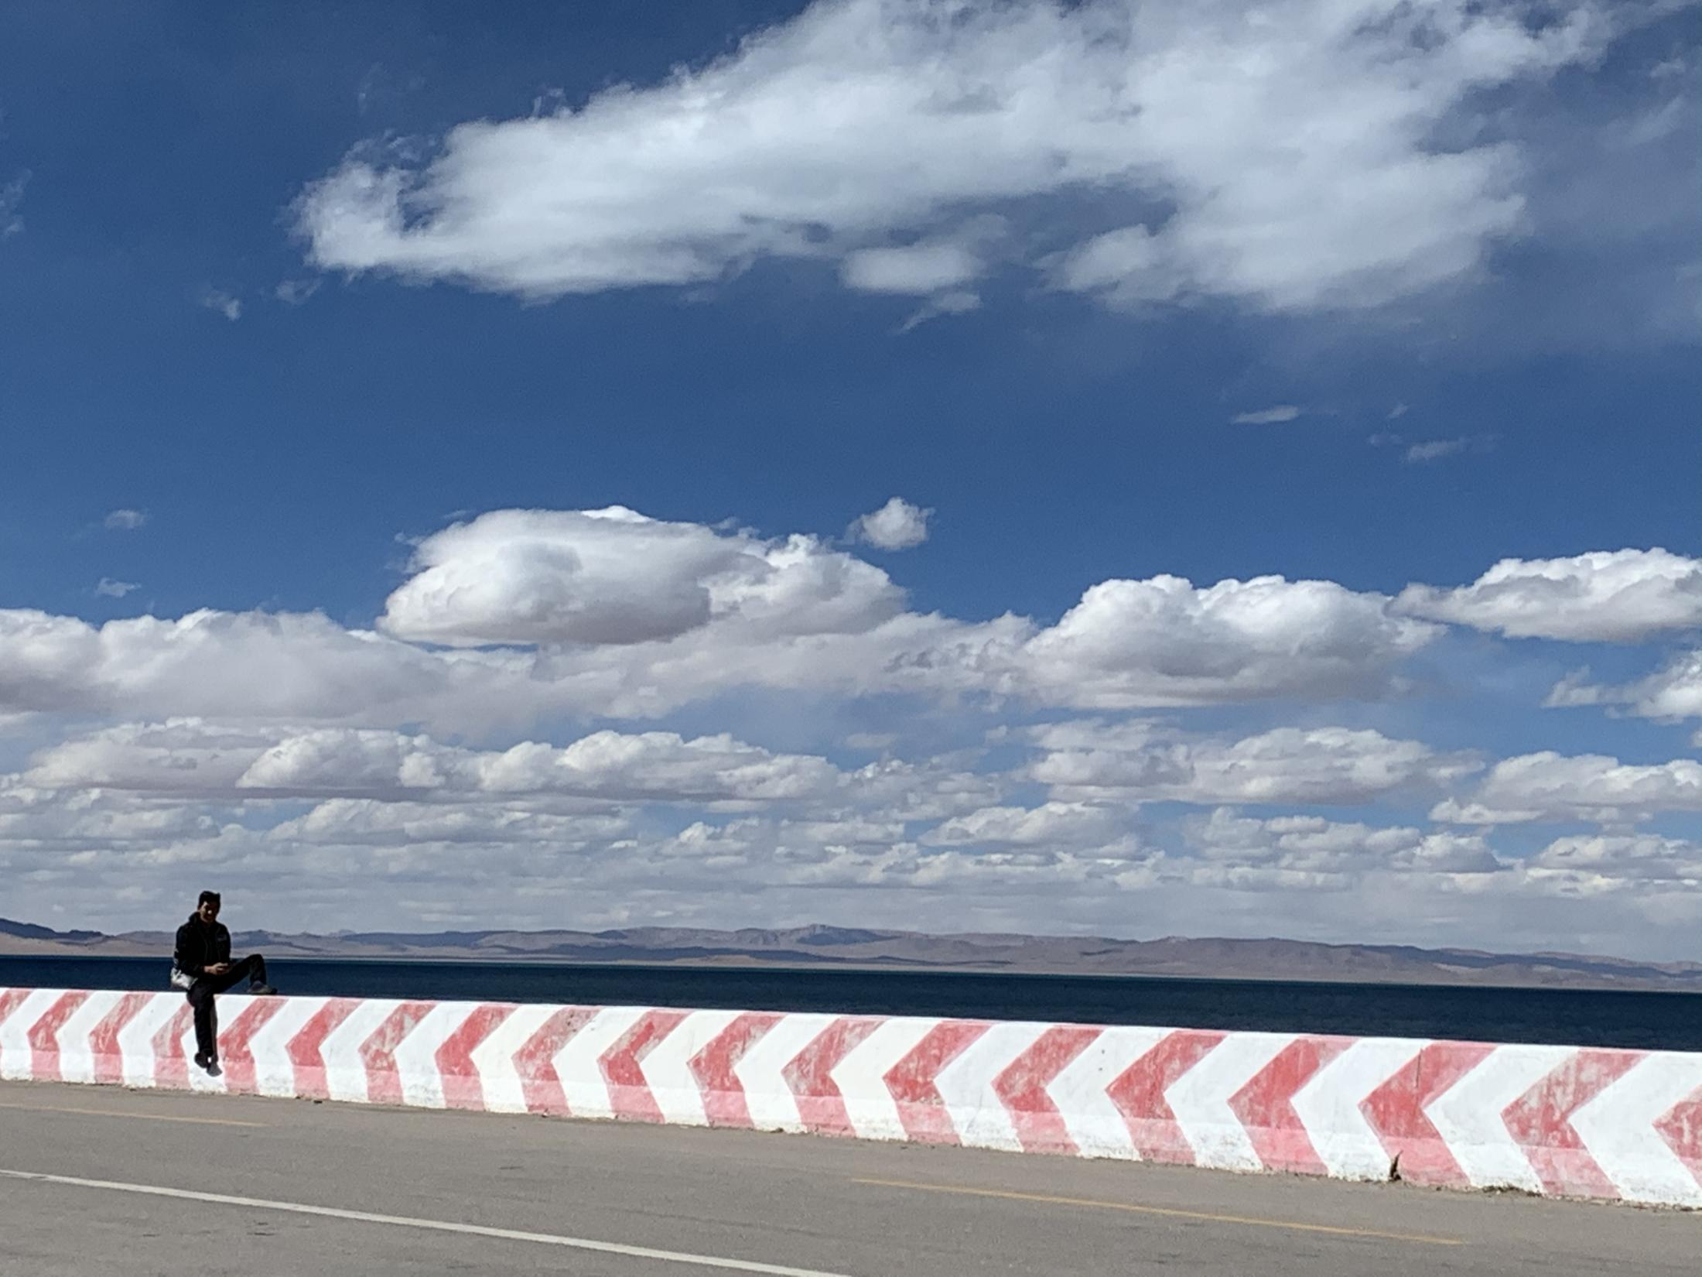

Slide 21
Part Ⅲ
Text A Intensive Reading 5
5 For a moment, I genuinely⁸ did not know how to answer her question. I grew up knowing how salty⁹ sea water tastes, and how it stings¹⁰ your eyes. I knew how nice it felt to stand on wet sand and slowly sink¹¹ into it. The sea is so familiar to me, yet I couldn’t find words to help Nobu picture¹² what the sea is like.
★ be familiar to…
被某人熟悉；对某人来说是熟悉的
e.g. My argument had a logic that be familiar to economists.
经济学家对于我论点背后的逻辑会很熟悉。
be familiar with… 熟悉；认识
e.g. His fans would already be familiar with Caroline.
他的崇拜者们肯定已经很熟悉卡罗琳了。
★ sink /sɪŋk/ v.
to go down below the surface or towards the bottom of a liquid or soft substance
下沉；下陷；沉没 （过去式：sank；过去分词：sank）
e.g. The ship sank to the bottom of the sea. 船沉入海底。
★ picture
/ˈpɪktʃə(r)/ v.
to imagine sb. / sth.; to create an image of sb. / sth. in your mind 想象；设想；忆起
e.g. I can still picture the house I grew up in. 我还能回忆起我童年时住的那座房子。
★ couldn’t find words to
找不到语言形容……
e.g. I couldn’t find words to tell him what I was feeling at that moment.
那一刻，我真的不知道该如何应答。我从小就知道海水尝起来有多咸，海水的波光有多刺眼。知道站在潮湿的沙滩上然后慢慢地陷下去的感觉会有多舒服。虽然对海如此熟悉，可我却找不到语言去形容它，来帮助诺布想象海的样子。
★ salty /'sɔːlti/ adj.
含盐的，咸的
★ genuinely /'dʒenjʊɪnli/ adv.
真正地；真诚地；诚实地
★ sting /stɪŋ/ vt. 刺痛，刺激

Slide 22
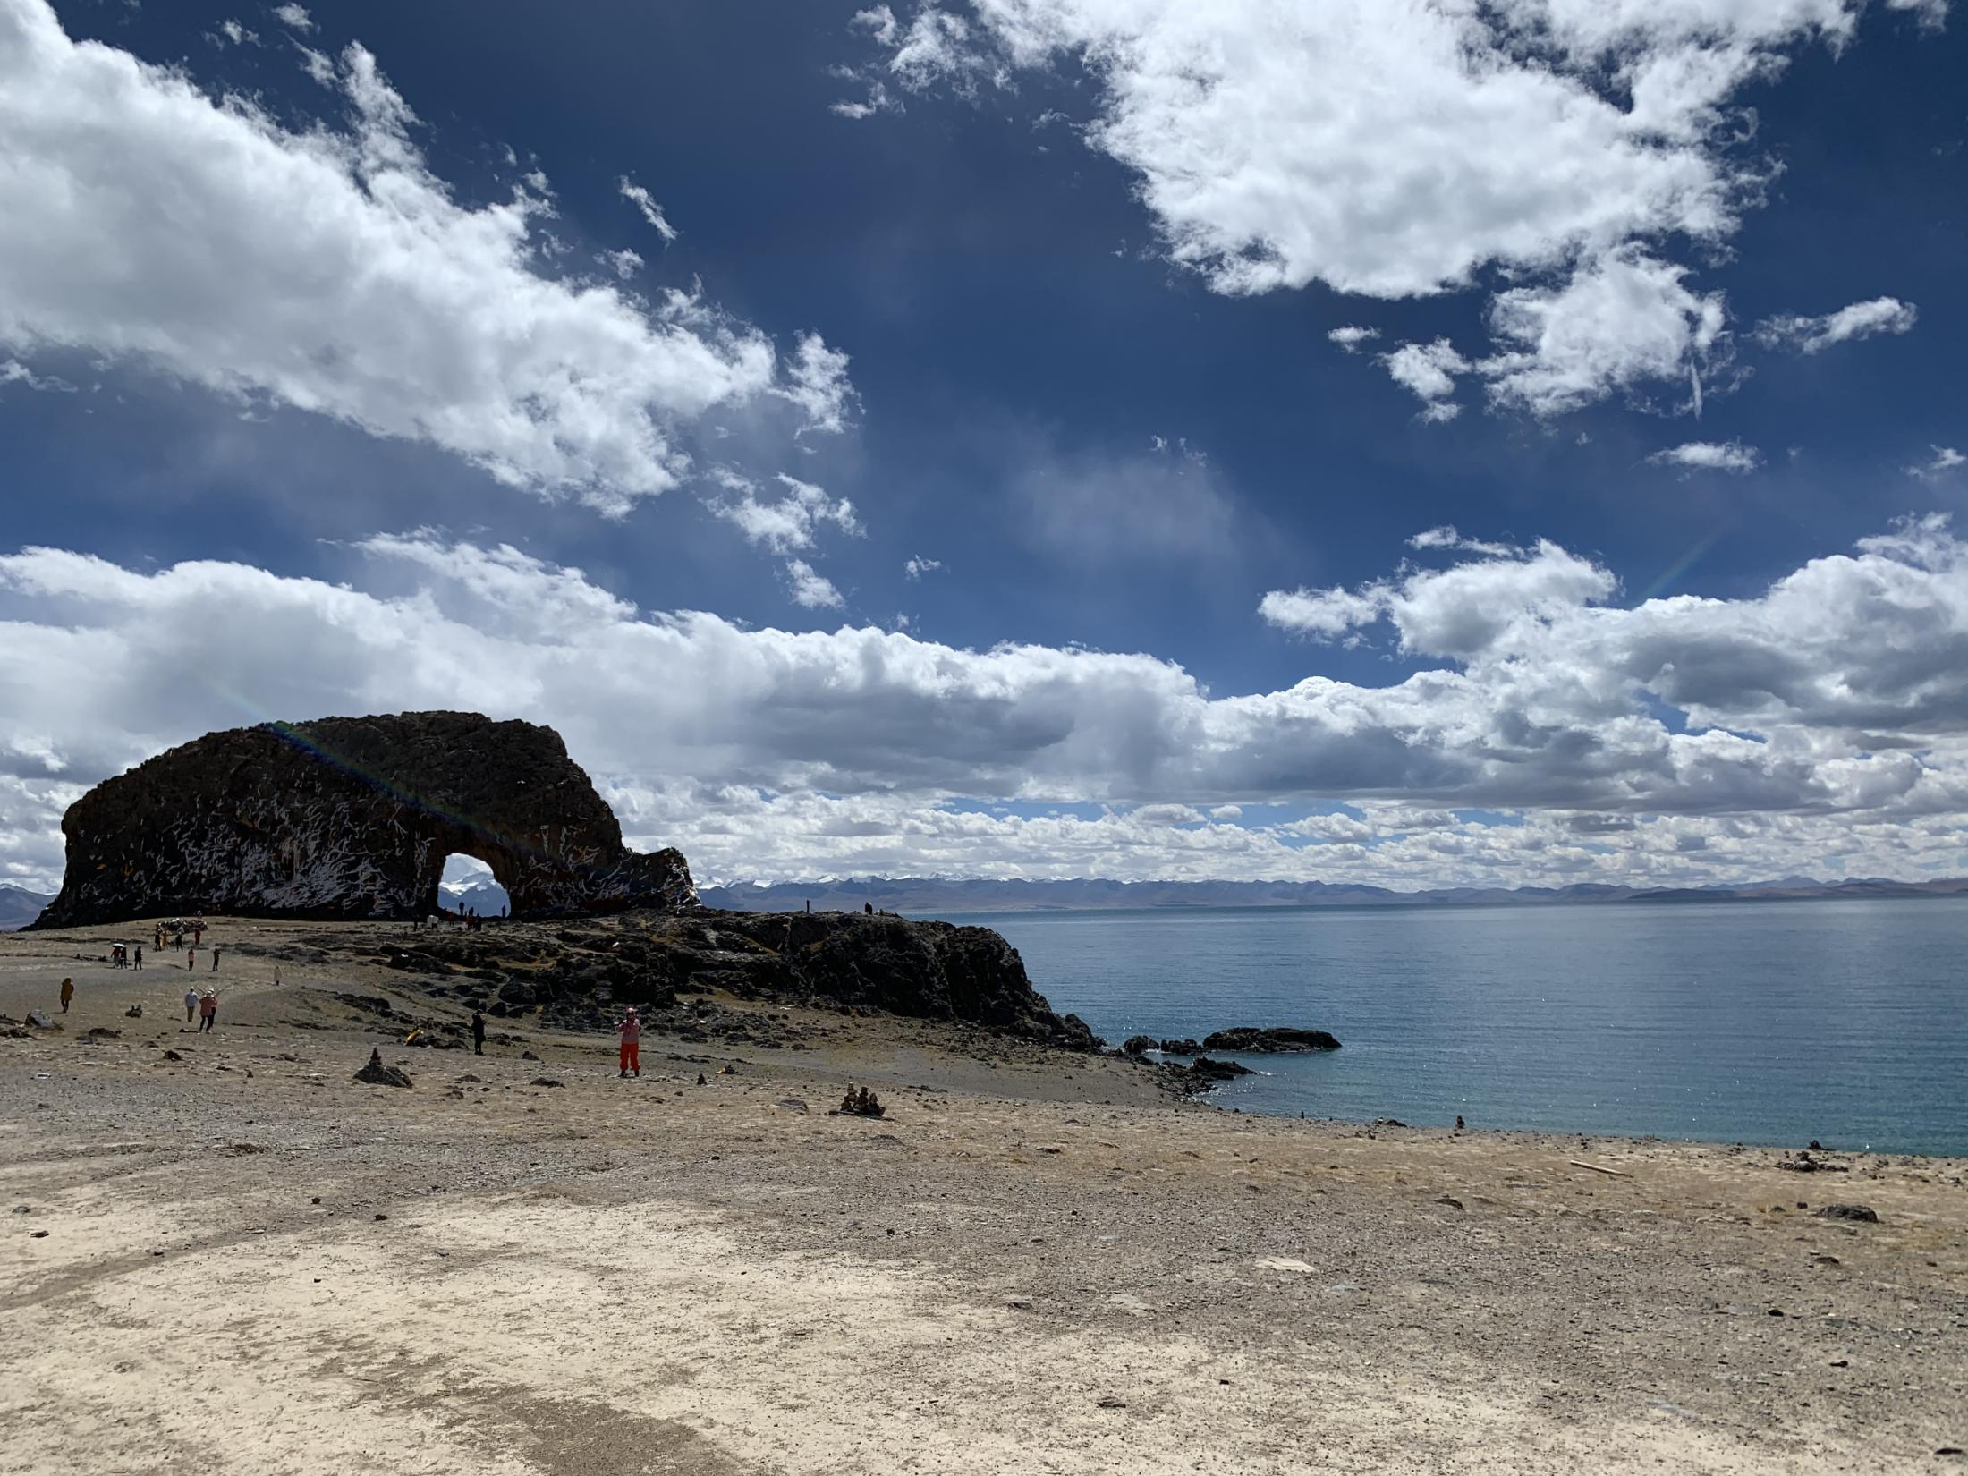
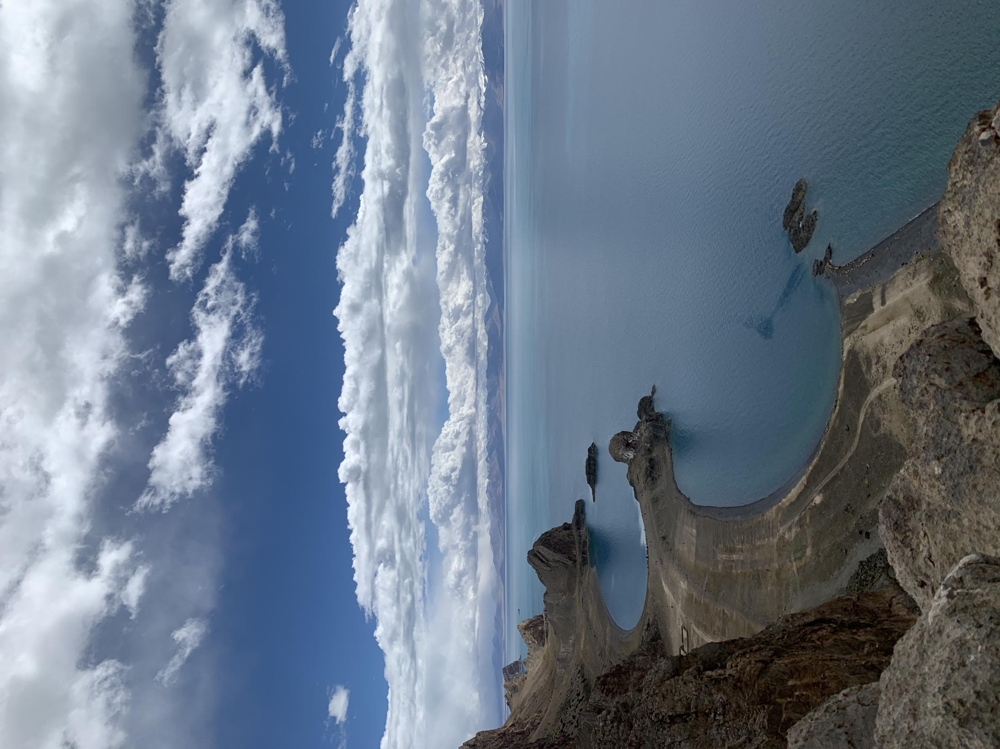

Slide 23
Part Ⅲ
Text A Intensive Reading 6-7
★ meanwhile /ˈmiːnwaɪl/ adv.
while sth. else is happening 同时；与此同时
e.g. I continued working, meanwhile, he went out shopping.
我继续工作, 这期间他出去买东西。
for the meanwhile 一会儿；暂时
e.g. We need some new curtains, but these will do for the meanwhile.
我们需要一些新的窗帘，但这些暂时还可以用。
in the meanwhile 在此期间；与此同时
e.g. I hope to go to medical school eventually. In the meanwhile, I am going to study chemistry. 我希望最终能上医学院，这期间我打算学化学。
★ shed /ʃed/ v.
to send light over sth.; to let light fall somewhere 散发出光；把光照到（或洒在）……上
~ sth. on / over sb. / sth.
e.g. The candles shed a soft glow on her face. 蜡烛在她的脸上映着一层柔光。
shed a light on 使（问题等）较容易理解
e.g. Recent research has shed new light on the causes of the disease.
最近的研究可以使人进一步了解导致这种疾病的原因。
shed a light on = cast / throw light on sth.
6 In that simple, short conversation, I realized¹³ how lucky I am to have seen a lot of what the world has got to offer. Meanwhile¹⁴, here on this side of the world, there’s someone who has no idea what other places look like or how they feel because they just couldn’t afford¹⁵ these experiences.
★ afford /əˈfɔːd/ v.
（usually used with can , could or be able to , especially in negative sentences or questions 通常与can、could或be able to连用，尤用于否定句或疑问句） to have enough money or time to be able to buy or to do sth.
买得起；（有时间）做，能做
在那次简短的对话中，我意识到自己是何等的幸运，已经见识了很多这个世界所给予的东西。同时，在世界的这一边，有人还不知道其他地方是何种景象，或者他们是何种感觉，仅仅因为他们没有钱去经历体验。
诺布的故事让我对所生活的这个世界有了全新的理解。
★ realize
/ˈriːəlaɪz/ v.
to understand or become aware of a particular fact or situation
理解；领会；认识到；意识到
e.g. I didn’t realize (that) you were so unhappy. 我没有察觉到你那么不开心。
★ have no idea 不知道
e.g. I have no idea which resort they will visit in this summer.
7 Nobu’s story shed¹⁶ a whole new light on the world we live in.

Slide 24
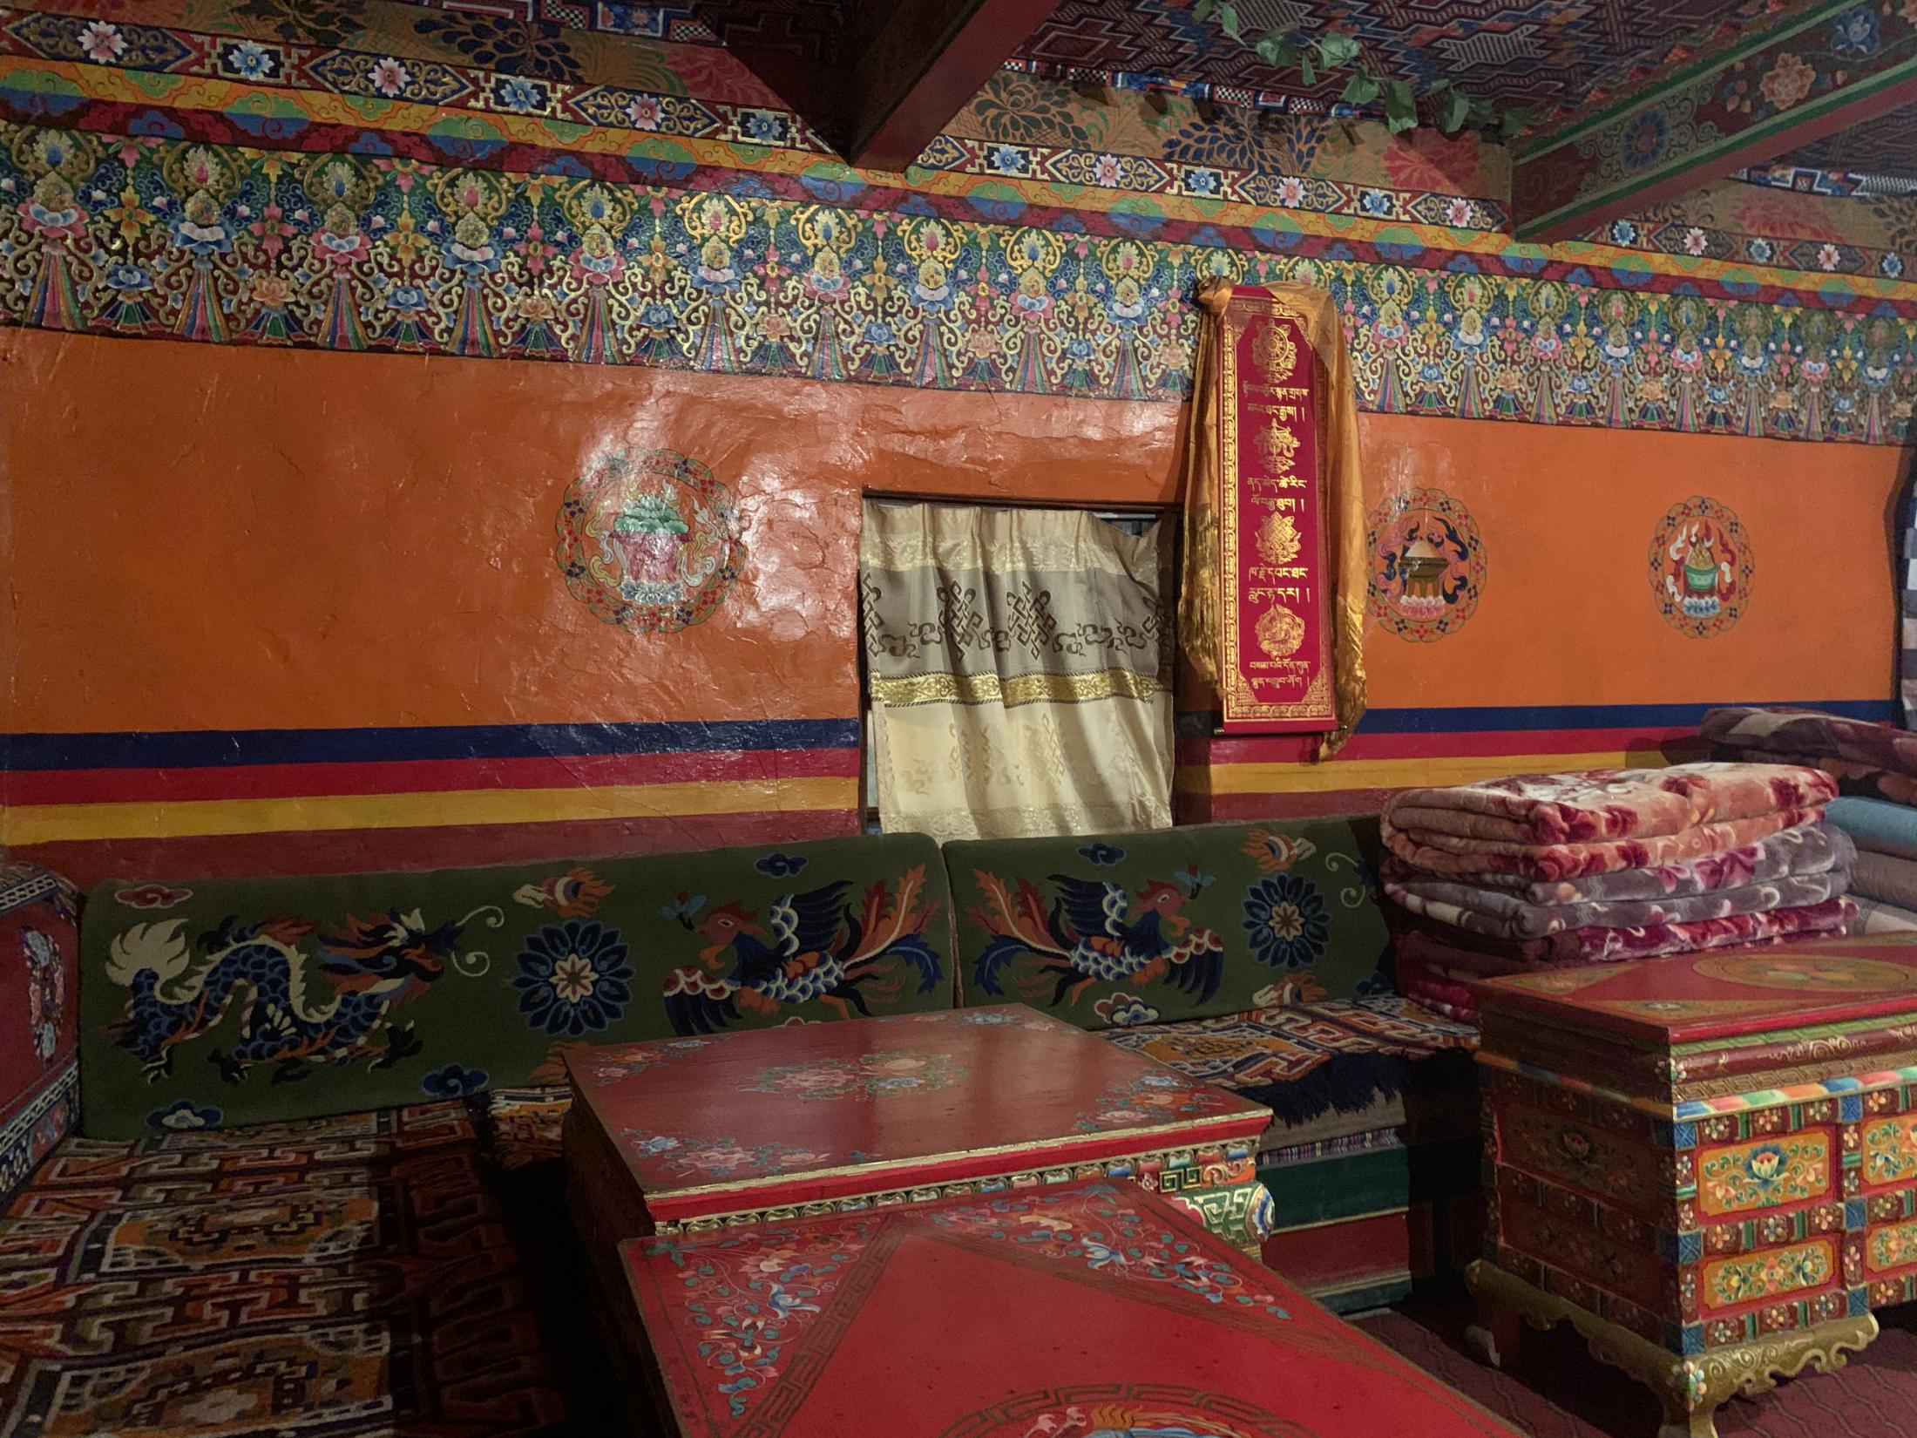
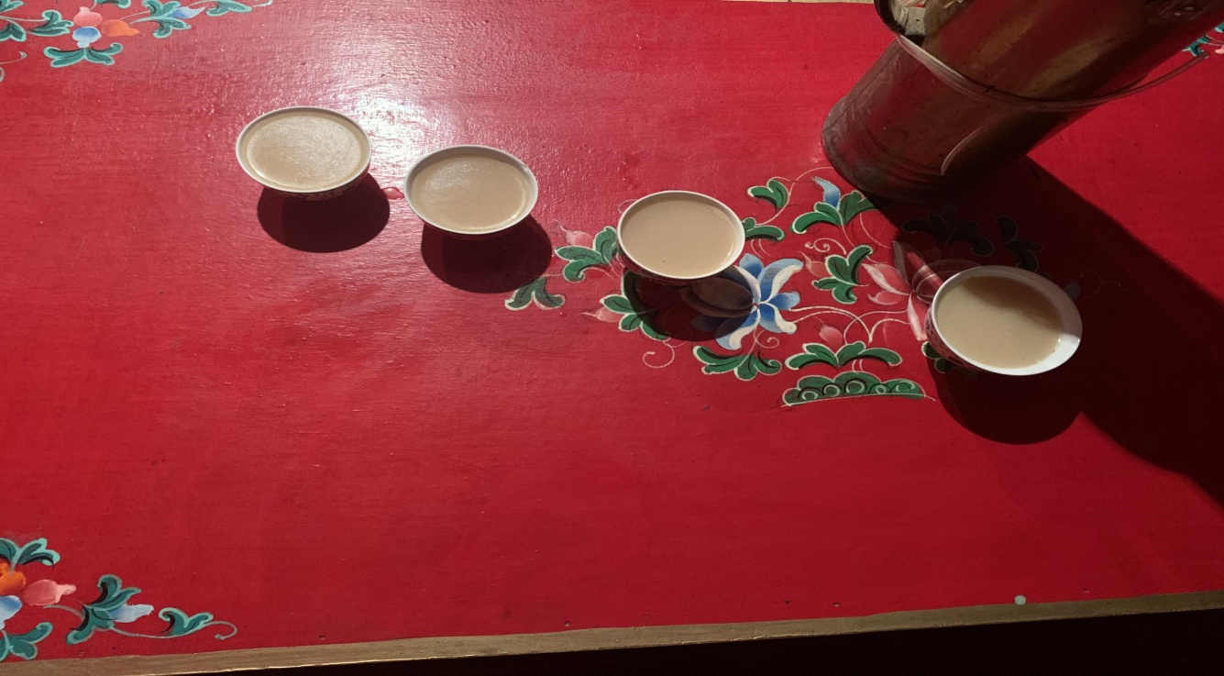
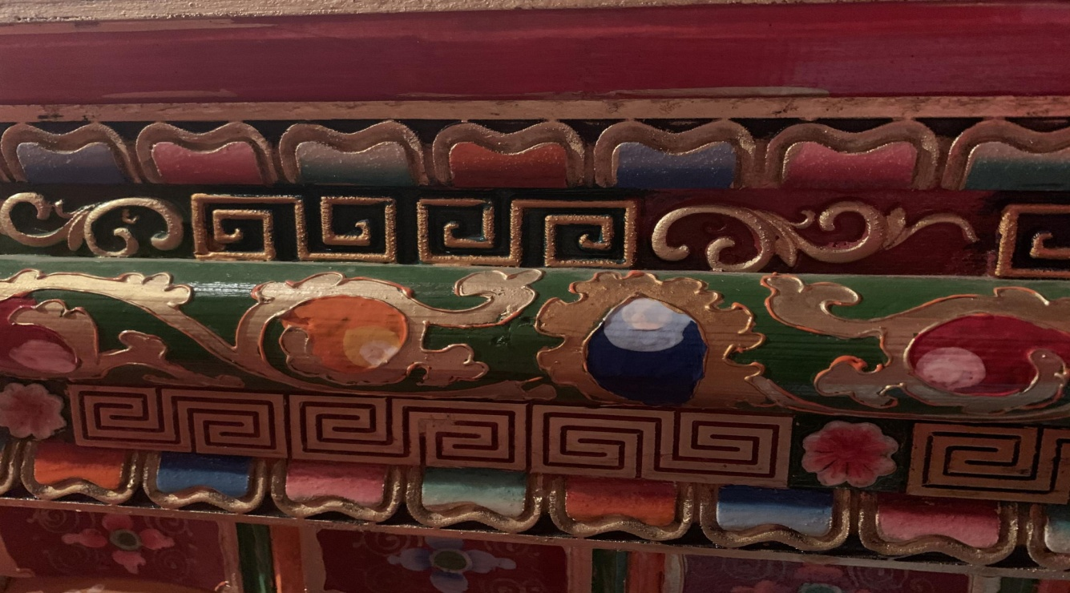

Slide 25
Part Ⅲ
Text A Intensive Reading 8
★ fancy /ˈfænsi/
adj. unusually complicated, often in an unnecessary way; intended to impress other people 异常复杂的；太花哨的
e.g. They added a lot of fancy footwork to the dance.
他们给这个舞蹈增加了许多复杂的舞步。
n. something that you imagine; your imagination 想象的事物；想象（力）
e.g. She said she wanted a dog but it was only a passing fancy.
她说想要一条狗，但这不过是一时心血来潮。
8 She made me think the luxury¹⁷ of travel isn’t in the fancy¹⁸ resorts¹⁹ you stay at or the souvenirs²⁰ you buy. It’s also not just about checking famous sights off of a list. The luxury of travel lies in the people you’ve met along the way, and how their stories will teach you a little lesson or two about life. Those people could be a fellow²¹ traveler, the hostel²² owner or a local²³ villager.
★ local /ˈləʊkl/adj.
belonging to or connected with the particular place or area that you are talking about or with the place where you live 地方的；当地的；本地的
e.g. Our children go to the local school.
我们的小孩在本地学校就读。
n. a person who lives in a particular place or district 当地人；本地人
e.g. The locals are very friendly. 当地人很友好。
她让我认识到旅行的奢华之处不在于你去了一个多么豪华的度假胜地，不在于你买了什么纪念品，也不在于你去过列表上多少个著名景点。旅行的乐趣在于一路上你所遇到的人，你从他们的故事中所获得的关于生活的一两点小经验。那些人可能是你的旅伴、旅社老板或者当地的村民。
★ luxury /ˈlʌkʃəri/ n.
the enjoyment of special and expensive things, particularly food and drink, clothes and surroundings 奢侈的享受；奢华
e.g. Now we’ll be able to live in luxury for the rest of our lives.
如今，我们可在有生之年过豪华生活了。
★ fellow /ˈfeləʊ/ n.
a way of referring to a man or boy
男人；男孩；小伙子；家伙；哥儿们
e.g. He’s a nice old fellow.
他这位老兄人不错。
★ hostel /ˈhɒstl/ n.
building that provides cheap accommodation and meals to students, workers or travelers
宿舍，招待所（提供廉价食宿服务）
e.g. The hostel is heavily reliant upon charity. 这家收容所在很大程度上依赖赞助。
★ souvenir /ˌsuːvə'nɪə(r)/ n.
纪念品；礼物
★ resort /rɪˈzɔːt/ n.
a place where a lot of people go on holiday / vacation 旅游胜地；度假胜地
e.g. a popular holiday resort 受欢迎的度假胜地
★ lie in 在于……
e.g. The reason lies in that the weather is too bad. 原因在于天气太恶劣了。

Slide 26
Part Ⅲ
Text A Intensive Reading 9
★ grateful /ˈgreɪtfl/ adj.
feeling or showing thanks because sb. has done sth. kind for you or has done as you asked 感激的；表示感谢的
e.g. I am extremely grateful to all the teachers for their help.
我非常感谢所有老师的帮助。
9 When you have learned valuable things, such as gratefulness²⁴ through your travels, that’s when you truly realize travel has actually²⁵ made you richer.
★ actually /ˈæktʃuəli/ adv.
used in speaking to emphasize a fact or a comment, or that sth. is really true
（在口语中用于强调事实）的确，真实地，事实上
e.g. What did she actually say? 她到底是怎么说的？
当你通过旅行学习到一些有价值的东西时，比如感激，那时你就会真正意识到旅行确实已让你变得更加富有。

Slide 27
4
Fill in the blanks with the words given below. Change the form where necessary.
1 Do you_______ that you are an hour late?
2 We can’t_________ to go on vacation this year.
3 Your resume should__________ your skills and achievements.
4 Although the original budget for the project was one billion Yuan, ________ the cost is likely to be 50% higher.
5 Each person’s fingerprints are__________ .
6 She has a very good reputation among her___________ .
7 Many______shops will be forced to close if the new supermarket is built.
8 I am very ________to all those who help me.
realize
afford
highlight
eventually
unique
fellows
local
grateful

Slide 28
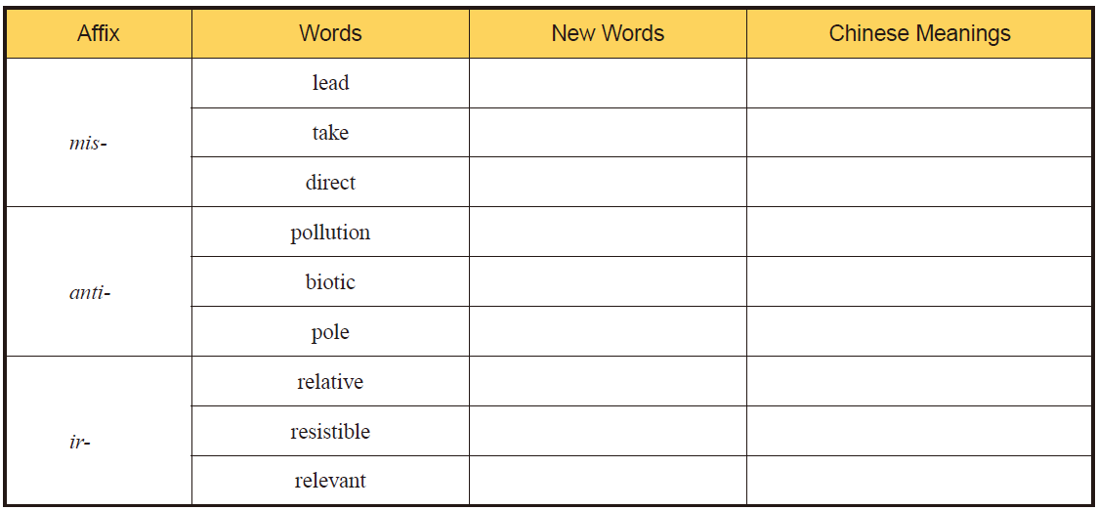
5
Add mis-, anti- or ir- to the following words to form new words and give the
corresponding Chinese meanings of the new words.
mislead
误导
mistake
弄错
misdirect
指错方向
antipollution
反污染的，防止污染的
antibiotic
抗生素
antipole
相反的极
irrelative
无关的
irresistible
不可抗拒的
irrelevant
不相干的

Slide 29
6
There are two sentences chosen from Text A. Choose the best Chinese translation for
each sentence.
A
1 Tibet has its own colors and its own unique traditions that are still upheld after thousands of years.
A. 西藏有自己的色彩，有自身数千年来仍旧秉持的独特传统。
B. 西藏有自己的色彩和独特的传统，数千年以后，这些将不存在。
C. 西藏有自己的颜色和独特的传统，这些在一千年后还会延续。

Slide 30
6
There are two sentences chosen from Text A. Choose the best Chinese translation for
each sentence.
C
2 Meanwhile, here on this side of the world, there’s someone who has no idea what other places look like or how they feel because they just couldn’t afford these experiences.
A. 同时，在世界的另一端，有些人却因为他们负担不起费用，对其他地方没有想法也没
有任何感受。
B. 同时，在世界的另一端，有些人却因为他们负担不起费用，他们没见过其它地方的样
子，以及他们怎么感觉。
C. 同时，在世界的另一端，有些人却因为他们负担不起费用，他们没见过其它地方，也
对其他地方没有任何感受。

Slide 31
7
Complete the following sentences with the given sentence structures
couldn’t find words to 找不到词汇表达/ 形容……
e.g. I couldn’t find words to describe the beautiful landscape. 我找不到词汇形容这美丽的风景。
1 We all felt grateful to our teacher, but_________________________ (我们找不到词汇表达).
2 Excited by the news, __________________________________(他找不到词汇表达他的感受) at that moment.
make sb. think… 让某人思考……
e.g. He makes me think what goal I should set in my life. 他让我思考应该设立什么人生目标。
1 ___________________________ (他让我想想我应该做些什么) in the college during the conversation.
2 ______________________________________ (经理让我想想什么行为是对的) when we do our jobs.
we couldn’t find words to express
he couldn’t find words to convey his feeling
He makes me think what I should do
The manager makes me think what behavior is right

Slide 32
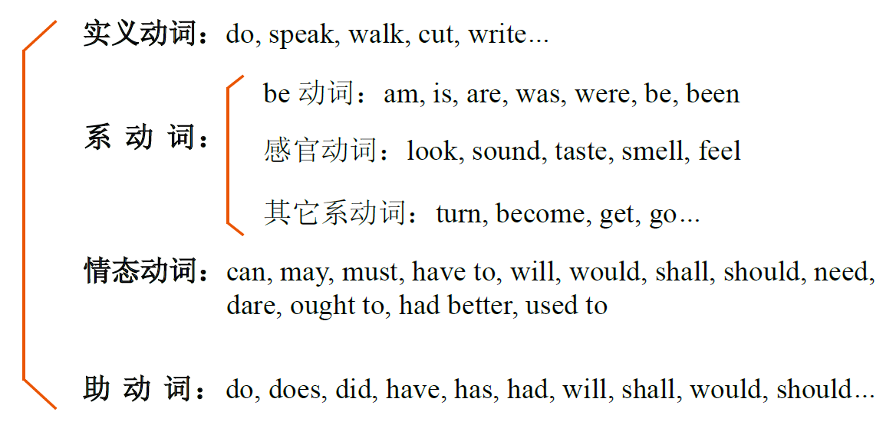
一、动词
动词按作用可分为实义动词（即行为动词）、系动词、情态动词和助动词四类。

Slide 33
一、动词
动词按作用可分为实义动词（即行为动词）、系动词、情态动词和助动词四类。
实义动词表示主语的行为、动作，可以单独作谓语。比如：walk ( 走)，run ( 跑)，jump ( 跳)，write ( 写字)，sing ( 唱歌)，dance ( 跳舞)，draw ( 画画)，shake ( 握)，kick ( 踢)，pat ( 拍) 等。实义动词又包括及物动词和不及物动词。

Slide 34
一、动词
动词按作用可分为实义动词（即行为动词）、系动词、情态动词和助动词四类。
系动词是表示主语是什么或怎么样的词。它虽有词义，但是不完整，不能单独作谓语，必须
和表语一起才能表达完整的意思。常见的系动词分为三类：
1）be 动词(is / am / are)
2）表示“感觉”。
3）表示“变得，变成”。

Slide 35
一、动词
动词按作用可分为实义动词（即行为动词）、系动词、情态动词和助动词四类。
助动词本身无词义，不能单独作谓语，只能与实义动词一起表达各种时态、语态。常见的助
动词有do (does / did), shall, will, have, has 等。
e.g. He does not speak English very well. 他的英语讲得不好。
Tom will go to kindergarten tomorrow. 汤姆明天去幼儿园。

Slide 36
一、动词
动词按作用可分为实义动词（即行为动词）、系动词、情态动词和助动词四类。
情态动词本身有一定的词义，表示说话人的情绪、态度或语气，但不能单独作谓语，只能和
动词原形一起表达完整的意思。常见的情态动词有can (could), may (might), must, need, ought to 等。
e.g. I can sing. 我能唱歌。
May I come in? 我可以进来吗?

Slide 37
二、冠词
冠词是帮助说明名词含义的一种虚词。它不能脱离名词而单独存在，也不能单独作句子成分。
冠词分为定冠词the 和不定冠词a (an) 两种。
不定冠词a / an 与one 同源，表示“一”的概念，但并不强调数目，用来表示不特定的人或事物。
不定冠词a 用于以辅音音素（不是指辅音字母）开头的名词前；an 用于以元音音素（不是指元音
字母）开头的名词前。
1）表示某一类人或物中的任意一个。
2）表示第一次提到的人或物。
3）表示一类人或物。
4）表示某人或某物，但不具体说明是何人或何物。
5）表示数量，有“一”的意思，但没有one 强烈。

Slide 38
二、冠词
冠词是帮助说明名词含义的一种虚词。它不能脱离名词而单独存在，也不能单独作句子成分。
冠词分为定冠词the 和不定冠词a (an) 两种。
定冠词通常用在名词前面，说明或限定某个特定的人或物。定冠词the 与this / that / these /
those 同源。
1）表示特指某（些）人或某（些）物。
2）指谈话人双方都知道的人或物。
3）表示上文提到过的人或物。
4）表示世界上独一无二的事物。
5）用在序数词、形容词最高级前，以及对两个人或物进行比较时起特指作用的比较级前。

Slide 39
二、冠词
冠词是帮助说明名词含义的一种虚词。它不能脱离名词而单独存在，也不能单独作句子成分。
冠词分为定冠词the 和不定冠词a (an) 两种。
零冠词主要指不使用冠词的情况，但不包括冠词省略的情况。
1）在表示国名、地名、人名等专有名词前。
2）名词前已有作定语的指示代词、物主代词、不定代词或名词所有格时。
3）不可数名词和复数名词表示一类人或物时。
4）在星期、月份、季节、节日前。
5）在称呼语或表示头衔的名词前。

Slide 40
1
Fill in the blanks with correct verbs.（选择适当的动词填空。）
1 My father encourages me ____________ (to learn, to do) English.
2 I get up early ___________ (to do, to have) exercise.
3 She ____ (is, was) from a small town in Guizhou Province.
4 My classmate _______ (can, may) swim very well.
to learn
to do
is
can

Slide 41
2
Fill in the blanks with the correct articles.（用恰当的冠词填空。）
1 What’s ________ (the, a) matter with you today?
2 Please give me _____ (an, the) orange.
3 ________ (A, An) apple ___ (the, a) day keep _____ (the, a) doctor away.
the
an
An
a
the

Slide 42
Notes
Useful Expressions for Notes

Slide 43
Always on the way

