Slide 1

A Brand New Day
Unit
One

Slide 2
Unit Objectives:
Knowledge and skill（知识、技能目标）:
1. Students should know how to talk about campus and college life.
2.Student should acquire the new words and expressions.
3.Students should grasp the grammar about the notional words and function words.
4.Students should master the skills of writing personal information form.
Feelings, attitudes and values（情感、态度和价值观目标）:
Students should be able to understand and cherish the college life.

Slide 3
Unit Objectives:
Ideological and Political Aims（思政目标）
Ideological and Political Aims（思政目标）
Students should know learning objectives, set up a correct view of learning
Encourage students to think about the meaning of receiving college education,
make clear the purpose of learning.

Slide 4
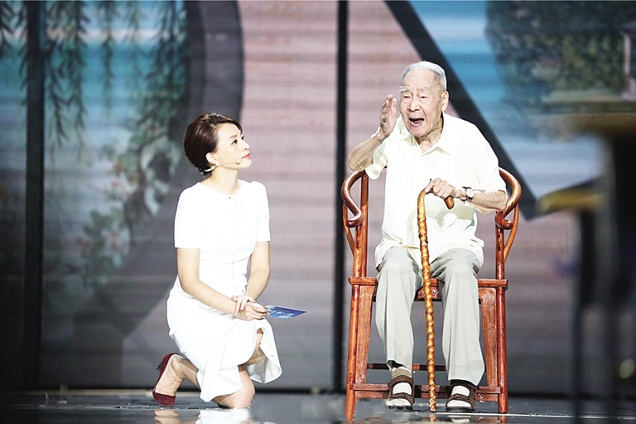
“开学第一课”
许渊冲演讲：翻译，向世界讲好中国故事
2010年获得"中国翻译文化终身成就奖" ，2014年8月2日许渊冲荣获国际翻译界最高奖项之一的"北极光"杰出文学翻译奖 ，系首位获此殊荣亚洲翻译家。
在国内外出版中、英、法文著译六十本，包括《诗经》、《楚辞》、《李白诗选》、《西厢记》、《红与黑》、《包法利夫人》、《追忆似水年华》等中外名著。

Slide 5
"自信使人进步，自卑使人落后"
态度严谨
奋斗不息
课后拓展：
Embarking on Your Journey:
tips for college freshmen
（开启新征程，给大学生的几点建议）

Slide 6
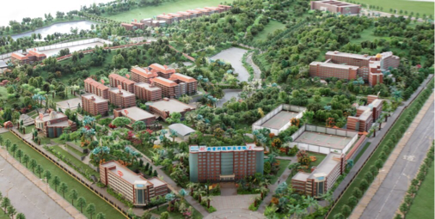
A Brand New Day：A Journey to the University
Gongqing Institute of Science and Technology

Slide 7
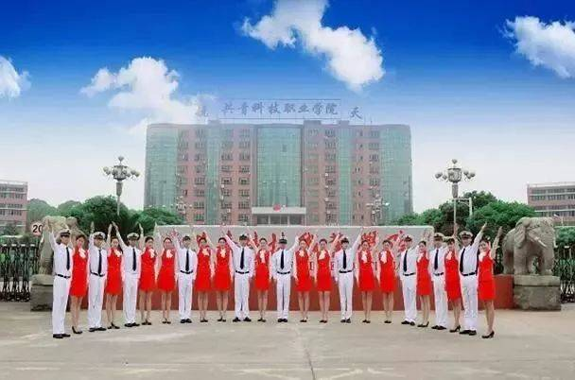
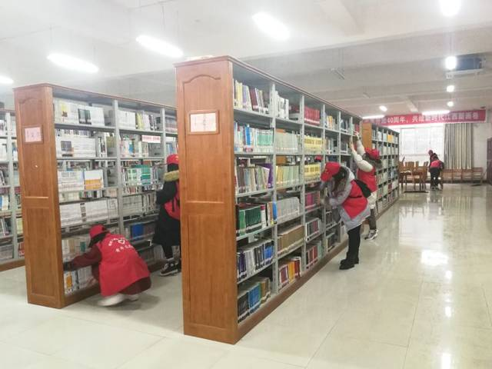
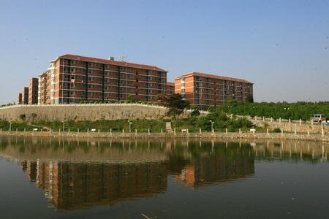
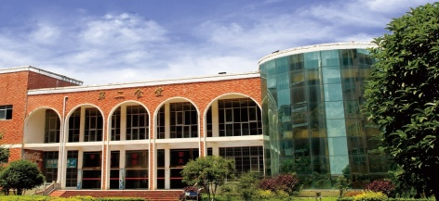
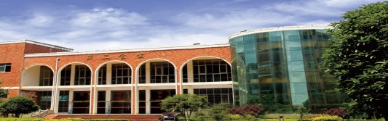


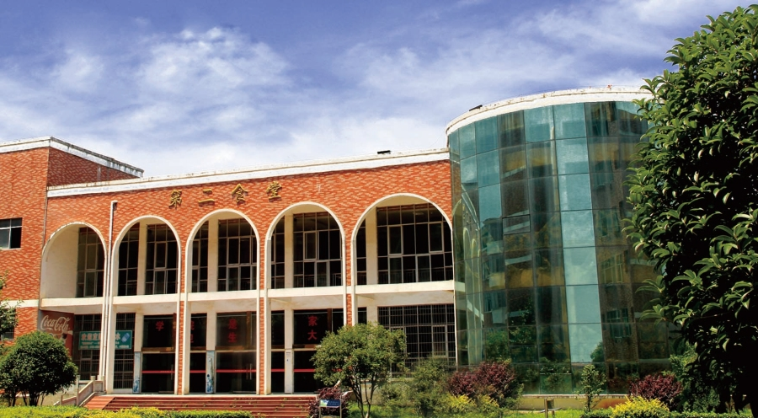
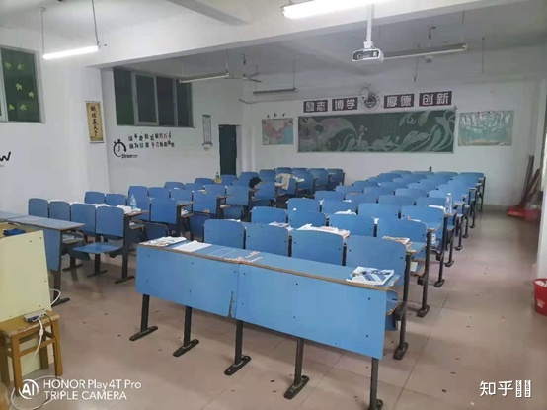
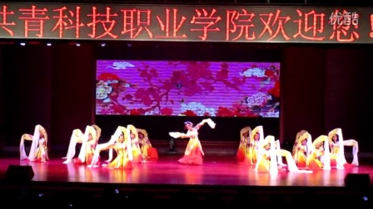
Fill in “Personal
Information Form”
Reading skills
Self-introduction
Noun
Talk about “University”
Watching & Performing

Slide 8
Lead-in
Listening ＆
Speaking
Reading
Grammar
Watching & Performing
Applied Writing

Slide 9

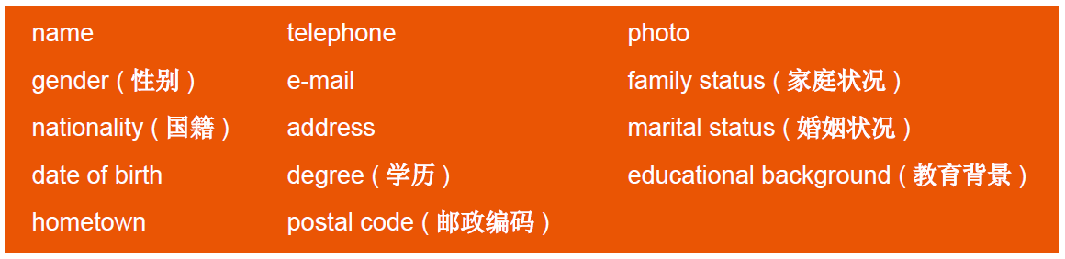
Personal Information Form

Slide 10
Personal Information Form
Last Name |  | First Name
Birth Date(M/D/Y) |  | Gender
Nationality |  | Place of Birth
Student ID Number |  | Marital Status
Cell Phone |  | E-mail
Current Address
Home Address
Emergency Contact
Name |  | Relation
Cell Phone |  | E-mail
Address
Educational Information
Period | School Attended | Award/Degree Eearned
Li
Jiaqi
June 7th, 1992
Male
Chinese
Yueyang, Hunan
20200001
Single (Unmarried/Married)
18970015678
56789012@126.com
Floor 2, Yunhan Road No. 979, Nicheng Town, Pudong New Distric, Shanghai
Floor 2, Yunhan Road No. 979, Nicheng Town, Pudong New Distric, Shanghai
Fu Peng
Collegue
18970016789
890127329@qq.com
Floor 2, Yunhan Road No. 979, Nicheng Town, Pudong New Distric, Shanghai
2010~2013
Nanchang University
Bachelor’s Degree /Master’s Degree/ Doctoral Degree
2008~2010
Yueyang No. 1 School
/
2006~2008

Slide 11
Lead-in
Listening ＆
Speaking
Reading
Grammar
Watching & Performing
Applied Writing

Slide 12

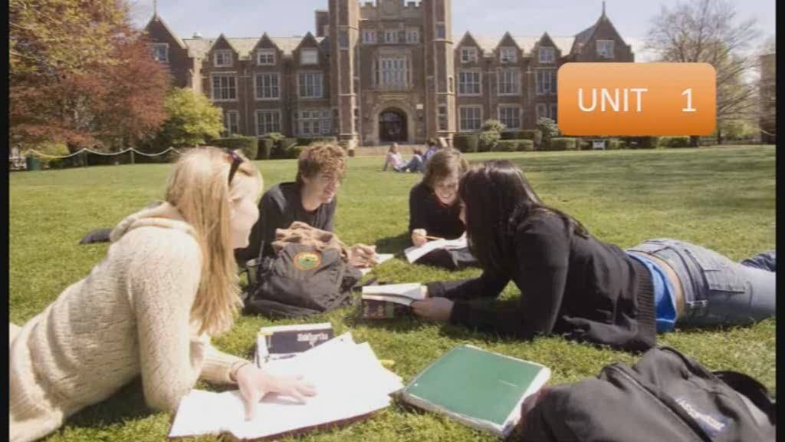
1
Listen to the dialogues and fill in the blanks.

Slide 13
Words and Expressions
province 省份
major 主修
department 学院
settle in 习惯；安定下来
accounting 会计学
maths 数学

Slide 14
Dialogue 1
S: It is a fine day, isn’t it?
M: Yes, I like the weather in the city. By the way, I am from _________________ Province. My name is ________.
Nice to meet you.
S: Nice to meet you, too. I am Steven from _____________ Province. I major in___________________.
Which department are you in?
M: I am in the Department of ______________ and I am a freshman on the campus. How about you?
S: I have been studying here for two years.
M: Really? Could you do me a small favor and show me around? I want to take a tour of the campus.
S: No problem. Let me show you around.
Heilongjiang
Mary
Shandong
English
Law

Slide 15
Dialogue 2
S: Hi, Daisy!
D: Hi, Simon. Nice to meet you again.
S: I hope you are settling in at school!
D: I am! I’ve made lots of friends and I really enjoy my ______________.
S: Good! Me too! By the way, you didn’t tell me what you are studying here.
D: Didn’t I? I’m doing ___________________________.
S: Really? That’s great. You hope to join a company after graduating?
D: Maybe. My parents moved to Canada the year I was born. We are living in Toronto. I suppose I
might get a job in Toronto when I graduate. It’s _______________ to say really.
college life
software engineering
hard

Slide 16
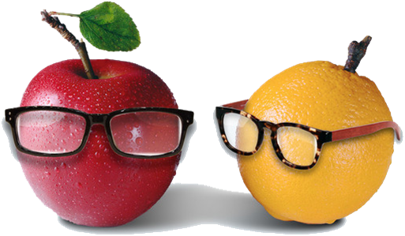
Dialogue 2
S: What about your friend Zoe?
D: She’s from Australia. She lives in Sydney. Her father runs a hotel business there and she is
studying a degree in accounting.
S: Accounting? Really? She must be very good at maths.
D: I guess so. What about you, Simon?
S: I’m __________________________.
D: Great! So I’ll know who to call if I ever need a lawyer.
S: Sure. You’re welcome to call anytime.
going to be a lawyer

Slide 17

2
Listen to the dialogues again and check your answers, and then make a dialogue
according to the situation given below. The following sentence patterns are for your
reference.
Situation: As the college English Corner is recruiting new members, you and your friend want to join in. Since it is the first time to see the members, the host wants everyone to introduce themselves to each other.

Slide 18
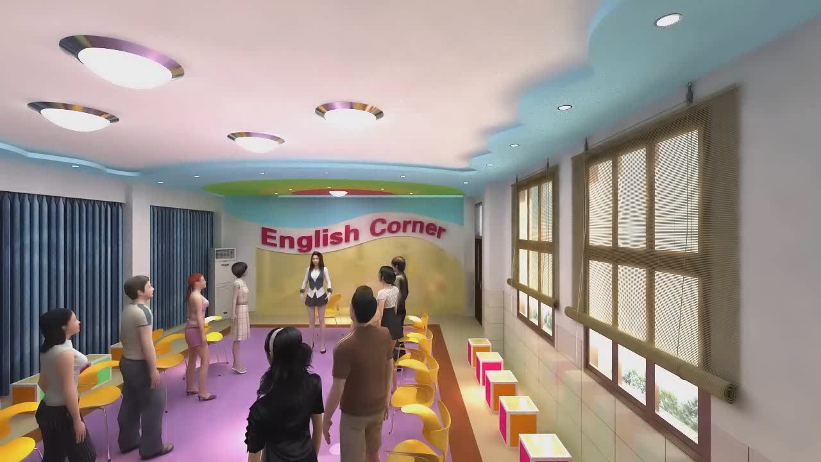
Listen to the dialogues again and check your answers, and then make a dialogue
according to the situation given below. The following sentence patterns are for your
reference.

Slide 19
My name is...
I come from… Province.
I am in the department of...
I major in… and I want to be a/an...
I am an easy-going person.
I’d like to meet different people.
I am a vegetarian.
My favourite food is…
I am a young man of wide interests. In my spare time I like playing basketball.
I have two younger sisters and one elder brother.

Slide 20
Lead-in
Listening ＆
Speaking
Reading
Grammar
Watching & Performing
Applied Writing

Slide 21


Watch the video by scanning the QR code and fill in the blanks. In the
video, four college students share the reasons why they chose their colleges.

Slide 22
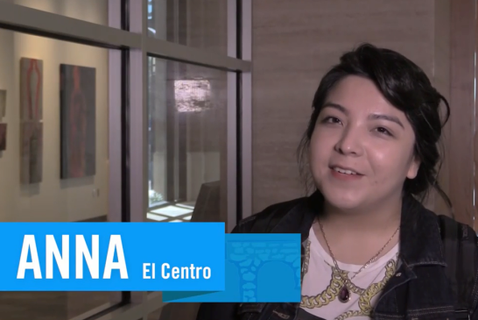

Because it’s centered downtown and it’s around everything. And it’s very busy and it’s very___________________________________________ to get in and out of here, you know, through the bus line using DART ( 大型运输系统运营商).
convenient
My girlfriend. Because I was at Collin before and I didn’t do so great.So I thought if I went to a school where I had somebody to push me,it’d________________________________ , try harder.
help me out

Slide 23
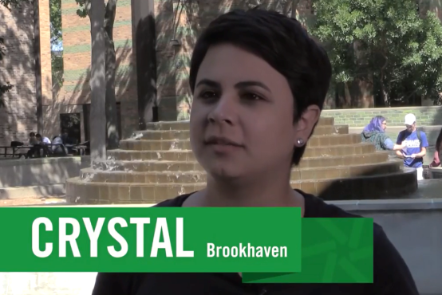

quality
I felt that the________________________________ of education was higher than I had seen anywhere else.
I picked Eastfield just because I heard so many good things about
The ______________________________________ here. And I just feel like they care about you passing and care about you.
professors

Slide 24
2
Read the above sentences and then share the reason why you chose your college with your partners. Here are some sentences for your reference.
It was actually the only school that had the program I wanted to take.
I choose it because it is so beautiful.
It is so close to my home.
It has a multitude of ( 多种多样的) clubs.
… (your college name) was recommended to me by my college counselor ( 咨询师) at high school.
I chose come to… (your college name) because I think it’s easier and cheaper for me.

Slide 25

3
Discuss the following questions with your partners.
1. What’s your first impression of your college?
2. What is your major? Why did you choose it?
3. What things would you like to do during college?

Slide 26

3
Listen to the song Good Time and then fill in the blanks.

Slide 27
3
Listen to the song Good Time and then fill in the blanks.
Woke up on the right side of the bed
What’s up with this Prince song (1) ______ my head?
(2) _______________ if you’re down to get down tonight
Cause it’s always a good time
(3) ___________ all my clothes like I didn’t care
Hopped into a cab, take me anywhere
I’m in if you’re (4) ___________________ tonight
Cause it’s always a good time
inside
Hands up
Slept in
down to get down

Slide 28

Good morning and good night
I’ll wake up at twilight
It’s gonna be (5) ___________
We don’t even have to try
It’s always a good time (Whooo)
Whoa-oh-oh, oh-oh-oh, whoa-oh-oh
It’s always a good time
Whoa-oh-oh, oh-oh-oh
We don’t even have to try
It’s always a good time
alright

Slide 29
Lead-in
Listening ＆
Speaking
Reading
Grammar
Watching & Performing
Applied Writing

Slide 30





Part Ⅲ
Text A Intensive Reading 1
Big Lessons I Learnt in My First Year
1 Life changed a lot for me in my first year of college. Looking back, here are some of the biggest lessons I’ve learnt and how I wish I’d known them in advance!
Direct Your Own Study
★ in advance 预先；提前
e.g. If you want to get the book, you must pay for it in advance.
如果你想得到这本书，你必须提前付款。
It’s cheaper if you book the tickets in advance.
如果你提前订票，票价会便宜一些。
Language Point:
“how I wish I’d known them in advance”中，them一词代指前句中所指的lessons。文中为避免重复，故用代词代替。
★ look back 回顾；回头看
e.g. He turned to look back, but by then she was out of sight.
他转头看去，但那时她已经不见了。
It wasn’t such a bad experience when I look back on it.
现在回想起来，我觉得那并不是一段特别糟糕的经历。
大学一年级我所学到的重要事情
大学第一年的生活和以前相比差别很大。回首这一年，我懂得了一些很重要的道理，我多么希望我能提前明白这些！
规划自己的学习

Slide 31

Part Ⅲ
Text A Intensive Reading 2
★ decide /dɪ'saɪd/ v. to think carefully about the different possibilities that are available and choose one of them 决定；下决心
~ between A and B / ~ against sth. 对……做出抉择；决定；选定
e.g. It was difficult to decide between the two candidates.
很难在这两个候选人之间决定取舍。
They decided against taking legal action. 他们决定不提起诉讼。
Language Point:
“attend a lecture”中，lecture为名词，与attend一起构成动宾短语，名词放在动词后，做动词宾语，构成动宾结构。
2 College is harder than high school because everything is self-directed¹. If you live by the saying “due² tomorrow, do tomorrow”, self-directed learning can be quite dangerous. In high school, whether³ you liked it or not, you were forced⁴ to listen to your teachers’ lectures. However, in college you can decide⁵ not to attend a lecture one day. But if you’re not careful, one day can turn into weeks, then into months and before you know it, somehow you end up going a whole semester without learning anything.
★ force /fɔːs/
v. to make sb. do sth. that they do not want to do 强迫；迫使
~ sb. into sth. / into doing sth. 强迫，迫使（某人做某事）
e.g. The President was forced into resigning. 总统被迫辞职。
~ sb. to do sth. 某人被迫做某事
e.g. I was forced to take a taxi because the last bus had left.
最后一班公共汽车已经开走，所以我只好坐了一辆出租汽车。
在大学里学习要比在高中学习更为艰难，因为一切都是自主性的。如果你之前的学习习惯是“明天交明天做”，那么自我导向的学习方式对你来讲就具有一定的危险性。在高中，不管你喜不喜欢，总有人强制你去听老师讲课。但是在大学，去不去上今天的课都是自己决定。如果掉以轻心的话，一天不去上课可能会演变成数周不去、数月不去。在你意识到这些之前，一个学期就过去了，而你什么都没学到。
★ end up doing sth. 以……告终
e.g. She ended up teaching English as a foreign language.
她最后做了教师，教外国人学英语。
I must play my spare time well, or I end up doing nothing.
我必须善于利用空闲的时间, 否则生命将会在无所事事中告终。
★ turn into
to change and become someone or something different, or to make someone or something do this 变为；成为
e.g. The icy rain turned into snow. 冰冷的雨变成了雪。
We think he’ll turn into a top-class player. 我们认为他会成为一流的选手。
★ due /djuː/
adj. expected to happen, arrive, etc. at a particular time 预期的；到期的
e.g. The next meeting is due to be held in three months’ time.
下次会议预计将在三个月后召开。
★ whether /ˈweðə(r)/
conj. used to express a doubt or choice between two possibilities （表示迟疑或两个可能性之间的选择）是否
e.g. He seemed undecided whether to go or stay. 他似乎还没有决定去留。
★ self-directed 自主的，自我指导的
e.g. Fellow students and teachers are much impressed by her self-motivated and self directed learning style. 他的同学和老师们都十分欣赏她积极自主的学习方式。

Slide 32
Part Ⅲ
Text A Intensive Reading 3
3 My tip for successful self-directed learning is to create and manage your study space.
Create a Study Space
对于如何成功实现自我导向学习，我的建议是创建并合理管理自己的学习区域。
创建一个学习区域

Slide 33
Part Ⅲ
Text A Intensive Reading 4
★ comfort /'kʌmfət/
n. the state of being physically relaxed and free from pain; the state of having a pleasant life, with everything that you need 舒适；安慰
e.g. The hotel offers a high standard of comfort and service.
这家旅馆提供高标准的舒适享受和优质服务。
vt. to make sb. who is worried or unhappy feel better by being kind and sympathetic towards them 安慰
e.g. It comforted her to feel his arms around her. 感受到他的拥抱使她得到安慰。
4 When I’m in the comfort⁶ of my own home, in my warm bed surrounded⁷ by soft pillows⁸ and blankets⁹, there is no efficient¹⁰ study coming out of me.
★ surround /sə‘raʊnd/
v. to be all around sth. / sb. 围绕；包围
~ sth. / sb. with / by sth. 围绕；环绕
e.g. Tall trees surround the lake. 环湖都是大树。
The lake is surrounded with / by trees. 湖边树木环绕。
As a child I was surrounded by love and kindness. 幼年时我备受关爱。
★ efficient /ɪ'fɪʃnt/
adj. doing sth. well and thoroughly with no waste of time 效率高的；有效的
e.g. She was efficient and reliable. 她办事很有效率，也很可靠。
当躺在家里舒适的床上，被松软的枕头和毯子环绕的时候，我根本无法做到高效学习。
★ pillow /'pɪləʊ/ n. 枕头
★ blanket /'blæŋkɪt/ n. 毛毯

Slide 34
Part Ⅲ
Text A Intensive Reading 5
★ keep sth. away from
to avoid going near sb. / sth. 远离……
e.g. Most weekends I try to keep away from the laptop, the Internet and work.
大多数周末，我尽量远离笔记本电脑、上网和工作。
Keep away from the edge of the cliff. 切莫靠近悬崖边。
Language Point:
“Keep Netflix, social media, TV, games and the things you like away from this area”一句中this area，代指上句中study space。要准确把握代词所指代的具体东西。
5 You’ll have plenty of work to do after classes, so create a space that’s just for study. Keep Netflix, social media, TV, games and the things you like away from this area. It’s your study zone, your serious¹¹ space, and your go-there-to-get-it-done space.
Get Extra¹² Help
★ plenty of
a large number of; lots of 大量；很多
e.g. Children should have plenty of exercise. 孩子们应该多锻炼身体。
Are there plenty of fresh fruits and vegetables in your diet?
你的饮食中新鲜果蔬充足吗？
在大学，上完课后通常有很多作业要做，所以你需要创造一个专供学习的区域。视频网站，社交媒体，电视，游戏等其他的娱乐设备要统统远离这片区域。这就是你的学习空间，一个严肃的空间，一个在这里完成任务的空间。
获取其他帮助
★ serious
/'sɪəriəs/ adj. 严肃的；认真的
★ extra
/'ekstrə/ adj. 额外的

Slide 35
Part Ⅲ
Text A Intensive Reading 6
★ grasp /grɑːsp/ v.
(a) to take a firm hold of sb. / sth. 抓住
e.g. He grasped my hand and shook it warmly. 他热情地抓住我的手握了起来。
(b) to understand sth. completely 理解
e.g. They failed to grasp the importance of his words. 他们没有理解他的话的重要性。
~ a chance / an opportunity 急忙抓住，毫不犹豫地抓住（机会）
e.g. I grasped the opportunity to work abroad.
我毫不犹豫地抓住了去国外工作的机会。
6 Joining study groups is the perfect way to meet like-minded¹³ people that can help you if anything is unclear or if you happen to miss some information in your notes. If you’re struggling¹⁴ with grasping¹⁵ a concept¹⁶ in one of your classes, go to talk to your professors during their office hours. You won’t believe how much professors want to help students who are making an effort¹⁷ to learn.
★ struggle /'strʌgl/
v. to try very hard to do sth. when it is difficult or when there are a lot of problems 奋斗，努力；挣扎
~ for sth. 奋斗；努力；争取
e.g. Fish struggle for survival when the water level drops in the lake.
湖水水位下降时，鱼会拼命挣扎求生。
~ against / with sb. / sth. 斗争；抗争
e.g. He struggled against cancer for two years. 他同癌症抗争了两年。
加入学习小组是一个遇见志趣相投的人的绝佳方式。这样，当你学习上有困惑或者笔记上遗漏重要知识点时，他们会给你很大帮助。如果在某堂课上你遇到棘手的，无法理解的概念，那就在教授们办公时间内去找他们谈谈吧。教授们都非常愿意帮助那些努力学习的学生。
★ happen to
偶然，碰巧；发生于……
e.g. I happen to have an honest partner.
碰巧我有一个诚实的伙伴。
I don’t know what I’d do if anything happened to him.
我不知道一旦他出了事我该怎么办。
★ make an effort 做出努力
e.g. I’ll make an effort to stop smoking. 我会努力戒烟。
You should make an effort to improve your reading comprehension.
你应该努力提高你的阅读能力。
★ like-minded
/ˌlaɪk'maɪndɪd/ adj. 想法相同的；志趣相投的
★ effort /'efət/ n. 努力
★ concept /'kɒnsept/ n. 概念；观念

Slide 36
Part Ⅲ
Text A Intensive Reading 7
★ adjust /ə'dʒʌst/
v. to change something slightly, especially to make it more correct, effective, or suitable 调整；适应
~ sth. to sth. 调整；调节
e.g. Adjust the lighting so it is soft and restful.
调节灯光使其看上去既柔和又能给人带来舒缓感。
~ to sth. / to doing sth. / ~ oneself to sth. 适应；习惯
e.g. How did you adjust to college life?
你是如何适应大学生活的？
It took her a while to adjust to living alone.
她过了一段时间才适应独自生活。
You’ll quickly adjust yourself to college life.
你将很快适应大学生活。
7 You’ll learn a lot in your first year, but I was surprised by just how many personal lessons I picked up, too. There might be highs and lows as you adjust¹⁸ to being a college student, but if you can learn to direct your own study, create a study space for yourself and get extra help, you’ll have everything you need in the first year.
★ pick up 学会；获得；捡起
e.g. I don’t want Roger to pick up any bad habits of speech.
我不想让罗杰养成任何坏的语言习惯。
They depend on the goodwill of visitors to pick up rubbish.
他们相信游客会自觉捡起垃圾。
在第一年你要学的东西太多了，我对自己有如此多的感悟都有点吃惊。在你努力适应大学生这一身份的时候肯定会有一些起伏得失，但是如果你能学会规划自己的学习，创建专门的学习区域，主动去寻求外援，那么你就能在第一年学到所需的一切。
★ highs and lows 起起伏伏；高潮和低谷
e.g. We all have experienced highs and lows in our life.我们都经历过人生的高峰和低谷。
He’s experienced all the highs and lows of an actor’s life.一个演员一生中的起起落落他都经历过了。

Slide 37

Text A Intensive Reading

Slide 39
Big Lessons I Learnt in My First Year
New Words
1 self-directed /ˌselfdɪ'rektɪd/ adj. 自主的；自我指导的
2 due /djuː/ adj. 预期的；到期的
3 whether /'weðə(r)/ conj. 是否；不论
4 force /fɔːs/ vt. 强迫；迫使
n. 力量；武力
5 decide /dɪ'saɪd/ v. 决定；下决心

Slide 40

6 comfort /'kʌmfət/ n. 舒适；安慰
vt. 安慰
7 surround /sə'raʊnd/ vt. 围绕；包围
8 pillow /'pɪləʊ/ n. 枕头
9 blanket /'blæŋkɪt/ n. 毛毯
10 efficient /ɪ'fɪʃnt/ adj. 效率高的；有效的
11 serious /'sɪəriəs/ adj. 严肃的；认真的
12 extra /'ekstrə/ adj. 额外的
13 like-minded /ˌlaɪk'maɪndɪd/ adj. 想法相同的；志趣相投的
14 struggle /'strʌgl/ v. & n. 奋斗，努力；挣扎
15 grasp /grɑːsp/ v. & n. 理解；抓住
16 concept /'kɒnsept/ n. 概念；观念
17 effort /'efət/ n. 努力
18 adjust /ə'dʒʌst/ v. 调整；适应

Slide 41

look back 回顾；回头看
e.g. He turned to look back, but by then she was out of sight.
in advance 预先；提前
e.g. If you want to get the book, you must pay for it in advance.
turn into 变为；成为
e.g. The icy rain turned into snow.
end up (doing sth.) 以……告终
e.g. She ended up teaching English as a foreign language.

Slide 42

plenty of 大量；很多
e.g. Children should have plenty of exercise.
keep (sth.) away from 远离……
e.g. Most weekends I try to keep away from the laptop, the Internet and work.
happen to 偶然，碰巧；发生于……
e.g. I happen to have an honest partner.
make an effort 作出努力
e.g. I’ll make an effort to stop smoking.
pick up 学会；获得；捡起
e.g. I don’t want Roger to pick up any bad habits of speech.
highs and lows 起起伏伏；高潮和低谷
e.g. We all have experienced highs and lows in our lives.

Slide 43


Netflix /‘netfliks/ 网飞公司 （美国在线影片租赁提供商）

Slide 44

1 Looking back, here are some of the biggest lessons I’ve learnt and how I wish I’d known them
in advance! (Para. 1)
Looking back 为现在分词短语，作句子的状语；I’ve learnt 为省略that 的定语从句，修饰和
限定先行词 lessons。and 连接的前后两个句子为并列句，其中后面是由how 引导的感叹句，had known 表示虚拟语气。
2 When I’m in the comfort of my own home, in my warm bed surrounded by soft pillows and
blankets, there is no efficient study coming out of me. (Para. 4)
When 后面引导的是条件状语从句，此处的coming out of me 修饰前面的efficient study。
3 You’ll have plenty of work to do after classes, so create a space that’s just for study. (Para. 5)
that’s just for study 为that 引导的定语从句，修饰和限定先行词space。

Slide 45
4 Joining study groups is the perfect way to meet like-minded people that can help you if anything is unclear or if you happen to miss some information in your notes. (Para. 6)
Joining study groups 为动名词短语作主语，谓语用单数形式；that can help you 为that 引导的定语从句，修饰前面的like-minded people。后面的or 连接的是两个均由if 引导的条件状语从句。
5 You won’t believe how much professors want to help students who are making an effort to learn.(Para. 6)
how much professors want to help students 为believe (that) 引导的宾语从句；who are
making an effort to learn 为who 引导的定语从句，修饰和限定先行词students。

Slide 46

6 There might be highs and lows as you adjust to being a college student, but if you can learn to
direct your own study, create a study space for yourself and get extra help, you’ll have everything you need in the first year! (Para. 7)
There might be 表示“可能会有……”；adjust to doing sth. 表示“适应于……”，此处to 为介词，
后接动词ing 形式；从属连词as 引导时间状语从句，表示“随着……”。but 后面引导的是一个并列句，表转折。

Slide 47


1
Read Text A and then complete the following table.
Direct My Own Study
Create A Study Space
Get Extra Help After Class

Slide 48
2
Answer the following questions based on Text A and then discuss with your partners.
1. Why does the author believe that college is harder than high school?
2. How should you create a good study space?
3. What should you do if you don’t understand a certain concept from class?

Slide 49
3
Read the 7th paragraph aloud and recite it.
You’ll learn a lot in your first year, but I was surprised by just how many personal lessons I picked up, too. There might be highs and lows as you adjust to being a college student, but if you can learn to direct your own study, create a study space for yourself and get extra help, you’ll have everything you need in the first year.

Slide 50

4
Fill in the blanks with the words given below. Change the form where necessary.
1 The book is ____________to return tomorrow.
2 There must be individual ___________________ and mutual help.
3 A strong man will _____________ with the storm of fate.
4 After a long argument, we _____________where to go for our holiday.
5 Now you can watch the latest films in the ___________ of your own room.
6 I really have to __________________ myself to be nice to him.
7 You don’t have to ______________ the setting every time you take a photo.
8 I’ve put on a T-shirt under my sweater for __________ warmth.
due
effort
struggle
decided
comfort
force
adjust
extra

Slide 51
5
Add un- , -(e)r , -or or -ly to the following words to form new words and give the
corresponding Chinese meanings of the new words.
Affix | Original Words | New Words | Chinese Meanings
un- | easy
 | certain
 | fortunate
-(e)r, -or | direct
 | write
 | learn
-ly | happy
 | glad
 | serious
uneasy
焦虑的；不安的；心神不定的；不自在的
uncertain
拿不定主意的，犹豫的；未知的；不确定的；不完全确定的
unfortunate
不幸的，倒霉的；令人尴尬的；不适当的；得罪人的
director
经理，管理者，主任，董事；（学校）校长，主任
writer
作家；作者；著者
learner
学习者
happily
快乐地；高兴地；满足地
gladly
乐意地，情愿地；高兴地，欣然
seriously
严重地；严肃地；认真地

Slide 52
6
Choose the best Chinese translation for each sentence.
C
1 Looking back, here are some of the biggest lessons I’ve learnt and how I wish I’d known them in advance!
A. 回想起来，这里有很多我学过的课程，我希望我提前学到它们！
B. 回首过去，这里有一些我上过的课程，我多么希望我提前知道这些课程！
C. 回首这一年，我懂得了一些很重要的道理，我多么希望我能提前明白这些！
2 You’ll have plenty of work to do after classes, so create a space that’s just for study.
A. 课后你会做大量的作品，所以要创造一个研究空间。
B. 下课后通常有大量的作业要做，所以你需要创建一个专供学习的空间。
C. 课后你会有大量的工作要做，所以创建一个空间，只进行研究。
B

Slide 53
7
Complete the following sentences with the given sentence structures.
whether… or not 无论……
e.g. Whether you like it or not, I’ll do it. 不管你喜欢与否，我都要做这件事。
1 It all depends on _____________________________ ( 他是否喜欢这个公司).
2 ________________________ ( 不管我们是否意识到), English is very important.
there might be… 可能有……
e.g. There might be some food you have never eaten before. 这儿可能有你以前从没吃过的东西。
1 ____________________( 可能没有任何答案) to your problems.
2 As you have seen,____________________________________________ ( 大学和高中很不一样).
whether he likes the company or not
Whether we realize it or not
There might be no answer
there might be much different from college to high school

Slide 54

Text B Extensive Reading

Slide 55

Part Ⅲ
Text B Extensive Reading 1-2
What We Wish
My dear child,
1 As we drove off from your college, I wanted to write a letter to tell you all that is on my mind. 2 First, I want to tell you how proud we are. Getting into college is real proof¹ of how great a student you are. You should be as proud of yourself as we are.
我们的期望
亲爱的孩子：
当我们从你学校开车离开的时候，我就想写一封信告诉你我心中所想。
首先，我想告诉你我们有多为你自豪。进入大学学习这件事能证明你学业上的优秀。你应该像我们一样为你自己感到自豪。
★ proof /pruːf/ n.
any factual evidence that helps to establish the truth of something
证据；证明
e.g. There is no proof that the knife belonged to her.
没有证据证明那把刀子是属于她的。
★ be proud of… 为……感到自豪
e.g. That’s a beautiful piece of work. You should be proud of it.
那件作品非常漂亮，你应当为之自豪。
★ drive off 驾车离开
e.g. The robbers drove off in a stolen vehicle.
劫匪驾驶着一辆偷来的汽车逃跑了。

Slide 56

Part Ⅲ
Text B Extensive Reading 3
3 Your college years will be the most important years in your life. It is in college that you will discover² what learning is about. This will be the period where you go from teachertaught to master-inspired, after which you must become a self-learner. So take each subject seriously, and even if what you learn isn’t critical³ for your life, the learning skills you acquire⁴ will be something you cherish⁵ forever.
未来的大学生活将会是你生命中最重要的一段时光。在大学里，你才会认识到学习究竟是怎样一回事。你会发现，在大学里学习渐渐从教师——教导模式变成导师——启迪模式，经历这个过程之后你就能独自学习了。所以认真对待每门课程，尽管学习内容可能不是生活中至关重要的，但是从中培养的学习技能将会是你一生的财富。
★ discover /dɪ'skʌvə(r)/ v.
to become aware that a particular place or thing exists 发现
e.g. She discovered that they’d escaped.
她发现他们已经逃跑了。
From the garden you walk down to discover a large and beautiful lake.
由花园往前走，你会发现一个宽阔美丽的湖。
★ acquire /ə'kwaɪə(r)/ v.
to gain sth. by your own efforts, ability or behavior 获得；学到
e.g. Having read the book, she will be able to pass on the acquired knowledge to her students. 读完此书，她便能将从书中所得传授给她的学生。
★ critical /'krɪtɪkl/ adj.
expressing disapproval of sb. / sth. and saying what you think is bad about them
关键的；决定性的
e.g. The president’s support is critical to this project. 总统的支持对该计划至关重要。
★ cherish /'tʃerɪʃ/ v.
to love sb. / sth. very much and want to protect them or it 珍惜
e.g. Children need to be cherished.
儿童需要无微不至的爱护。
★ take… seriously 重视，认真对待
e.g. He is joking. Don’t take it seriously.
他在开玩笑，别当真。

Slide 57

Part Ⅲ
Text B Extensive Reading 4
4 Follow your passion in college. Take courses you think you will enjoy. Don’t be trapped⁶ by what others think or say, but make up your own mind.
★ trap /træp/ v.
to keep sb. in a dangerous place or bad situation that they want to get out of but cannot
使……陷入困境；诱捕
e.g. They were trapped in the burning building. 他们被困在燃烧着的楼房里。
★ make up one’s mind 下决心，决定
e.g. Have you made up your minds where to go for your honeymoon?
你们决定好到哪里去度蜜月了吗？
要以自己的热情为出发点，选择你喜欢的课去上。不要被他人的想法话语所影响，而是你自己拿主意。

Slide 58
Part Ⅲ
Text B Extensive Reading 5
5 Most importantly, make friends and be happy. College friends are often the best in life. Pick a few friends and become really close to them. Don’t worry about their hobbies, grades, looks, or even personalities⁷.
在大学中最重要的还有交友和过得开心。大学时的朋友通常是一生的挚友。结交三五个亲密好友，不要担心朋友们的爱好、成绩、外表，甚至性格。
★ personality
/ˌpɜːsə'næləti/ n. 个性；品格

Slide 59
Part Ⅲ
Text B Extensive Reading 6
6 Start planning early. What would you like to do? Where would you like to live? What would you like to learn? I think your plan of studying fashion is good, and you should decide where you want to be, and get into the right courses.
尽早开始规划，诸如你想做什么，想要在哪里生活，你想学什么。我觉得你学习时装的规划是个不错的想法。现在你就应该决定你想要成为什么，并着手修读那些合适的课程。

Slide 60
Part Ⅲ
Text B Extensive Reading 7
7 Whether it is coursework planning or managing your time, you should control your life. I will always be there for you, but the time has come for you to be in the driver’s seat — this is your life, and you need to be in control. Being in control of your life will make you feel great. Try it, and you’ll love it!
★ be in control of… 控制……
e.g. He’s reached retiring age, but he’s still firmly in control.
他虽然已到退休年龄，但仍大权在握。
A teacher must be in control of his class. 教员必须负责管好他的班。
无论是课程规划还是时间管理，你都应该自己去掌控。我会一直在你身边支持你，但是现在已经到了需要你自己掌控人生的时候了，毕竟这是你自己的生活，你需要自己做主。这种感觉很棒，试试吧，你会爱上这种感觉。

Slide 61
Part Ⅲ
Text B Extensive Reading 8
8 College is the place where you have the greatest amount⁸ of free time, the first chance to be independent⁹, the most flexibility¹⁰ to change, and the lowest risk¹¹ for making mistakes, so please value¹² your college years. Make full use of your free time, become an independent thinker in control of your destiny¹³, be bold¹⁴ to experiment¹⁵, learn and grow through your success and challenges¹⁶.
★ risk /rɪsk/ n.
the possibility of sth. bad happening at some time in the future; a situation that could be dangerous or have a bad result 危险；风险
~ of sth. / ~ to sb. / sth. ……的危险
e.g. Smoking can increase the risk of developing heart disease.
吸烟会增加得心脏病的危险。
The chemicals pose little risk to human health.
这些化学药品对人类健康没有什么危害。
★ value /'væljuː/ v.
to think that sb. / sth. is important 重视
~ sb. / sth. as sth. 把……珍视为……
e.g. I really value him as a friend. 我真的把他视为好朋友。
~ sb. / sth. for sth. 因……受到重视
e.g. The area is valued for its seafood. 这个地区因它的海鲜而受到重视。
★ destiny /ˈdestəni/ n.
what happens to sb. or what will happen to them in the future, especially things that they cannot change or avoid
命运；天命；天数
e.g. He wants to be in control of his own destiny. 他想要掌握自己的命运。
★ independent /ˌɪndɪ'pendənt/ adj.
not influenced or controlled in any way by other people, events, or things 独立的
e.g. We’re going independent from the university and setting up our own group.
我们马上就将从大学分离出去，成立我们自己的团体。
★ flexibility /ˌfleksə'bɪlətɪ/ n.
able to change to suit new conditions or situations 柔韧性，机动性，灵活性；伸缩性；可塑度；柔度
e.g. Women have lost out in this new pay flexibility.
在这一新的薪资弹性化政策中吃亏的是女性。
在大学，你拥有最多的自主时间。第一次拥有独立的机会，改变起来最灵活，犯错误成本最低，所以你要珍惜大学这几年的时间，充分利用自己的课余时间，成为能主宰自己命运的独立思考者；要勇敢去尝试，通过追求成功和不断的挑战，去学习并成长。
★ challenge /'tʃælɪndʒ/ n.
to invite someone to compete or take part, especially in a game or argument
（尤指比赛或辩论）挑战（书），邀请
e.g. Tina has challenged me to a game of poker.蒂娜向我挑战，要我和她玩扑克牌一决高低。
★ amount
/əˈmaʊnt/ n. a quantity of sth. 数量；数额
~ of sth. ……的数量
e.g. We’ve had an enormous amount of help from people. 我们得到了人们大力帮助。
★ bold /bəʊld/ adj.
not frightened of danger 大胆的；无畏的
e.g. She was a bold and fearless climber. 她是一位勇敢无畏的登山者。
★ make use of… 利用……
make full use of… 充分利用……
e.g. We could make better use of our resources. 我们可以更有效地利用我们的资源。
★ experiment
/ɪk'sperɪmənt/ vi. & n. 实验；尝试

Slide 62
Part Ⅲ
Text B Extensive Reading 9
9 May your time in college become the happiest years in your life, and may you blossom¹⁷ into just what you dream to be.
Love,
Dad & Mom
希望你的大学生活能够成为你生命中最开心的时光，祝愿你成长为你梦想成为的人。
爱你的爸爸、妈妈
★ blossom /'blɒsəm/ vi. 发展成；开花
n. 花
blossom into… 成长为……

Slide 63


Slide 64
What We Wish
1 proof /pruːf/ n. 证明；证据
2 discover /dɪ'skʌvə(r)/ vt. 发现
3 critical /'krɪtɪkl/ adj. 关键的；决定性的
4 acquire /ə'kwaɪə(r)/ vt. 获得；学到
5 cherish /'tʃerɪʃ/ vt. 珍惜
6 trap /træp/ vt. 使……陷入困境；诱捕
n. 陷阱，圈套
New Words

Slide 65

7 personality /ˌpɜːsə'næləti/ n. 个性；品格
8 amount /ə'maʊnt/ n. 数量；总额
9 independent /ˌɪndɪ'pendənt/ adj . 独立的
10 flexibility /ˌfleksə'bɪləti/ n. 灵活性；弹性
11 risk /rɪsk/ n. 风险
vt. 冒……的危险
12 value /'væljuː/ vt. 重视
n. 价值
13 destiny /'destəni/ n. 命运
14 bold /bəʊld/ adj. 大胆的；无畏的
15 experiment /ɪk'sperɪmənt/ vi. & n. 实验；尝试
16 challenge /'tʃælɪndʒ/ vt. & n. 挑战；怀疑
17 blossom /'blɒsəm/ vi. 发展成；开花

Slide 66

1 drive off 驾车离开
2 be proud of… 为……感到自豪
3 take… seriously 重视，认真对待
4 make up one’s mind 下决心，决定
5 be in control of… 控制……
6 make use of… 利用……
7 blossom into… 成长为……

Slide 67
A
1 This letter is for a _________.
A. freshman B. sophomore C. junior D. senior
2 The parents wrote this letter _______.
A. before their child went to school
B. when they drove off from home to send their child to college
C. after they left their child’s college
D. when their child registered in college
3 The parents are very _____ their child.
A. ashamed of B. proud of C. sorry for D. worried about
C
B

Slide 68
D
4 The parents want their child to plan his study by thinking _______.
A. what he wants to do
B. where he wants to live
C. what he wants to learn
D. all of above
5 According to the text, which one is NOT correct?
A. In college, you will discover what learning is about.
B. In college, you can make mistakes without punishment.
C. In college, you will have a lot of free time.
D. In college, being in control of your life will make you feel great.
B

Slide 69
Lead-in
Listening ＆
Speaking
Reading
Grammar
Watching & Performing
Applied Writing

Slide 70
一、名词
名词分为普通名词和专有名词。
普通名词包括可数名词和不可数名词。可数名词是指能以数目来计算，可以分成个体的人或物。可数名词有单复数形式。不可数名词是指不能以数目来计算，不可以分成个体的概念、状态、品质、感情或表示物质材料的东西。
专有名词常表示个人、地方、机构、组织等。如：Tom, the Great Wall, the Spring Festival,France, the United States)。

Slide 71
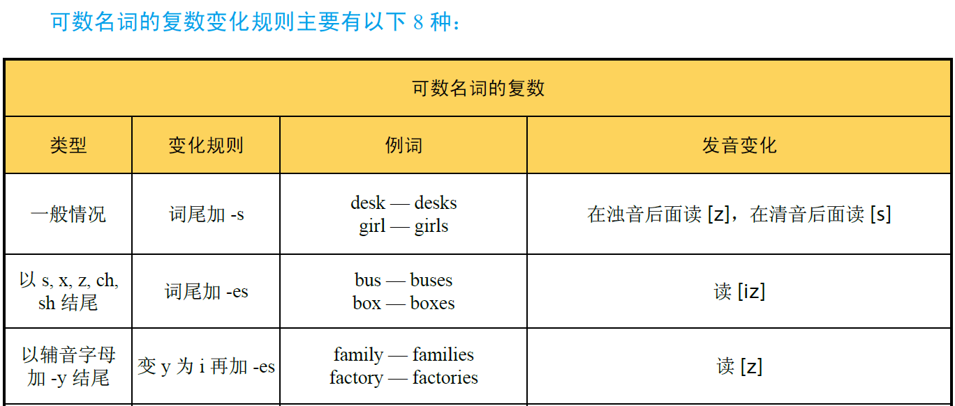

Slide 72
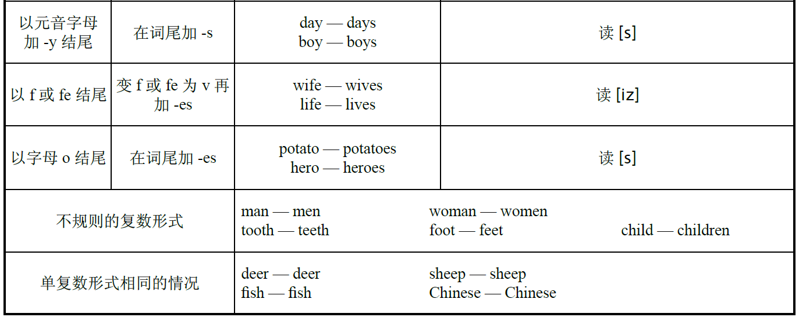

Slide 73

Give the singular or plural form of the following nouns.（写出下列名词的单数或复数形式。）
1 students ___________ 2 shelf ___________ 3 woman __________
4 teeth ___________ 5 story ___________ 6 watch __________
7 babies ___________ 8 families ___________ 9 farmers __________
student
shelves
women
tooth
stories
watches
baby
family
farmer

Slide 74
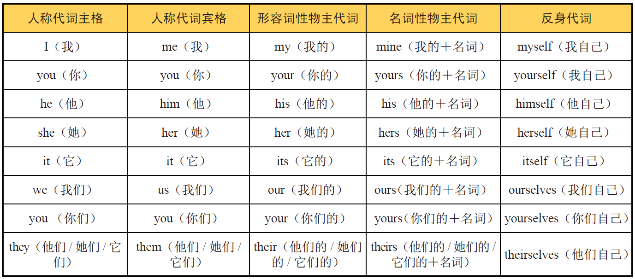
二、代词
代词是代替名词及起名词作用的短语或句子的词。根据其意思和用法，代词可分为人称代词、物主代词、反身代词、指示代词、相互代词、疑问代词、连接代词、关系代词、不定代词九类。其中，人称代词、物主代词、反身代词的形式变化表如下：

Slide 75


1
Match the nominative pronouns with the accusative pronouns.（将人称代词的主格与
宾格连线。）

Slide 76
2
Choose the correct pronouns to complete the sentences.（从括号内选择适当的代词
填空。）
1 Mike is my classmate. I sit next to _______ (he, him, his, himself).
2 Lucy has lost ____ (she, her, hers, herself) pen.
3 Help __________ (you, your, yourself, yours) to some fruit, Mary.
4 (We, Us, Our, Ours, Ourselves) _________ English teacher is Mrs. Green.
him
her
yourself
Our

Slide 77
Lead-in
Listening ＆
Speaking
Reading
Grammar
Watching & Performing
Applied Writing

Slide 78

1
Now watch the movie clip. Read the words closely after the speaker so as to improve
your short-term memory, pronunciation, stress and intonation by imitating what you hear.
Setting: Bartleby tries to persuade his friends to apply for running the South Harmon Institute of Technology.

Slide 79
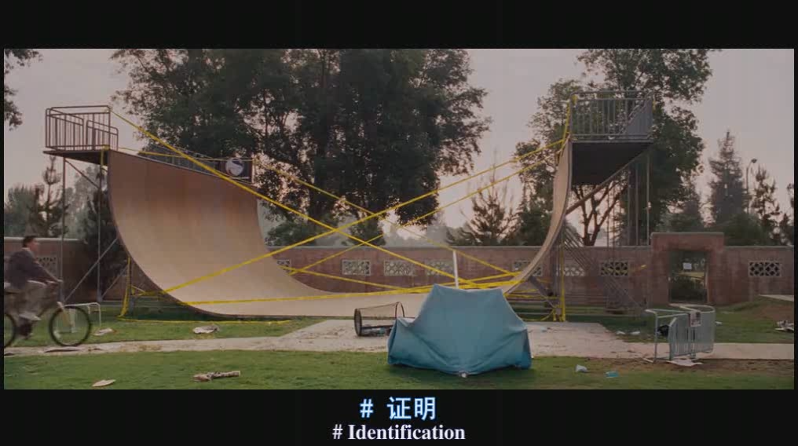

Slide 80
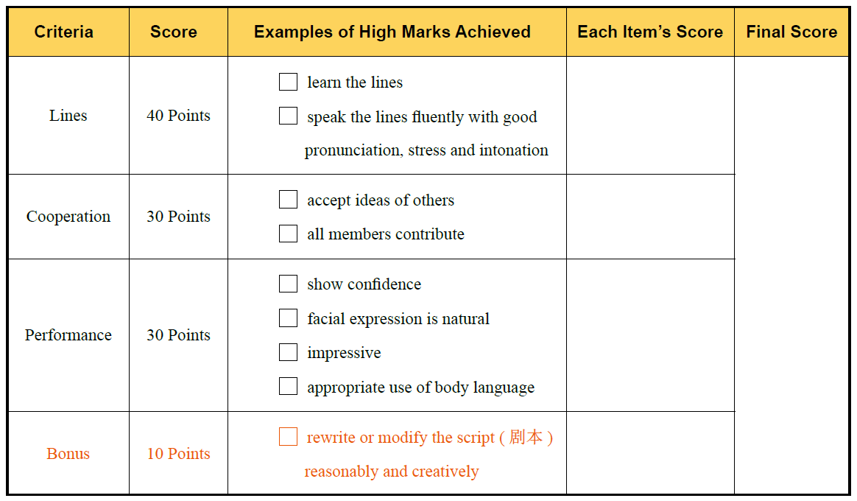
2
Work in pairs. Role-play the characters in the movie clip with your partner on the
platform. The teacher and students in other teams can give a score for the performance.
The following score sheet is for your reference.

Slide 81

3
Read the lines from the movie Smurfs: The Lost Village 《蓝精灵：寻找神秘村》 and
try to recite them.
1 There is a place.
A place that knows no sadness.
Where even feeling blue is a happy thing.
有一个地方。
一个不知道悲伤的地方。
在那里沮丧也是一种快乐。
2 All of that is about to change.
一切即将发生变化。

Slide 82
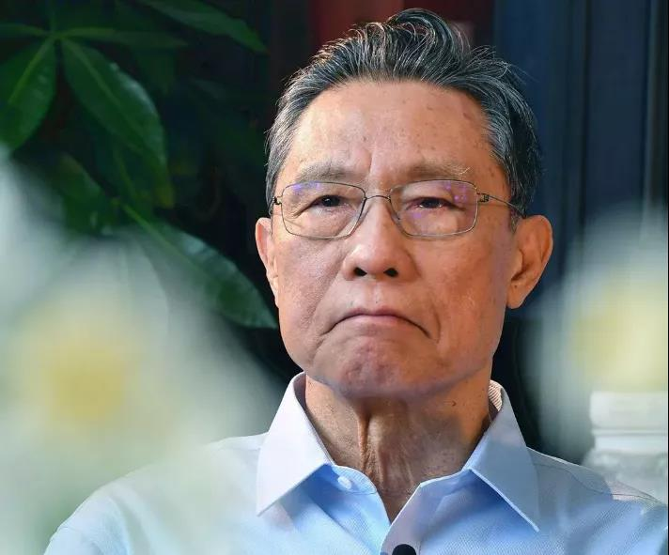
思政视频：钟南山如何开启医学之路
钟南山，我国呼吸疾病研究领域的领军人物，敢医敢言，勇于担当，提出的防控策略和防治措施挽救了无数生命，在非典型肺炎和新冠肺炎疫情防控中作出巨大贡献。这位“共和国勋章”的获得者是如何炼成的？看本视频钟南山院士亲自讲述在英国留学的那段铭心刻骨的经历，我们便能了解一二。
中国的希望在青年，我们应为民族复兴的中国梦而奋斗。

